Slide 1
IBM Cloud Infrastructure Center
—
Ji Chen
Architect, STSM jichenjc@cn.ibm.com
Wu Jia
Product Manager wujia@cn.ibm.com
IBM Cloud Infrastructure Center
Notes:
Last update: Oct 07, 2022
Pre-announcement: IBM Cloud Infrastructure Center 1.1.6 -- ANN: Aug 23, 2022, GA: planned for 4Q2022
Seller presentation for IBM Cloud Infrastructure Center. → FYI, there is NO short name or abbreviation for Cloud Infrastructure Center.
More key contacts:
Jia Wu, Product Manager, IBM Cloud Infrastructure Center, wujia@cn.ibm.com
Stev Glodowski, Product Management Lead RH OpenShift & IBM Cloud Infrastructure Center, stev.glodowski@de.ibm.com
Ji Chen, Cloud Infrastructure Center Architect, jichenjc@cn.ibm.com
Wu Jia, Cloud Infrastructure Center Development Manager, wujia@cn.ibm.com
Ingo Adling, CTO, ADLUNG@de.ibm.com
‘Jerry‘ (Gerald) Hosch, Sales enablement, hosch@de.ibm.com

Slide 2

Agenda
This is the approved icon for
IBM Cloud Infrastructure Center
Introduction
Product capabilities
Demo
Use cases
What’s New
More Info
Notes:
<Details are self-explanatory on the slide>
2

Slide 3
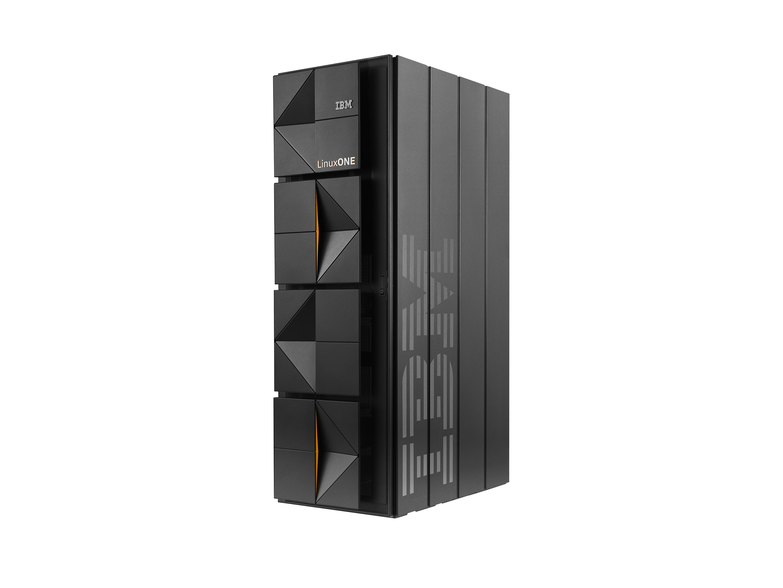
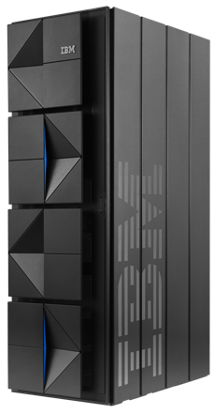
IBM® zSystems®, LinuxONE, and cloud experience
Shift from “maintenance mode” to “innovation mode” by modernizing your IBM zSystems / LinuxONE applications for digital services
Optimize your consumption of IBM zSystems / LinuxONE data, applications and infrastructure through a choice of deployment options
IBM zSystems and cloud
Advances in hybrid cloud make modernizing an IBM zSystems / LinuxONE environment less risky, less costly and faster than ever before and creates greater value for the business
Create new efficiency, reduce costs and boost productivity with a structured approach to applying AI and automation to operations
Notes:
IBM z16 and LinuxONE Emperor 4 helps accelerate modernization and integrate into a hybrid cloud environment with capabilities that
Enable all developers to develop applications using familiar tools and existing skill sets
Get to market faster for new and modernized services and integrate applications and data across the hybrid cloud
Gain efficiencies and tie cost to value by optimizing deployment on best fit resources across the hybrid cloud
Provide energy efficiency, helping to reduce energy costs and carbon footprint by consolidating servers and modernizing databases.
As businesses continue their journey to cloud, the overwhelming trend is a shift to a hybrid model utilizing on-prem and off-prem infrastructure. IBM zSystems has been investing heavily in open-source and cloud software and solutions and is now positioned to be an integral part of this hybrid infrastructure. A key priority for businesses as they adopt this hybrid model, is connecting, accessing, and integrating existing applications and data with new digital services.
To do this they must review their application real estate and decide what action to take, which will include modernization of many existing workloads, including those on IBM zSystems. With new software, tools, and methodologies now available on the IBM zSystems platform, clients can modernize their IBM zSystems workloads on IBM zSystems, with an approach that is less costly, less risky, and faster than migration to other platforms. Shifting resources from maintenance of IBM zSystems workloads to modernization can help accelerate your journey to hybrid cloud while also creating new value for the business. And we are giving your more choice in how you consume IBM zSystems resources with a broader choice of deployment options
Another part of this shift to being an integral part of our client’s cloud strategy has been simplifying and streamlining operations on zSystems. One key aspect of this is leveraging AI in operational processes. This has many potential benefits such as increased resiliency through pro-actively identifying future failures, but also helps reduce operational costs by boosting productivity and allowing resources to be shifted to more value creation activities.
3

Slide 4







IBM’s hybrid cloud and AI platform approach
IBM zSystems and cloud
IBM Consulting
Business Transformation • Technology Consulting • Application Operations
System Integrator Partners
IBM Software
Software and SaaS Partners
Automation • Data & AI • Security • Transaction Processing
IBM Cloud Paks®
Red Hat® Hybrid Cloud Platform
Development, Security and Operational Services
OpenShift® • Red Hat Enterprise Linux • Ansible® Automation Platform
IBM Infrastructure
Public Clouds
Enterprise
Infrastructure
Edge
IBM zSystems / IBM LinuxONE • Distributed Infrastructure (IBM Cloud®, Power®, Storage) • Infrastructure Support
AWS • Azure • Others
4
Notes:
IBM’s solution is based on hybrid cloud and an AI platform approach.
Hybrid cloud is a better architecture for business innovation, because it takes a platform approach to provide a single integrated fabric across all those silos. You can have a common cloud experience that enables common, agile practices and supports interoperability and integration of workloads. So that single client experience that depends on core processing on zSystems, and a web tier in the cloud can be developed and automated using common tools, regardless of where the capabilities reside.
Looking on this slide from the IBM zSystems perspective, we should mention that we have more capabilities available.
z/OS, Linux on IBM Z, IBM zSystems and LinuxONE are all an integral part of the stack.
From the infrastructure at the bottom, all the way through each of the layers
To name a few:
We have IBM Cloud Infrastructure Center available, our infrastructure-as-a-service solution to manage the virtual infrastructure used by the OpenShift platform.
The rich z/OS software, which is providing the integration, devOps, AIOps capabilities, think about the recently announced ‘IBM Z and Cloud Modernization Stack’.
All these products ties into the hybrid cloud stack, are integral pieces of it, and support the integration with OpenShift as the base for IBM’s hybrid strategy.
4

Slide 5
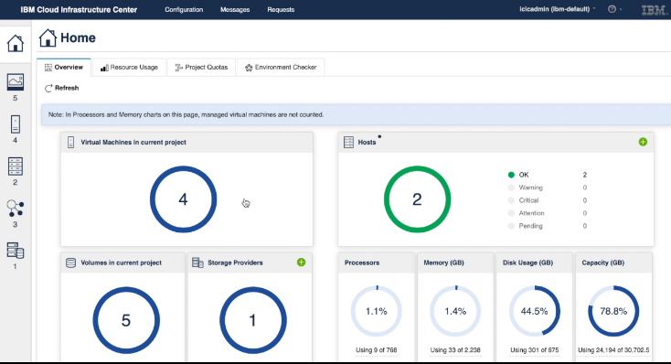
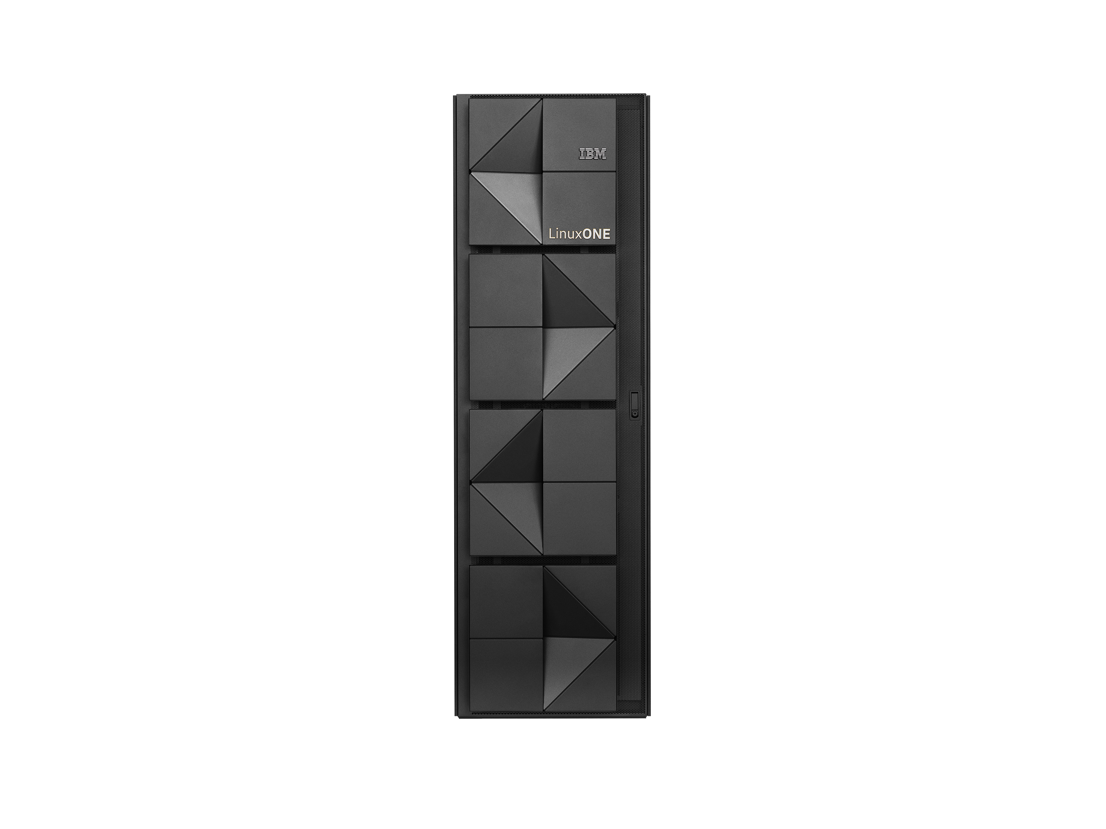
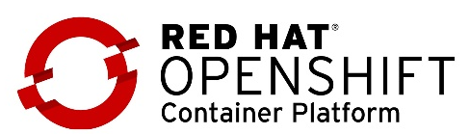
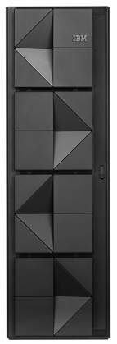
Infrastructure-as-a-Service for IBM zSystems and LinuxONE
Target segments
Foundation for scalable Infrastructure-as-a-Service (IaaS) management of traditional and cloud workloads across the enterprise and hybrid cloud
IaaS layer for Red Hat OpenShift deployments (hybrid cloud stack)
Guest provisioning for noncontainerized workloads
Notes:
Cloud Infrastructure Center is a ready-to-use Infrastructure-as-a-Service management solution, including on-premises cloud deployments of IBM z/VM and Red Hat KVM-based Linux virtual machines on IBM zSystems and IBM LinuxONE.
It simplifies the infrastructure management, and integration with cloud management tools which is based on industry-standard OpenStack APIs.
Clients are using IBM Cloud Infrastructure Center in two areas:
First, Cloud Infrastructure Center is used to deploy Red Hat OpenShift Container Platform clusters on IBM zSystems/LinuxONE.
Second, clients use Cloud Infrastructure Center to deploy noncontainerized Linux images plus applications on IBMZ/LinuxONE.
5

Slide 6

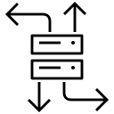

Capabilities
Capabilities
Modernize for hybrid cloud –
empower how you manage, automate, and integrate infrastructure as a service
Infrastructure management
Instantiate, define, capture, and manage the full lifecycle of the virtual machines based on IBM z/VM® and Red Hat KVM on IBM zSystems and LinuxONE.
Service automation
Automate infrastructure management services for users via the Cloud Infrastructure Center self-service portal, while leveraging IBM zSystems / LinuxONE investments.
Cloud integration
Integrate the IBM zSystems / LinuxONE infrastructure across the enterprise and hybrid cloud by connecting the layers of cloud computing via OpenStack compatible APIs.
Notes:
Looking at the use capabilities of IBM Cloud Infrastructure Center, we have three key capabilities to mention:
Manage the lifecycle of IBM z/VM and Red Hat KVM-based virtual machines, including on-premises image deployment of Linux distributions plus applications, incl. Red Hat OpenShift Container Platform, on IBM zSystems/IBM LinuxONE
Automate services for users via the Self-service Portal
Integrate with enterprise cloud management tools via OpenStack-compatible APIs to provision/orchestrate cloud workloads (e.g., IBM Cloud Paks, Red Hat tools like Ansible, Terraform, or VMware vRealize)
With that, Cloud Infrastructure Center provides a foundation for a scalable infrastructure cloud management solution across the enterprise.
6

Slide 7
Infrastructure management
Capabilities
Instantiate, define, capture, and manage
the lifecycle of virtual machines
LPARs
z/VM or Red Hat KVM
Linux
+
Solutions
Red Hat
OpenShift cluster
Red Hat Enterprise Linux CoreOS
IBM Cloud Infrastructure Center
Virtual Machines
Physical resources
(CPU, storage, memory, etc)
Notes:
First, we focus on the lifecycle management of the virtual infrastructure.
We see in the picture an IBM zSystems environment, with LPARs running Linux plus solutions (data bases and applications) and Red Hat OpenShift Container Platform, both based on z/VM or Red Hat KVM.
Cloud Infrastructure Center can help to manage the lifecycle management of the virtual machines - instantiate, define, capture, delete, etc.
Cloud Infrastructure Center can deploy Red Hat, SUSE, and Ubuntu Linux operating system images
Cloud Infrastructure Center can also deploy Red Hat OpenShift cluster which bundled with Red Hat Enterprise Linux CoreOS.
7

Slide 8
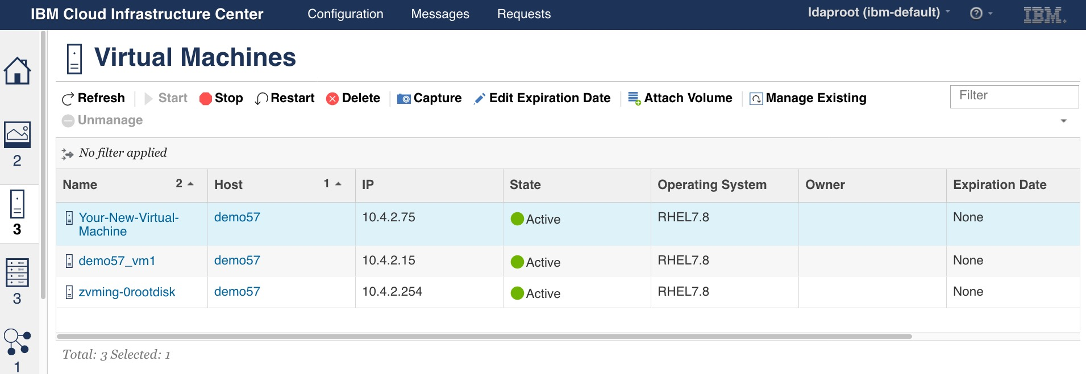

Infrastructure management
Provision & manage lifecycle
Capabilities: Tech example
Start, stop, delete, and restart of virtual machines
Quickly deploy new virtual machine by launching a stored image or utilizing a template
Maintain image library
  Create and capture images and store them in the library for usage
VM Life Cycle
Shutdown
Deploy
Template
Stop
Start
Create
Deploy
Create
Deploy
Delete
Image
Active
Deleted
Image file
Capture
10
Notes:
Cloud Infrastructure Center manages the virtual machines throughout the full lifecycle.
From left to right:
The user selects a deploy-able image, specifies the deployment parameters like target compute node, compute template, network, and the virtual machine with the image is deployed.
The virtual machine can be stopped, restarted (cold and warm), or deleted, and can be also captured (doing a ‘snapshot’).
Capturing an image is an important feature regarding efficiency. If the client wants to install a data base on top of a Linux operating system, normally he has to do that step-by-step. Capturing a ‘golden image’ that includes the Linux operating system and the application/data base, enables to reuse this image for future purposes. This image can be used to create a ‘deploy template’, used to deploy similar virtual machines.
The deployment of a template simplifies the deployment process for the end user. A ‘deploy template’ includes the information about which image to use, how much compute, storage, and network capacity is assigned to the virtual machine, and which storage and network specific parameters will be utilized.
Admins can create many ‘deploy templates’ with different attributes and make them consumable via the ‘service catalog’.
8

Slide 9
Infrastructure management
Automate
Capabilities: Tech example
User-provisioned infrastructure (UPI) via IBM Cloud Infrastructure Center
Cloud Infrastructure Center supports provisioning of Red Hat OpenShift Container Platform clusters as part of Red Hat Enterprise Linux CoreOS
Blog: Installing Red Hat OpenShift Container Platform (UPI) via IBM Cloud Infrastructure Center
Blog: Using the Ansible playbook to operate IBM Cloud Infrastructure Center
IBM Cloud Infrastructure Center OCP UPI Ansible Playbooks - download:
https://github.com/IBM/z_ansible_collections_samples/tree/master/z_infra_provisioning/cloud_infra_center/ocp_upi
Red Hat CoreOS
disk image from http://mirror.openshift.com
Bastion
DNS Server
Load Balance
Boot from
Root disk
Machine
Config
Server
Boot from
Root disk
Boot from
Root disk
Boot from
Root disk
Boot from
Root disk
Boot from
Root disk
Boot from
Root disk
OpenShift
Control Plane
OpenShift
Compute
OpenShift
Control Plane
OpenShift
Compute
OpenShift
Control Plane
OpenShift
Compute
Bootstrap
Image Service
Network Service
Compute
Service
Compute
Service
Compute
Service
Block Storage Service
IBM Cloud Infrastructure Center
z/VM #1
z/VM #2
z/VM #3
Overview:
Red Hat OpenShift z/VM UPI via IBM Cloud Infrastructure Center
10
Notes:
Here an example showing how the infrastructure management can be automated using Cloud Infrastructure Center.
With Ansible playbooks, Cloud Infrastructure Center can be used to provision Red Hat Enterprise Linux CoreOS (Red Hat OpenShift Container Platform) into the user-provisioned infrastructure.
See blog: ibm.com/support/pages/node/6403213
Ansible playbooks to operate IBM Cloud Infrastructure Center:
Blog: Using the Ansible playbook to operate IBM Cloud Infrastructure Center
IBM Cloud Infrastructure Center OCP UPI Ansible Playbooks - download:
https://github.com/IBM/z_ansible_collections_samples/tree/master/z_infra_provisioning/cloud_infra_center/ocp_upi
9

Slide 10


Service automation
Capabilities
Service automation, built on industry-standard APIs, provides high level of investment protection as the cloud and traditional infrastructure is abstracted by the IaaS layer.
IBM Cloud Infrastructure Center
End users
Self-Service Portal
Lifecycle mgmt. of virtual machines
Template and Image deployment
...
Consumes services offered in the catalog
Service Catalog
App developer
Administrator
Inserts updated and new services
OpenShift admin
End users can consume required services from the service catalogue in the self-service portal, without worrying about infrastructure details or acquire deep technical skills.
Notes:
Next key capability is the automation of services.
Once the ‘services’ are defined as a “deploy template”, they can be made available via the “self-service portal’, as a selectable service in the ‘service catalog’. With that, every user can use them without any knowledge about the underlaying infrastructure.
Looking At the picture, you see in the middle the ‘Service catalog’, provided via the ‘self-service portal’ that is part of Cloud Infrastructure Center.
On the left side are the end users, which could be multiple types of personas.
One is the application developer who wants to consume a virtual machine for development or testing of an application. The app developer might not know anything about IBM zSystems / LinuxONE, and she does not need to know about zSystems in order to provision the required infrastructure to her job. The ‘Self-service Portal of Cloud Infrastructure Center’ abstracts from the need to have IBM zSystems platform specific skills.
Another type of end user could be an OpenShift admin, the person that needs another OpenShift cluster to be deployed, or scaling capabilities for OpenShift (vertically and horizontally).
On the right side is the (infrastructure) admin on IBM zSystems/LinuxONE. He is inserting the updates of the services into the ‘service catalog’, making them consumable for the end users.
Service automation, built on industry-standard APIs, provides high level of investment protection as the infrastructure is abstracted by the IaaS layer.
Cloud Infrastructure Center allows to leverage existing playbooks and providers for OpenStack connecting to Cloud Infrastructure Center. Additional exploiters include the IBM Cloud Paks, Red Hat tools, VMware vRealize Automation, and other cloud management offerings.
The self-service portal, coming with Cloud Infrastructure Center, provides a convenient user experience.
FYI, everything on the slide in blue belongs to Cloud Infrastructure Center and comes with it, the other parts belong to other products.
10

Slide 11
Cloud integration with cloud management tools
Capabilities
Connecting the layers of cloud computing enables to integrate IBM zSystems / LinuxONE infrastructure across the enterprise
Instantiate, define, capture, and manage the lifecycle of VMs
End users
(multiple personas, such as service consumer, developer, admin, …)
Platform-as-a-service (PaaS) layer
Cloud management tooling
VMware
vRealize
Red Hat
OpenShift
Red Hat
CloudForms®
Red Hat
Ansible®
Terraform
IBM Cloud Paks
Other 3rd party tools
Infrastructure-as-a-service (IaaS) layer
IBM Cloud Infrastructure Center
Self-Service portal
Infrastructure
resource layer
Compute
Storage
Network
Notes:
Last key capability, cloud integration with cloud management tools.
This slide shows the multiple layers involved in cloud computing.
The Cloud Infrastructure Center provides the Infrastructure-as-a-service layer.
Beneath that, we see the infrastructure resource layer across compute, storage, and network, which Cloud Infrastructure Center can manage, provision, etc., and make them ready to be consumed by the northbound Platform-as-a-service (PaaS) layer, including the cloud management tooling around Cloud Paks, Red Hat tools, VMware, and so on.
From an end user perspective, the end user can operate using the Cloud Infrastructure Center self-service portal, with its graphical user interface to manage the underlaying infrastructure – shown via the arrow going from the end use to the self-service portal.
But the end user can also be a user who is operating with any of the PaaS layer and cloud management tools, shown via the arrow from the end user to the PaaS layer with the cloud management tools. These tools are able to communicate with Cloud Infrastructure Center based on the OpenStack APIs. I will share an example on the next slide.
All functionality Cloud Infrastructure Center provides via the self-service portal, is provided also supported via a command line interface (CLI) for scripting - and all are leveraging the industry-standard OpenStack capable RESTful APIs. Any of the PaaS layer applications understand REST and can ‘talk’ via the RESTful APIs with Cloud Infrastructure Center to make the underlaying infrastructure ready and consumable.
11

Slide 12


Cloud integration
Enterprise cloud management
Capabilities
Via OpenStack compatible APIs, Cloud Infrastructure Center allows for easy integration with cloud management tools to provide an out-of-the-box experience to end users.
Enterprise cloud
management
Service Portal
Red Hat tooling
VMware
Consumes services via
Service Portal
Terraform
…
Admin
End user
Integrates services with cloud management tools
OpenStack
compatible APIs
IBM Cloud Infrastructure Center
Services
running in virtual machines on
IBM zSystems and LinuxONE
Notes:
As mentioned, here an example of integrating IBM zSystems into the client enterprise cloud management solution.
Let’s start with the lower box in the picture. The client is running services, based on virtual machines, on the IBM zSystems/LinuxONE platform, and the VMs are managed by Cloud Infrastructure Center.
The client can create a service portal or use its existing service portal – you see the red box in the upper part of the picture -, to provide infrastructure services to the end users (consumers of services).
The box oval in the middle of the picture shows, that the service portal can be connected to Cloud Infrastructure Center via the industry-standard RESTful OpenStack compatible APIs. This can take place via Red Hat tools, VMware tooling, or Terraform provider, or other products ‘speaking’ OpenStack.
Cloud Infrastructure Center works as the OpenStack ‘adapter/plug’ to the cloud management tools to make the connection of a service portal to the IBM zSystems/LinuxONE platform in the back.
With that, a single glass of pane is created to manage x86, ARM, Power, and IBM zSystems/LinuxONE infrastructure (this can be done for example via an integration with VMware Realize running on x86).
The end user has the possibility to request infrastructure, and to receive virtual infrastructure through the service portal. If she is an application developer, she can use the virtual infrastructure to develop or test an application.
The admin owning the environment and the setup, is responsible to keep everything running. It might be that he must approve the request from the end user, but beside the approval, there is no manual intervention (admin activity) required. The provisioning and the starting of the new virtual machines happen automatically.
FYI, everything on the slide in dark blue belongs to Cloud Infrastructure Center and comes with it, the other parts belong to other products.
12

Slide 13
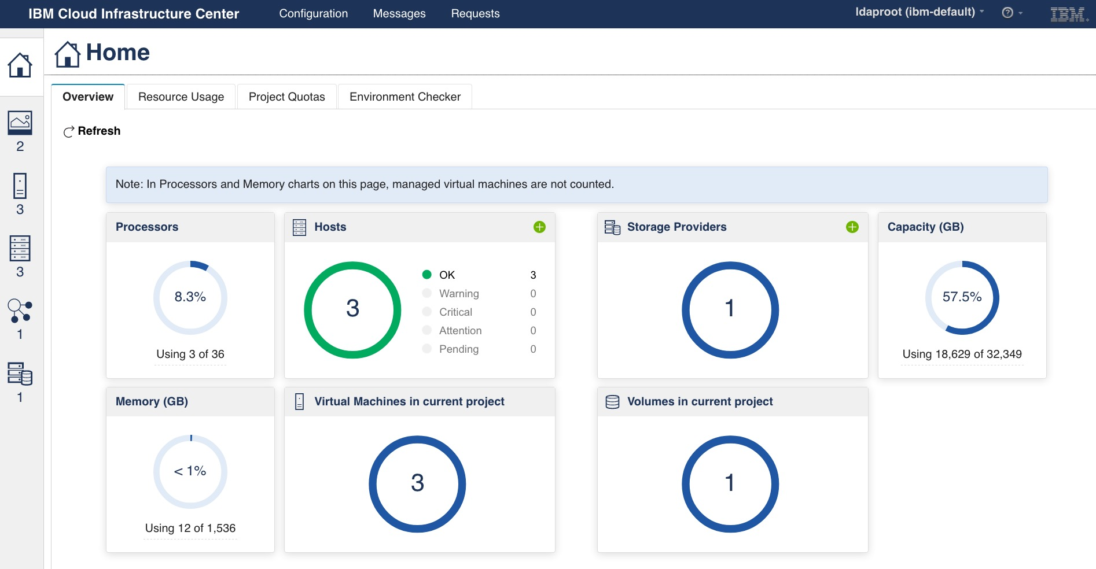
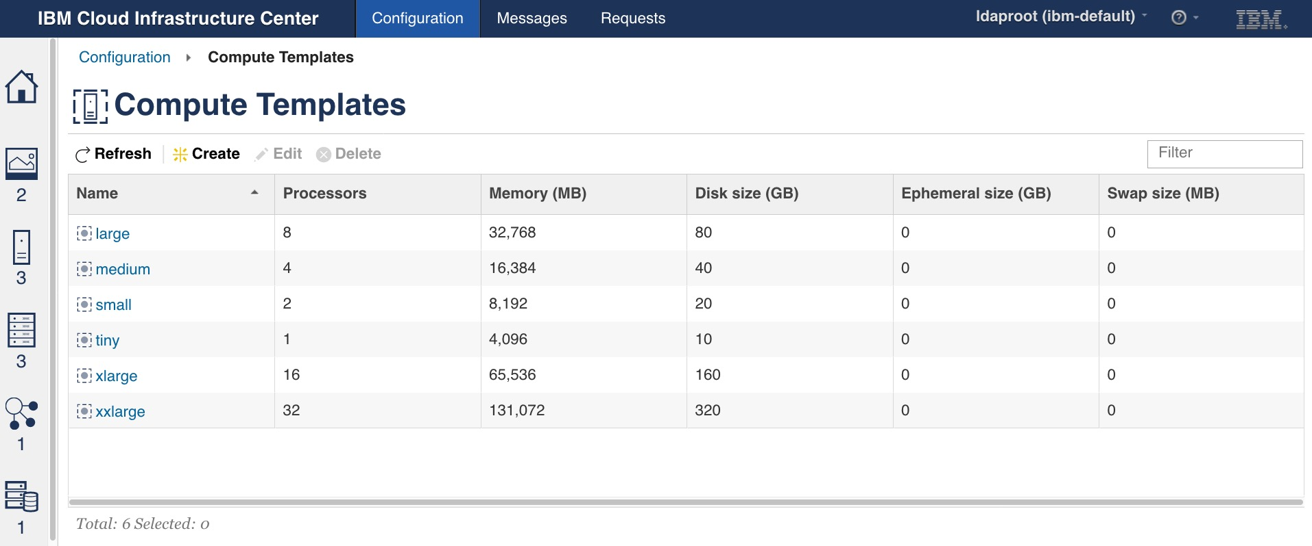
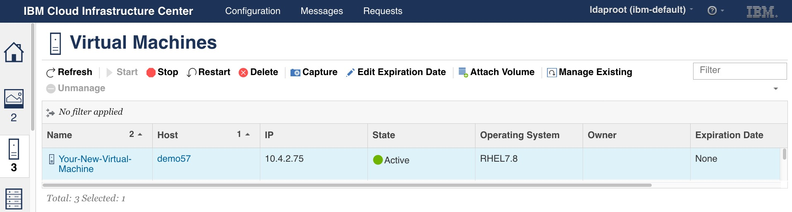
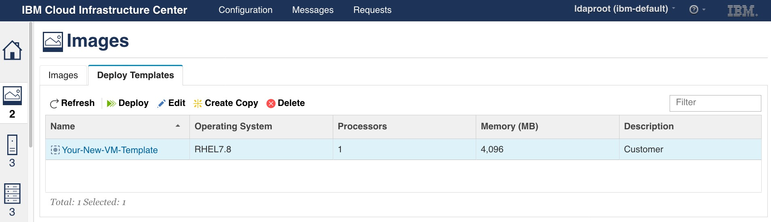
User experience with Cloud Infrastructure Center
Self-service portal
Simplified user experience for developers and private cloud consumer requiring self-service virtual machine provisioning and management
Capabilities + value prop
Capacity overview
Understand how capacity is being used within the project
Virtual Machine lifecycle & image management
Discover and on-board existing virtual machines
Capture and maintain a library of VM images
Quickly deploy a VM by launching a stored image
Migrate and move VMs to available systems expediting deployment
Virtual machine expiration, limits & quotas
Automated VM shut down for expired VMs
Ensures VMs continue to be validated by owners
Limit capacity allocated to each project
Project admins can approve VM extensions and user requests
6
Notes:
The Self-service Portal provides a simplified user experience for developers or other cloud consumer requiring self-service virtual machine provisioning and management.
The slide shows a few picture that shows how Cloud Infrastructure Center looks like, for some this might look familiar. This is because Cloud Infrastructure Center is leveraging what Power Virtualization Center (PowerVC) is providing. So, clients who know PowerVC, will be able to use Cloud Infrastructure Center very fast and efficiently.
The self-service portal comes with all the capabilities you expect.
It provides an overview of the capacity Cloud Infrastructure Center can provide,
you can manage your virtual machines, your infrastructure across the lifecycle that includes the compute, storage, and network capabilities,
you can create policies and templates,
you have multi-tenancy build-in, so you can split the resources that Cloud Infrastructure Center manages into smaller portions, or tenants, or projects, -whatever is required-, and individual project administers can manage the resources assigned to such projects.
13

Slide 14



Managing your infrastructure lifecycle is easier than before
Value prop
Fast deployment
Manage your virtual machines from a single point of action
Create and deploy images of Linux operating systems, incl. applications
Instantiate, define, and capture virtual machines with a single mouse click
Integrated tooling
Integrate your IaaS platform on IBM zSystems / LinuxONE with your service platforms of choice
Seamless integration with automation tools such as Red Hat tooling and VMware vRealize
Automated deployment via CloudForms and Terraform
Convenient usage
Contract, create and allocate infrastructure from a self-service portal
Deliver fast service to multiple tenants and different roles (developers, admins, users, etc.)
Built on the devOps-model to support consistency and agility across all platforms
Notes:
Managing your infrastructure lifecycle is easier than ever before with Cloud Infrastructure Center.
Cloud Infrastructure Center is focusing on to provide fast deployment, to integrated with could tools when it comes to hybrid cloud, and to provide a convenient use experience.
The goal is to help clients to easy provision, to manage, and to consume virtual infrastructure.
The capabilities shown here, are all build round the three, primary personas of Cloud Infrastructure Center
FYI, Integrated tooling includes support for Red Hat OpenShift Container Platform.
The detailed capabilities and benefits are self-explanatory.
14

Slide 15
Demo

Slide 16
Use cases
Use cases
Deployment of on-premises database-as-a-service
“Data Gravity”
Select a database and automate deployments in an as-a-service model at scale.
Deployment of Red Hat OpenShift clusters
“User Provisioned Infrastructure”
Support to help simplify and automate Red Hat OpenShift cluster deployments
IaaS management for service providers
“Tenant-safe services”
Service providers can offer tenant-safe IaaS, in a virtual environment
Simplified experience with virtualization
“Simplify”
Industry standard based and vendor-agnostic technology for simplified IaaS management
Notes:
Cloud Infrastructure Center's adoption patterns include four common use cases, although that doesn't exclude others.

Slide 17
Deployment of on-premises database-as-a-service
Use cases
Select a database and deploy it in an as-a-service model with simple IaaS management via Cloud Infrastructure Center.
Production example:
MongoDB-as-a-service is used as a caching database for read-only queries of the backend database.
Business problem
Modernization of apps and data to improve scalability, response time, and security.
Capability to scale up and down a large amount of database instances
x86 infrastructure fails to support the required quality of service
x86 systems lack on scalability, resilience, and security
Solution
Cloud Infrastructure Center
manages the infrastructure, running on-premises z/VM- and Red Hat KVM-based Linux virtual machines,
deploys Linux images with a database
IBM zSystems/LinuxONE and IBM Storage providing high levels of scalability and qualities of service
Benefits
Workloads in the as-a-service environment adheres to the industry regulation and sustainability objectives
Fast database recovery
Agility to support large scale database instances
Superior performance, scalability, reliability and security
Automated deployment of database instances at scale based on pre-defined playbooks delivers a turn-key solution
MongoDB
Linux distribution
IBM Cloud Infrastructure Center
IBM z/VM or RHEL KVM
IBM zSystems / IBM LinuxONE
Notes:
Deployment of on-premises database-as-a-service
Cloud Infrastructure Center can manage virtual infrastructure which includes the deployment of Linux based images which include non-containerized workloads. Using this capability, an administrator can build an image that consists of a Linux distribution and a database, and users can deploy it as a database-as-a-service on IBM zSystems and LinuxONE.
The administrator can build multiple variations of such a database-as-a-service image, using different Linux distributions, different data bases, and different configuration settings. Each variation can be saved as a ‘deployment template’, and the collection of ‘deployment templates’ can be offered as available services in the service portal to users and teams (services to deploy a database).
The thought behind it: create once and deploy quickly and easily.
17

Slide 18
Use cases
Deployment of Red Hat OpenShift clusters
Cloud Infrastructure Center supports the simplification and automation of Red Hat OpenShift Container Platform cluster deployments.
Business problem
Lack of automation for large deployments
Manual deployment of Red Hat OpenShift clusters
Solution
OpenStack compatible API, can be consumed by tools such as Red Hat Ansible, Red Hat CloudForms or Terraform
Ansible scripts can be written to orchestrate the whole Red Hat OpenShift cluster creation steps
Deployment support for Red Hat OpenShift clusters
Benefits
Simplification and automation of Red Hat OpenShift cluster provisioning
Flexible and easier life-cycle management of Red Hat OpenShift
No requirement for DHCP, FTP services for simple cluster creation
Blogs:
Installing Red Hat OpenShift Container Platform (UPI) via IBM Cloud Infrastructure Center
Using the Ansible playbook to operate IBM Cloud Infrastructure Center
Download: Cloud Infrastructure Center OpenShift UPI Ansible Playbooks
https://github.com/IBM/z_ansible_collections_samples/tree/master/z_infra_provisioning/cloud_infra_center/ocp_upi
Notes:
Deployment of Red Hat OpenShift clusters
Cloud Infrastructure Center supports the simplification and automation of Red Hat OpenShift Container Platform cluster deployments, and the management of the virtual machines used for the deployment of the cluster.
A Red Hat OpenShift image can be deployed into a virtual machine that is based on z/VM or Red Hat KVM like any other image.
Cloud Infrastructure Center can facilitate an automated Red Hat OpenShift cluster deployment in a user provisioned infrastructure model via Red Hat Ansible or Terraform.
An Ansible Playbook example is available for download, and a technical blog describes details.
18

Slide 19
Use cases
IaaS management for service providers
Service providers can accelerate the deployment of Linux images in a virtual environment, integrate the environment across the enterprise, and thereby reduce cost and complexity.
Business problem
Traditional IT ops-model is complex to manage infrastructure across multiple platforms
Individual management for infrastructure pillars
Existing management requires manual admin activities
Solution
Manage the infrastructure as-a-service for
  containerized, and
  non-containerized / traditional workloads
Lifecycle management: define, instantiate, and manage the z/VM and Red Hat KVM-based virtual infrastructure
Deployment of Linux images including workloads
Benefits
Act as a service bureau for infrastructure-as- a-service (IaaS) services to a multiplicity of tenants
Consistent, industry-standard user experience
Quickly deploy a virtual machines from an image library
Built-in OpenStack compatible APIs enable easy integration
Tenant-safe service management via a self-service portal
Examples:
Read the full IBM CIO Office story
IBM LinuxONE Community Cloud
Notes:
Infrastructure as a service management for service providers
Service providers require tools that can take advantage of the virtualized infrastructure to offer their services in a secure, deterministic, and repeatable way.
Cloud Infrastructure Center can serve as the management system for the virtualized infrastructure supporting different types of cloud computing service models. With the built-in OpenStack-compatible APIs, Cloud Infrastructure Center can satisfy a wide range of infrastructure management demands and can integrate various components to automate infrastructure services and thereby reduce cost and complexity, while delivering on the need for predictability and repeatability in a secure, multi-tenant-safe way.
Important when serving multiple customers is accurately charging the allocated resources to each customer. Cloud Infrastructure Center, integrated with the IBM Cloud Pak for WatsonAIOps, enables metering of the resources consumed by the virtual machines that are managed by Cloud Infrastructure Center.
19

Slide 20
IBM CIO Office – integrating IBM zSystems into hybrid cloud
Use case: external case study
IBM CIO Office transformed to a cloud operations model and integrated IBM zSystems into a hybrid cloud approach. The standardization enabled the integration across platforms, accelerated the environment setup, and reduced costs and complexity.
Business problem
Using a traditional IT ops-model, it was complex to manage the infrastructure assets across multiple platforms. Individual management pillars existed for the infrastructure components. Existing management required scripting and many admin tasks had to be done manually.
Solution
The new tooling is a cloud ops-model, based on standard OpenStack APIs, which enables the integration of the IBM zSystems environment into CIO Office’s hybrid cloud. With the new user portal, the user experience is strongly improved.
“IBM Cloud Infrastructure Center allows us to substantially improve our infrastructure management and reduce cost & complexity to manage from simple to complex environments.”
Eric Everson Mendes Marins,
PCS_ZVM squad at IBM CIO Office
Read the full story
Notes:
Who is using Cloud Infrastructure Center? There are several clients using it today, the example of the IBM CIO Office, is shown here.
The CIO Office created an enterprise cloud provisioning portal for their application developers.
Formerly, CIO Office had different management pillars for the different platforms used in the enterprise. They used a traditional IT operations model based on platform specific management tools, which required specific platform skills and a lot of manual admin operations.
With the decision to move to a cloud operation model, they started to implement cloud management tooling based on the industry-standard OpenStack APIs, which enabled the integration of IBM zSystems, IBM Power and x86 into one cloud provisioning portal. They established their hybrid cloud, with an easy to use and strongly improved consumer/end user experience.
CIO Office use IBM Cloud Infrastructure Center for the integration of IBM zSystems into the portal, and the lifecycle management of the IBM zSystems-based cloud infrastructure resources.
Bottom-line, as said by Eric Marins: IBM Cloud Infrastructure Center enabled them to improve their infrastructure management, and reduced cost & complexity to manage complex environments.
Read the blog: www.ibm.com/blogs/systems/ibm-cio-office-integrates-ibm-z-into-the-hybrid-cloud
BTW, Cloud Infrastructure Center is also used to manage the IBM LinuxONE Community Cloud, there had been a presentation at the SHARE Virtual Summit March 2021: How the LinuxONE Community Cloud Benefits from IBM Cloud Infrastructure Center (https://www.share.org/Events/Past-Events/Proceedings/Proceeding-Details/how-the-linuxone-community-cloud-benefits-from-ibm-cloud-infrastructure-center)
20

Slide 21
Use cases
Simplified experience with virtualization
As the platform’s infrastructure solution, Cloud Infrastructure Center simplifies client experience with IBM zSystems / LinuxONE.
Business problem
Get started fast with first deployments
New clients lack of skills
Clients want to leverage exist skills and tooling
Solution
Consistent, industry-standard user experience to manage lifecycle of z/VM and Red Hat KVM-based virtual infrastructure
Built-in OpenStack compatible APIs enable usage of common management tools, such as IBM Cloud Paks, Red Hat tools, Terraform, or VMware vRealize Automation
Benefits
Simplify client experience with IBM zSystems and LinuxONE virtualization
Vendor-agnostic IaaS management
Provide ‘Private Cloud’ infrastructure as a service via OpenStack for z/VM, KVM
IaaS automation via Terraform, VMWare vRealize Automation, etc… using the API/CLI layer
Notes:
Simplified experience with virtualization on IBM zSystems and LinuxONE
The capabilities of Cloud Infrastructure Center in ‘infrastructure management’, ‘automated deployment via the self-service portal’, and the ‘integration of IBM zSystems and LinuxONE based infrastructure into enterprise cloud computing’ are all based on the industry standard and vendor-agnostic technology for IaaS management and deliver a major step towards simplifying the management of virtualized infrastructure.
21

Slide 22
Key new functions with Cloud Infrastructure Center 1.1.5
New with 1.1.5
Red Hat related update
Live guest relocation (LGR) enablement
Multiple attach of persistent storage
Secure execution enablement
Upgrade validation tool
Enhancement of health detection and report of virtual machine and storage
Allocation based chargeback integration with IBM Cloud Pak for Watson AIOps
Notes:
IBM Cloud Infrastructure Center 1.1.5 -- ANN: Mar 01, 2022, GA: Mar 11, 2022
US announcement letter: http://www.ibm.com/common/ssi/ShowDoc.wss?docURL=/common/ssi/rep_ca/9/897/ENUS222-119/index.html&lang=en
What’ new with Cloud Infrastructure Center 1.1.5, see IBM Documentation: https://www.ibm.com/docs/en/cic/1.1.5
Live Guest Relocation (LGR) for z/VM virtual machines: Administrators can move virtual machines through the Cloud Infrastructure Center UI/API from one z/VM to another z/VM with the LGR enablement to achieve business continuity. z/VM LGR enables to move workloads to other z/VM systems in the Single System Image (SSI) cluster to keep workloads up and running, e.g., when doing maintenance.
Attaching persistent storage to multiple z/VM virtual machines: A volume (persistent storage) can be attached to multiple z/VM virtual machines. This is beneficial for solutions like a clustered database that need shared block storage across its nodes that run in multiple virtual machines. e.g., Oracle RAC is using shared block storage, so that the data can be shared among the RAC cluster.
Red Hat KVM based on Secure Execution protection: Cloud Infrastructure Center can do lifecycle management: create, delete, start, stop, cold migrate, etc. IBM Secure Execution for Linux is a z/Architecture security technology that protects data of workloads that run in a KVM guest from being inspected or modified by the server environment.
Allocation-based chargeback of metrics captured by Cloud Infrastructure Center using IBM Cloud Pak for Watson AIOps: The integration of Cloud Pak for Watson AIOps with Cloud Infrastructure Center through the OpenStack cloud provider (OpenStack API) enables administrators/users to monitor and consume the resource allocations of the resources, which are managed by Cloud Infrastructure Center, through IBM Cloud Pak for Watson AIOps.
Improved reliability, availability, and serviceability (RAS) with enhanced environment checker rules and health status precise report: An improved virtual machine and storage health status report helps administrators / users to detect abnormal status of a virtual machine and storage faster and provides more detailed information about the status.
An upgrade validation tool to improve upgrade user experience: The upgrade validation tool, providing pre-upgrade & post-upgrade validation, helps the administrator to validate whether there are potential issues before/after the upgrade.
Red Hat Enterprise Linux 8.5 and Red Hat Enterprise Linux CoreOS 4.9 as part of Red Hat OpenShift as guest operating systems: Additional operating systems are supported.
For details about the new functionality see the presentation: Technical Client Presentation (Deck , posted on Seismic).
22

Slide 23
1.1.5 - supported hypervisors, operation systems & servers
New with 1.1.5
As a managed hypervisor:
  IBM z/VM 7.2 or 7.1
  KVM as part of Red Hat Enterprise Linux 8.4
As a host environment on z/VM and Red Hat KVM:
  Red Hat Enterprise Linux 8.2 or 8.4
As guest operating system instance on z/VM:
  Canonical Ubuntu 20.04
  Red Hat Enterprise Linux 7.9, 8.2, 8.4, or 8.5
  Red Hat Enterprise Linux CoreOS 4.6, 4.7, 4.8, or 4.9 as part of Red Hat OpenShift
  SUSE Linux Enterprise Server 15 SP2
As guest operating system instance on Red Hat KVM:
  Red Hat Enterprise Linux 7.9, 8.2, 8.4, or 8.5
  Red Hat Enterprise Linux CoreOS 4.6, 4.7, 4.8, or 4.9 as part of Red Hat OpenShift
Hardware platforms:
IBM z16TM
IBM z15TM (all models)
IBM z14® (all models)
IBM z13®
IBM z13s®
IBM LinuxONE III (all models, incl LinuxONE III Express)
IBM LinuxONE Emperor II
IBM LinuxONE Rockhopper II
IBM LinuxONE Emperor I
IBM LinuxONE Rockhopper I
8
Notes:
Cloud Infrastructure Center 1.1.5: Supported hypervisor, operation system and hardware.
For more information go to “What is new” in the documentation of the version you are interested in at ibm.com/docs/en/cic.
For details about the new functionality see the presentation: Technical Client Presentation (Deck , posted on Seismic).
23

Slide 24
Pre-announced
Key new functions with Cloud Infrastructure Center 1.1.6
Pre-announced with 1.1.6
Consistency group and group snapshots
FCP devices management enhancement on IBM z/VM®
Security group on Red Hat® KVM
Hybrid hypervisor support
Notes:
US announcement letter: https://www.ibm.com/common/ssi/ShowDoc.wss?docURL=/common/ssi/rep_ca/5/897/ENUS222-275/index.html&request_locale=en - see detailed slides in backup.
Detailed slides are part of the client presentation on Seismic: https://ibm.seismic.com/Link/Content/DCFfcCQRfj87c8CWVFjGchpHgd4d
What’s pre-announced for Cloud Infrastructure Center 1.1.6:
Cloud Infrastructure Center 1.1.6 will further enhance the solution capabilities to help meet the demands of hybrid cloud by providing a ready-to-use solution for industry-standard infrastructure management that helps simplify the lifecycle management and improve administrator productivity.
Cloud Infrastructure Center 1.1.6 is being developed to deliver the following capabilities:
Consistency group support on IBM DS8000 series and IBM FlashSystem storage on z/VM and Red Hat KVM, enabling a snapshot for multiple disks at the same time to back up and restore those data disks and virtual machines without any data inconsistency
The ability to manage the FCP devices lifecycle on z/VM allows clients to add and delete FCP devices with fine granularity for more efficient FCP usage
The ability to manage the access control (security group) of a Red Hat KVM-based virtual machine allows clients to manage the firewall of a virtual machine and therefore achieving higher security and access control of the workload
Hybrid hypervisor support allows clients to manage both hypervisors, z/VM and Red Hat KVM, in one instance of Cloud Infrastructure Center to gain improved user experience
24

Slide 25

Learn more
Understand the use cases, read the IBM Whitepaper:
Empower how you deploy, manage, and integrate infrastructure as a service
Resources
  See assets in the Cloud Infrastructure Center sales kit
  Get the technical details from the IBM Documentation
  Get started using the Content solution
  Visit the IBM Cloud Infrastructure Center website
  Request a Platinum TechZone Demo?
  See PoC Accelerator for help to start a PoC, on ‘Product specific resources’ select ‘Cloud Infrastructure Center’
  Address your questions to the PM team!
Read blogs:
How to use multi-attach volumes in Cloud Infrastructure Center 1.1.5
Using the Ansible playbook to operate Cloud Infrastructure Center
  Ansible Playbooks to deploy Red Hat OpenShift UPI with Cloud Infrastructure Center: https://github.com/IBM/z_ansible_collections_samples/tree/master/z_infra_provisioning/cloud_infra_center/ocp_upi
  Installing Red Hat OpenShift Container Platform with User-Provisioned Infrastructure via Cloud Infrastructure Center
How to manage persistent storage of multiple datacenters
z/VM Network topology introduction in Cloud Infrastructure Center
Create a virtual machine in Cloud Infrastructure Center by Terraform
More external blogs & more
Notes:
NOTE: See the support for a PoC in the PoC Accelerator (https://ibm.biz/poc-accelerator), on ‘Product specific resources’ select ‘Cloud Infrastructure Center’
To learn more, IBM offers resources for different personas to learn more about IBM Cloud Infrastructure Center,
IBM Whitepaper: https://www.ibm.com/downloads/cas/PN9AE9YK
Sales kit (Seismic): https://ibm.seismic.com/Link/Content/DC326HG3ghV38GQGJCW9cqH97GCV
Documentation:
IBM Docs: https://www.ibm.com/docs/en/cic
IBM Content Solution: https://www.ibm.com/support/z-content-solutions/cloud-infrastructure-center
Web: https://www.ibm.com/products/cloud-infrastructure-center
Demo:
Platinum demo: https://techzone.ibm.com/collection/ibm-cloud-infrastructure-center-for-private-cloud-iaas-management
Garage demo: https://www.ibm.com/it-infrastructure/services/client-experience-portal/offeringdetail.jsp?offid=2056&sourcenamekey=CATALOG_LOGICAL - The demo must be coordinated with the presenter's availability. Please book it at least 1 week in advance!
Blogs:
https://community.ibm.com/community/user/ibmz-and-linuxone/search?s=%22cloud%20infrastructure%20center%22&cs=Blogs&expanded-categories=undefined
https://www.ibm.com/mysupport/s/topic/0TO0z000000RcV7GAK/cloud-infrastructure-center?language=en_US
BTW, an evaluation license for 30, 60 or 90 days can be offered for a Proof-of-Concept with Cloud Infrastructure Center
Clients can provide product enhancement ideas via the ‚IBM zSystems Software Ideas portal wihtin AHA‘ https://ibm-z-software-portal.ideas.ibm.com/. They must click „Add Idea“ -> select „IBM Cloud Infrastructure Center“ and then get started with filling in the details about their idea, incl. description, priority, requested delivery date etc.
Key contacts
Stev Glodowski, Cloud Infrastructure Center Product Manager, stev.glodowski@de.ibm.com
Wu Jia, Product Management, wujia@cn.ibm.com
Ji Chen, Cloud Infrastructure Center Architect, jichenjc@cn.ibm.com
Ingo Adling, CTO, ADLUNG@de.ibm.com
‚Jerry‘ (Gerald) Hosch, Sales enablement, hosch@de.ibm.com
25

Slide 26
Notes:
<Details are self-explanatory on the slide>
26

