Slide 1

COOL THINGS
Why we Love z/VM a Look at Some Cool Things
PRESENTED TO MVMUA

Slide 2
Cool Things We Are Covering Today
PDR
Mapped
Minidisks
Cluster
Renaming
Single Volume
1PACK
Science
Research
Service Zones
Interfaces and Techniques

Slide 3
Why Single Volume VM System
Practice and test putting on maintenance
Create multiple Low Resource VM SYSTEMS for Virtual Network Testing
Student Sandboxes for Class Lab work
Fully Enriched starter system
1PACK

Slide 4
Why Single Volume VM System
Practice and test putting on maintenance
Create multiple Low Resource VM SYSTEMS for Virtual Network Testing
Student Sandboxes for Class Lab work
Fully Enriched starter system
1PACK
‘cause we can
‘cause it’s fun

Slide 5

Our 1PACK Experiment
z/VM Requires 5 Disks for Basic Non-SSI Install
COMMON VOLUME
RELEASE VOLUME
SYSTEM VOLUME
SPOOL SPACE
PAGE SPACE
Our Goal is to Consolidate these Volumes to a Single Volume that is functional and capable of being used to maintain z/VM, or test application of z/VM maintenance with simple restore options.

Slide 6

What We’ve Done
VOLUME TYPE | DEFAULT LABEL
COMMON | VMCOM1
RELEASE VOLUME | 720REL1
SYSTEM RESIDENT VOLUME | MO1RES
SPOOL SPACE | M01S01
PAGE SPACE | M01P01

Slide 7

Why 1PACK SYSTEM RESIDENCE
Sandbox to Test Maintenance
Can have multiple sandboxes with low Overhead (ours uses 256M memory and Mod 27.
Can actually use 1PACK as maintenance machine and create CPNUCLEUS to load up on Production machines.

Slide 8
How We Did it
High Level View of Process
Item 1
Create 2nd Level User to test your 1PACK
Item 2
Determine Required MDISK SPACE
Item 3
Allocate DRCT, SPOL, PAGE, PARM Space
Item 4
Create MDISK SPACE
Item 5
Copy required MDISKS to 1PACK

Slide 9
How We Did it
Allocate DASD SPACE
PERM
0 to END
DRCT
0001.0200
SPOL
1910.500
PAGE
0511.0175
PARM
FILES
2642.120, 2761.120

Slide 10
Renaming a Cluster and its Members
Business need and naming conventions must be followed.
Linux work consolidated onto one cluster for different agencies.
Requires a maintenance window
Dreaded and Feared Change Control.
Upgraded from 640 to 720 before LPAR name change
Not documented by IBM!
Lotsa steps and brain power required
Practiced on 2nd level system, why not?
Next step will be to separate workloads using the RACF SECLABEL capability
Cluster VZ9DIG with members VZ9PRD01 and VZ9PRD02 to be renames to VZ9PAZ with members VZPAZ01 and VZPAZ02

Slide 11
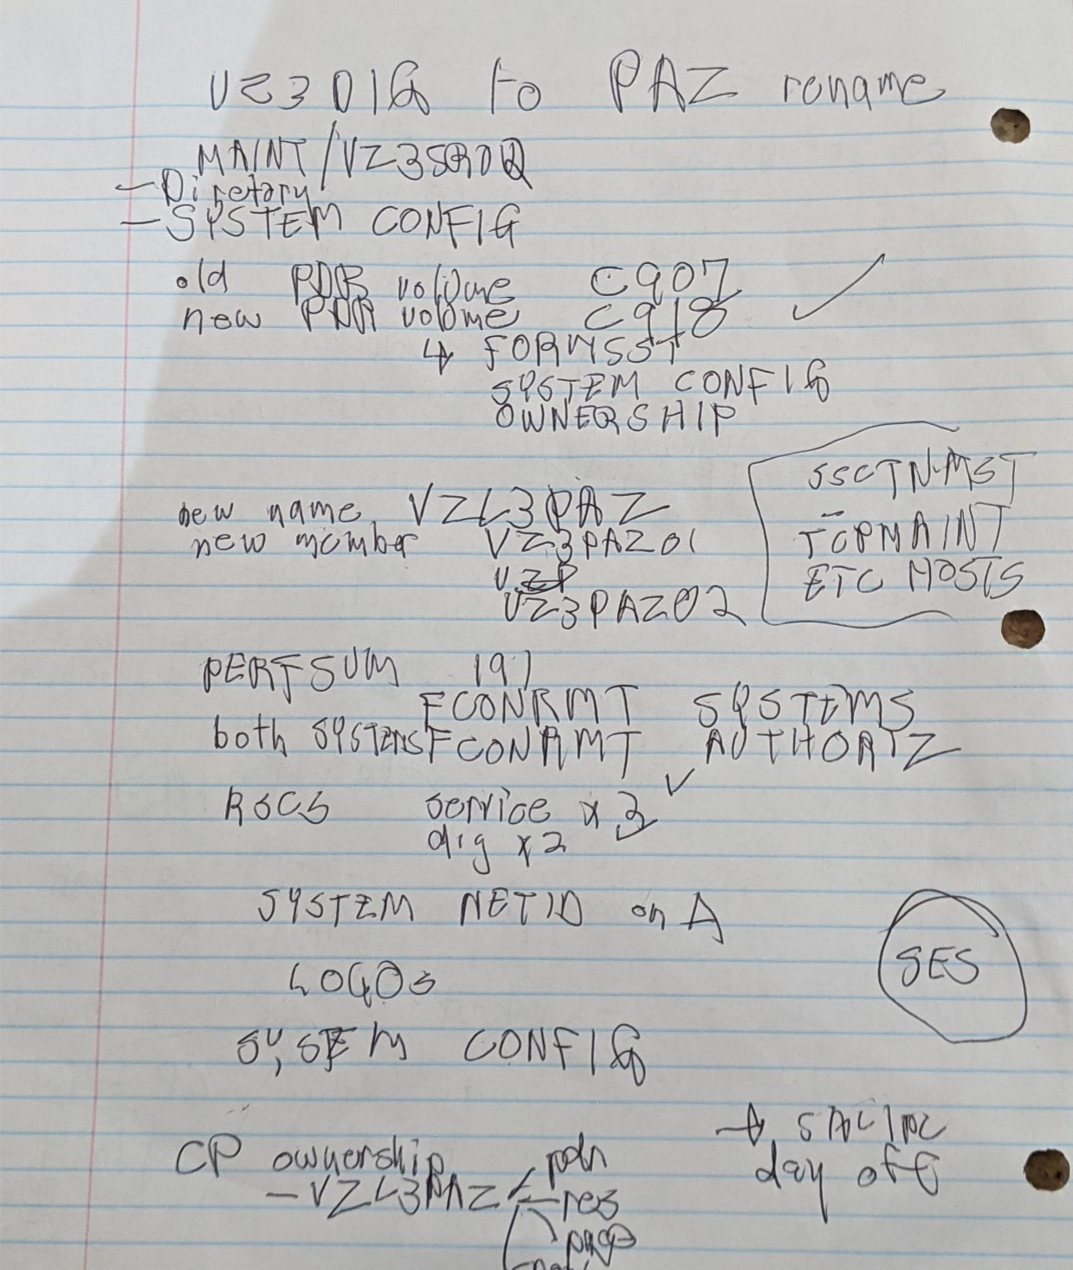
What’s happened to me? No more napkins for scribbling plans? Actual note taking. Took me long enough! 38 years of VM!

Slide 12
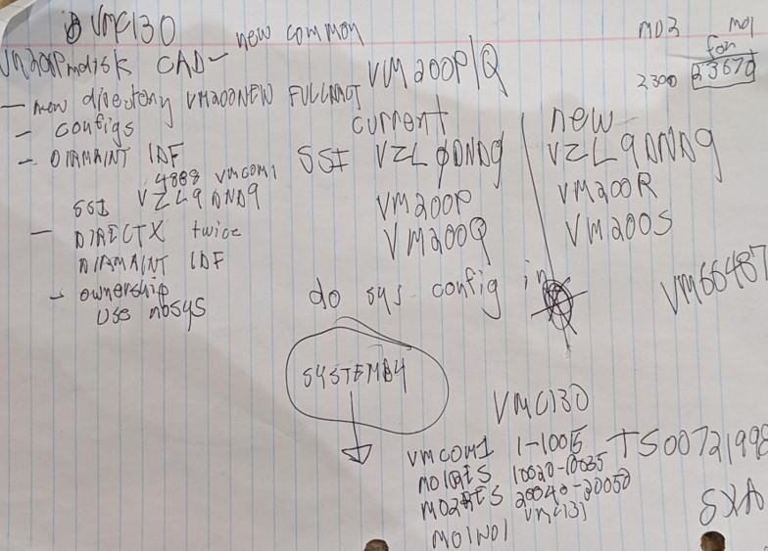
Let’s Do It
.

Slide 13
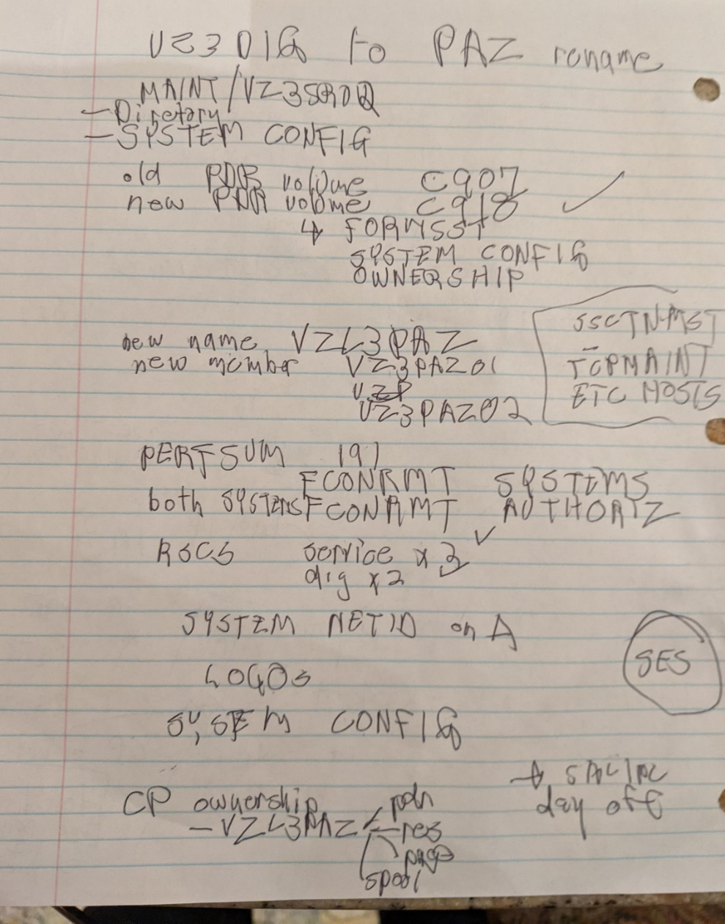
Just use this and you are good to go on an LPAR rename! No need to continue have fun thanks for coming out!

Slide 14
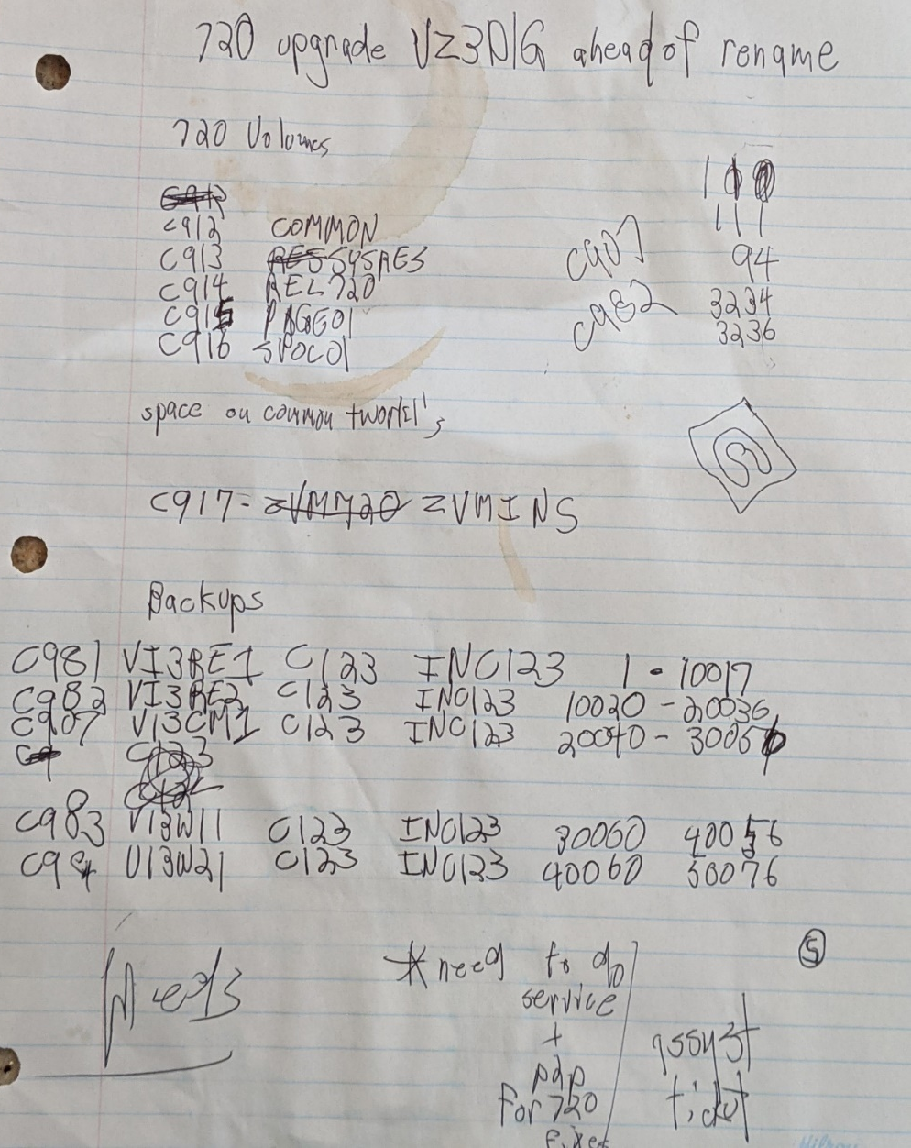
Even doing 3390 storage admin oh that pesky PDR record!
You know serious work being done due to the evidence. Espresso Stain.
ESPRESSO

Slide 15
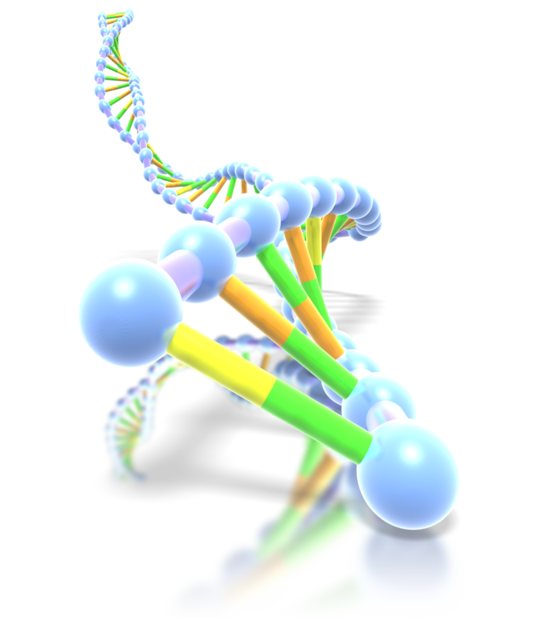
What do we care about?
CP CONFIG
MACHINE
DNA. Think of it as a personality injector.
DIRMAINT
RSCS
SYSTEM NETID
CRR Machine
PERFSVM
RACF

Slide 16
Interfaces & Techniques
The usual suspects:
  XEDIT
  CP & CMS commands
  REXX & PIPEs – indispensable
Techniques:
  Use service zone methods
    Sees all DASD on all z/VM CECS, clusters and members. ONLNE ALL
    Other clusters OFFLINE all and ONLINE only what’s needed
    MAPMDISK
  Backup SYSRES, COMMON, and RELEASE volumes
    Nothing to see hear move on … except it can save a disaster!

Slide 17
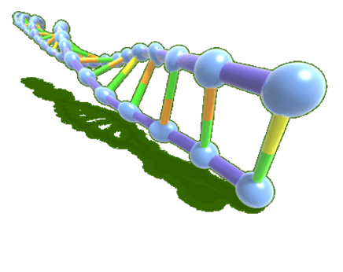
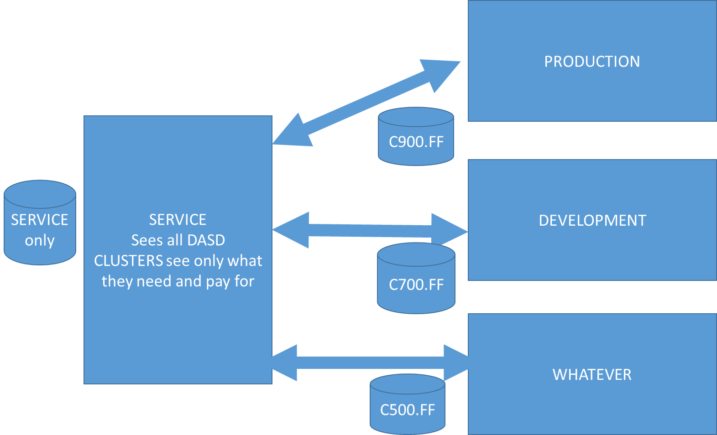
Service Zone connects to all and sees all DASD

Slide 18
MAPPED MINIDISK
Already discussed pre-plague at MVMUA no need to repeat myself
Already discussed pre-plague at MVMUA no need to repeat myself
Already discussed pre-plague at MVMUA no need to repeat myself
Already discussed pre-plague at MVMUA no need to repeat myself
Already discussed pre-plague at MVMUA no need to repeat myself

Slide 19
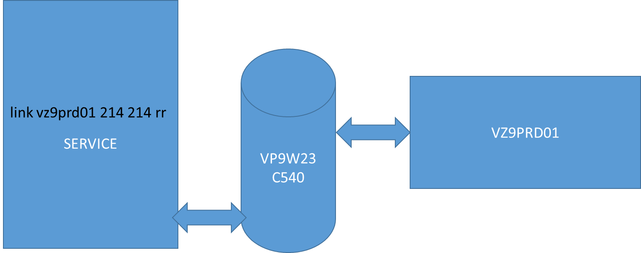
MAPPED MINIDISK: It MAPs!
Just joking!
MAINT’s mdisk statement for DDDD:
MDISK DDDD 3390 32760 30000 VP9W23 MR
VZ9RD01’s mdisk statement in the directory:
VZ9PRD01 MDISK 0214 3390 32760 30000 VP9W23 MR PW MAINT DDDD

Slide 20
The AT command is where it is at
At vz9paz01 cmd q cpservice ptf um35808
APAR PTF
VM66487 UM35808
Ready; T=0.01/0.01 17:39:33
at VZ9paz02 cmd q cpservice ptf um35808
HCPQCP6720I No items found to satisfy selection criteria.
Ready; T=0.01/0.01 17:39:45
This patch fixes an SZA004 and VZPA004 abend.

Slide 21
The AT command is where it is at
It’s actually NJE style. 2021! This is from the service zone
to the newly renamed LPAR.
sm rscs cmd VZ9paz01 cp q t
Ready; T=0.01/0.01 14:03:12
From VZ9PAZ01: DMTCMZ173I CP: TIME IS 14:03:12 UTC SATURDAY 10/16/21
DIRMAINT carries commands over RSCS …
and reader/punch
dirm to vz9paz01 cp q t
RPIMGR031E RESOURCE RSCS SPECIFIED BY SPOOL COMMAND NOT FOUND
RPIMGR031E RESOURCE VZ3PAZ01 SPECIFIED BY TAG COMMAND NOT FOUND
From VZ9PAZ01(DIRMAINT): DVHREQ2288I Your CP request for MAINT at * has been
From VZ9PAZ01(DIRMAINT): DVHREQ2288I accepted.
From VZ9PAZ01(DIRMAINT): DVHCMS3868I TIME IS 03:54:50 UTC SUNDAY 10/17/21

Slide 22
FINDIT and XFINDIT – From a hack programmer
PIPEs & REXX
  Quickly authored, unconcerned with lifespan
  Output reports contain userid, MDISK, file name and file type that contains the search string: VZ9DIG (In the necessary files more on that soon) that will be changed to VZ9PAZ
  Source code available use at your own peril
  DIRMAINT 01DB USER BACKUP
  DIRMAINT 01DF AUTHFOR CONTROL
  MAINT 0CF1 LDEV LOGO
  MAINT 0CF1 LOCAL LOGO
  MAINT 0190 SYSTEM NETID
FINDIT and XFINDIT are hack code that searches all CMS disks (FINDIT searches USER MDISK and XFINDIT searches SUBCONFIG MDISK statements).

Slide 23
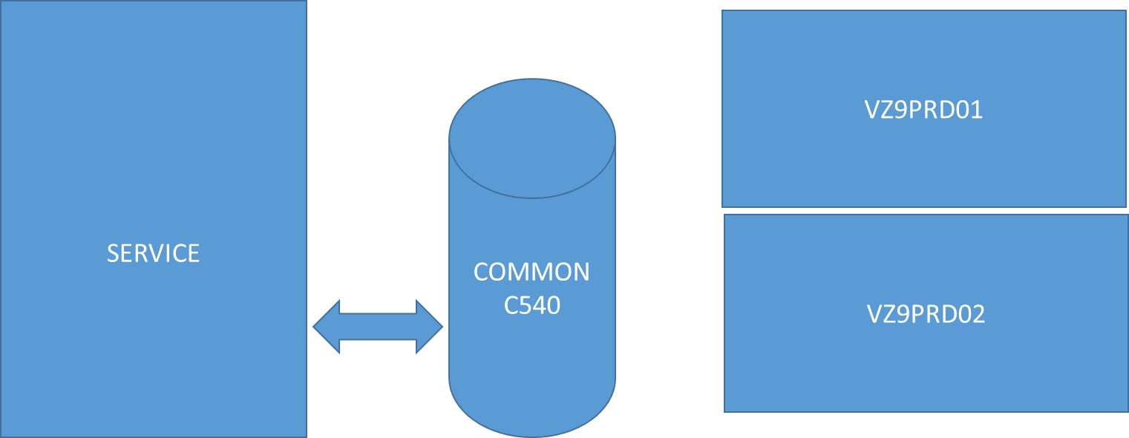
Oh That Pesky PDR record on the COMMON!
These system must be unconscious (SHUTDOWN). H&T never do this on a production system while any member is alive!
FORMSSI CREATE C540 CLSTR1 (FORCE

Slide 24
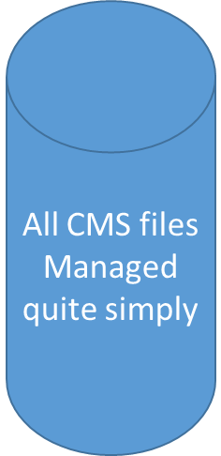
So…let’s rename all members of a Cluster
Most of the changelings:
  DIRMAINT
    CONFIGSS DATADVH, CONFIG* DATADVH on 11F
    AUTHFOR CONTROL on 1DF
    Full directory method with a USER INPUT
  PMAINT CF0
    SYSTEM CONFIG and any imbeds
  PERFSVM 191
    FCONRMT SYSTEMS and FCONRMT AUTHORIZ
  RSCS “191”
    RSCS CONFIG and PROFILE GCS
  MAINT 190: SYSTEM NETID
  Re-gen the annoying CRR server’s DMSPARMs

Slide 25

So…let’s rename all members of a Cluster!
SES/E Coercion
  MAINT720: VM SYSSUF
  PMAINT 41D: VM SYSPINV
  SERVICE & PUT2PROD worked fine!
Full directory method with a USER INPUT
  From SERVICE zone:
    change the old system name to the new in USER WITHPASS.
    Use DIRECTXA to load modified USER WITHPASS to all affected SYSRES.
    With target system down from Service Zone using DEFINE MDISK erase USER DIRECT and copy modified USER WITHPASS to DIRMAINT 1DF as USER INPUT.

Slide 26
What about RACF?
Nothing to do!
Well, I mean you could take a local backup of the DB MDISKs on 200 & 300
MDISK
200
Backup somewhere

Slide 27
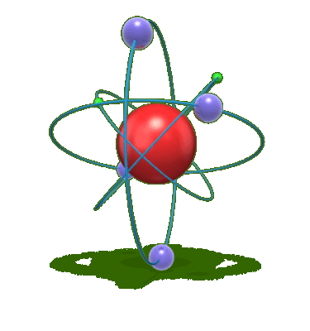
Phases of the method designed and practiced first on practically private 2nd level cluster then dared on production
Before shutdown:
  Copy files on the required MDISKs and have new versions ready.
  Prepare RSCS and local home rolled routines on SERVICE
After SHUTDOWN this phase from SERVICE zone:
  Directory method as shown
  OWNERSHIP: SYSRES’s, COMMON, all PAGE and SPOOL
  FORMSSI
Re-IPL phase
  Do not bring up workload Linux
  COPY the OLD files and bring on the new!
  SALIPL considerations
  Testing
  See point above
Final phase:
  Re-IPL with workload
Hope for the best! Worked Great!

Slide 28
Why we Love zVM and Always Will!
Great host for modern applications running in Linux virtuals
CMS may be old but:
  Great editor
  REXX
  PIPELINEs
CP is a marvelous hypervisor.
So many new creative and useful projects for business needs:
  1PACK
  LPAR Rename
  Many More!

Slide 29

Questions?
We are happy to help you!
Thanks to my long time friends and colleagues at MVMUA! Bill Munson, Eric Schuler-Dalverny, and Len Santalucia from VICOM!
And to you for listening today!
Kim and I congratulate MVMUA for decades of continuous VM love!

