Slide 1

IBM
DS8900F & TS7700
Recent Enhancements
MVMUA Users Group
19 October 2021
John Wolfgang
Enterprise Flash Storage Architect jwolfgang@vicominfinity.com
Mark Tansey
Director of Storage Sales mtansey@vicominfinity.com

Slide 2






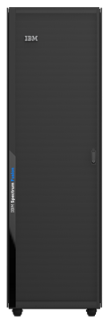
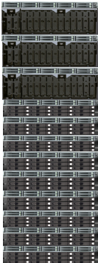


IBM Award-Winning Storage Portfolio
Primary Storage
Container Native SDS
Storage for AI and Unstructured Data
IBM Storage Insights
IBM Spectrum Fusion
IBM Spectrum Discover
IBM Spectrum Scale
IBM Spectrum Virtualize
IBM Cloud Object Storage
IBM Spectrum Fusion HCI
Elastic Storage System
Cloud Object Storage
All-Flash and Hybrid Systems
SVC
Storage for Enterprise Servers
FlashSystem 9200
ESS 3200, 5000
SAN Volume
Controller
FlashSystem 7200
FlashSystem 5000
FlashSystem 9200R
DS8900F
TS7700
Networking
Data Resilience and Modern Data Protection with IBM Spectrum Protect Suite
Notes:
IBM has a comprehensive hybrid multicloud storage portfolio, with a strong commitment to both open and mainframe platforms.
IBM Flash systems are powered by a common software-defined storage platform that is also available for public cloud and supports over 450 storage solutions from IBM and other vendors. This is all managed with the same platform that provides proactive support from AI-driven insights through IBM Storage Insights. And it can be used across all your block storage solutions.
For AI & Big Data, IBM provides the highest performance solutions with IBM Spectrum Scale and IBM Cloud Object Storage. Adding IBM Spectrum Discover and the solutions provide visibility and extensible metadata across these platforms, as well as network file system (NFS) platforms from other vendors such as EMC and NetApp and public cloud providers.
IBM Spectrum Protect and IBM Spectrum Protect Plus are the foundation for data resilience and modern data protection, which spans cloud enablement to air-gap protection with tape and provides leadership in container enablement and backup.
And in the center of the slide, storage solutions for IBM Z are highlighted, which includes the IBM DS8900F and the TS7700 virtual tape library solution. Let's dig a little deeper into the DS8900, starting with the relevance of IBM Z in today’s mission-critical, hybrid multicloud world.

Slide 3
Why IBM Storage for IBM Z ?
Analysts recognize IBM as a market leader
IBM DS8900
Deepest synergy with z/OS
  IBM Storage drives innovation in z/OS, Dell EMC & HDS are significantly behind.
  Db2 on IBM Z with IBM Storage reduces MIPS and improves performance
  Cloud flexibility via Transparent Cloud Tiering
  IBM zHyperLink exclusive connectivity with IBM Storage delivers unmatched I/O throughput for demanding workloads
Lowest RPO/RTO in the industry, due to superior POWER9 processors
IBM continues to invest in storage technology to enhance and develop new capabilities that customers need to run their business
TS7770
Replication technology provides unmatched availability with simplest administration
Lowest latency reads. Superior POWER9 and data reduction technology
Pervasive encryption for data in flight
Lowest risk and least intensive data migration
Lowest latency for replication
IBM DS8900F
IBM TS7700

Slide 4
New IBM DS8980F
Analytics Class
Next level performance to help customers process transactions faster, while allowing them to expand their workload possibilities to AI and Business intelligence.

Slide 5
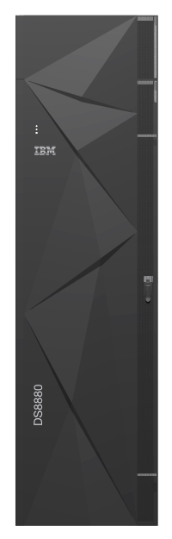
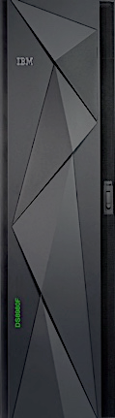
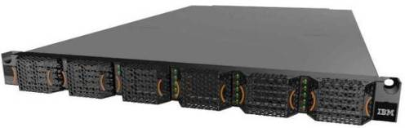


Evolution of the IBM DS8000 Analytics Class Storage System
HPFE Gen 1
HPFE Gen 2
HPFE Gen 2
2016
2017
2021
System | IBM DS8888F Model 982 | IBM DS8888F Model 988 | IBM DS8980F Model 998
Processor | POWER8 | POWER8 | POWER9
System cache | 2 TB | 2 TB | 4.3 TB
High-Performance Flash Enclosures (HPFE) | Gen 1 | Gen 2 | Gen 2
Number of cores per system | 96 | 96 | 44
Host Adapter Ports | 128 | 128 | 128
Minimum response time (4K read hit) | 90 µsec | 90 µsec | 80 µsec
Minimum response time w/ zHyperLink (4K read) | N/A | 18 µsec | 18 µsec
Notes:
More Horsepower – more powerful Power 9 processor provides capability for more threads and that translates to the ability to do more internal work. This will enhance all the capabilities such as Flash Copy, Safeguarded Copy, Easy Tier, etc.
CACHE SIZE
80 us response time for 4K read hit

Slide 6
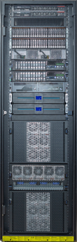
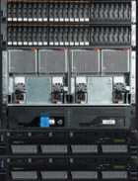
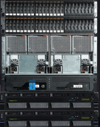
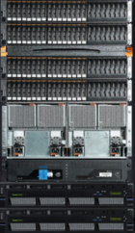
IBM DS8900F all-flash storage portfolio
IBM DS8910F
model 993
IBM DS8910F
model 994
IBM DS8950F
model 996
IBM DS8980F
model 998
1 HPFE
2 HPFE
For IBM z15 model T02 or LinuxONE III model LT2
Rackless configurations to be mounted in 19-inch industry standard racks
Racked solution delivered in a space-saving package
Racked solution with better performance and capacity for workload consolidation
Best performance to process more transactions faster and extend the workload possibilities to AI.
Same advanced functions and capabilities

Slide 7
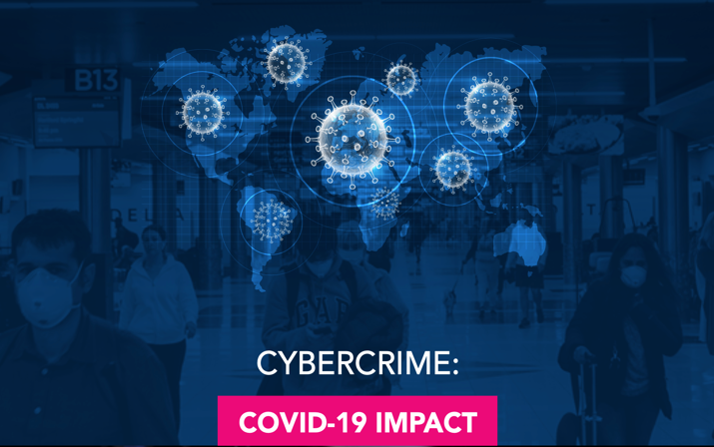
Cybercrime accelerated during the COVID-19 pandemic
Every 11 seconds
a company will likely become a victim of a cyber attack.¹
2x more attacks
during the CODIV-19 pandemic.³
INTERPOL
INTERPOL report shows alarming rate of cyberattacks during COVID-19.²
“Cybercriminals are developing and boosting their attacks at an alarming pace, exploiting the fear and uncertainty caused by the unstable social and economic situation created by COVID-19.”
Jürgen Stock, INTERPOL Secretary General
A further increase
in cybercrime is highly likely in the near future.²
$6 trillion
expected cost of damages during 2021.¹
Notes:
Cybercrime has been a problem for years, but it’s getting worse as it evolves and grows in response to the COVID19 pandemic.
According to INTERPOL, “Cybercriminals are developing and boosting their attacks at an alarming pace, exploiting the fear and uncertainty caused by … COVID-19.”
Every 11 seconds a company will likely become a victim of a cyber attack. During the COVID-19 pandemic, the number of attacks has doubled, and a further increase is expected in the near future. In 2021, cybercrime damages might reach 6 trillion US$ — that would be equivalent to the gross domestic product (GDP) of the world’s third largest economy.
Organizations affected by cyber attacks run the risk of having their normal business operations disrupted, as well as losing valuable data, customers and reputation within their industries.
Morgam S. Nov 13, 2020. “Cybercrime To Cost The World $10.5 Trillion Annually By 2025”. Cybercrime magazine. https://cybersecurityventures.com/cybercrime-damages-6-trillion-by-2021/
INTERPOL. Aug 4, 2020. “INTERPOL report shows alarming rate of cyberattacks during COVID-19” . https://www.interpol.int/News-and-Events/News/2020/INTERPOL-report-shows-alarming-rate-of-cyberattacks-during-COVID-19
Starks T. Oct 20, 2020. “US advisory meant to clarify ransomware payments only spotlights widespread uncertainty”. Cyberscoop. https://www.cyberscoop.com/ofac-ransomware-advisory-treasury-sanctions/

Slide 8

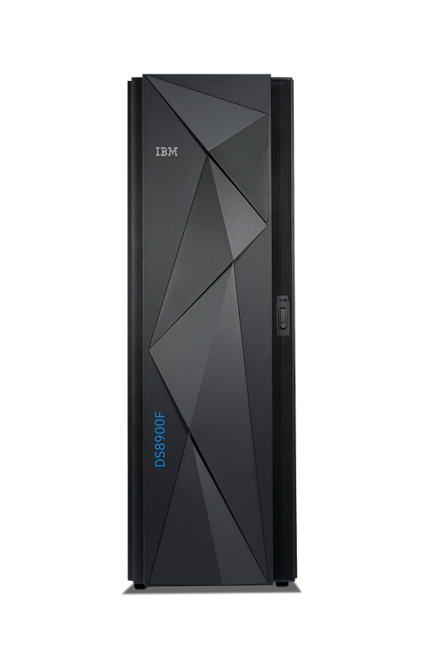


IBM Z Cyber Vault with IBM DS8000 Safeguarded Copy for data corruption protection
IBM z14 or z15 Server
Cyber Vault
(Isolated Logical Partition)
Prod 1
(Logical Partition)
Prod 2
(Logical Partition)
Data Recovery / Consistency Monitoring
Sysprog Test
Prod 3
(Logical Partition)
Prod 4
(Logical Partition)
Recovery Tools
Diagnostics
Restore
Cyber Vault Volume
Hundreds of immutable backups in a separate logical partition
Regular analytics to provide early corruption detection
Rapid surgical or worst-case catastrophic recovery
Production volumes
Backup Capacity
SafeGuarded backup 0
Backup
SafeGuarded backup 2
Recover
. . .
SafeGuarded
backup n
(up 500 per volume)
IBM DS8000 Safeguarded Copy
Notes:
IBM Z® Cyber Vault provides air gapped data corruption protection and tools delivered by combining security and protection capabilities of IBM Z and IBM DS8000. Unlike alternatives, it keeps up to 500 immutable, safeguarded copies of your data in a logical partition that is isolated and separated from your production system. The data is unable to be accessed from your production environment and contains functionality to identify logical data corruption and recover it with safe and trusted data. The air gapped data vault prevents reloading corrupt or compromised copies of data and can store hundreds of safeguarded copies for forensic, surgical or catastrophic recovery.

Slide 9

The impact of a cyber attack
Detect phase
Respond phase
Recover phase
Breach impact
3
4
2
Initial
compromise
Recovery complete
1
Cyber attack
0 | 30 | 45 | 60 | 90 | 2 hours | 10 hours tier 1 recovery | 2 days tier 2 recovery | 3 days | 1 week |  | 2 weeks
1
Corruption of data occurs, but not yet detected
3
Recovery is delayed because there is no easy way to identify the last valid copy
2
The attack is detected long after it happened. Corruption has affected backups and remote systems.
4
It takes even longer to recover all impacted data once the corruption has spread within the enterprise
Notes:
This chart shows the anatomy or lifecycle of a cyber or ransomware attack. At some point, the attack starts, hopefully it is thwarted at your firewall or before it can do any harm, but we are not all so lucky. In this case the attack is successful, and some data is damaged, corrupted, deleted, etc. We see this at point #1 a few minutes after the attack started.
We see the darker red area growing over time until the attack is discovered, and some action taken to stop it and then recover. The area under the blue is the impact, and that impact to the business keeps growing until you are able to recover, or at least start to recover your systems and data. And, depending on how long it takes to discover the attack, the impact will continue to grow, which ultimately increases the time to recover from the attack.

Slide 10



IBM Safeguarded Copy for Logical Corruption Protection
6:00
9:00
12:00
15:00
18:00
Corrupt
Validate
IBM DS8900F Safeguarded Copy prevents sensitive point in time copies of data from being modified or deleted due to user errors, malicious destruction or ransomware attacks
Production System
Cyber Vault LPAR
Production Volume
Backup Capacity
Recovery Volume
Backup
Safeguarded backup 1
Safeguarded backup 2
Safeguarded backup 3
Restore
Safeguarded backup 4
Safeguarded backup 5

Slide 11
IBM Safeguarded Copy for Logical Corruption Protection
6:00
9:00
12:00
15:00
18:00
Corrupt
Validate
IBM DS8900F Safeguarded Copy prevents sensitive point in time copies of data from being modified or deleted due to user errors, malicious destruction or ransomware attacks
Production System
Cyber Vault LPAR
Production Volume
Backup Capacity
Recovery Volume
Backup
Safeguarded backup 1
Safeguarded backup 2
Safeguarded backup 3
Restore
Safeguarded backup 4
Safeguarded backup 5

Slide 12

IBM Safeguarded Copy for Logical Corruption Protection
6:00
9:00
12:00
15:00
18:00
Full or incremental volume recovery
Good copy
Validate
IBM DS8900F Safeguarded Copy prevents sensitive point in time copies of data from being modified or deleted due to user errors, malicious destruction or ransomware attacks
Production System
Cyber Vault LPAR
Production Volume
Backup Capacity
Recovery Volume
Backup
Safeguarded backup 1
Safeguarded backup 2
Restore
Safeguarded backup 3
Safeguarded backup 4
Safeguarded backup 5

Slide 13
IBM Cyber Vault significantly reduces the impact
Detect phase
Respond phase
Recover phase
Breach impact
4
3
2
Initial
compromise
Recovery complete
1
Cyber attack
0 | 30 | 45 | 60 | 90 | 2 hrs | 10 hours tier 1 recovery | 2 days tier 2 recovery | 3 days | 1 week |  | 2 weeks
1
Corruption of data occurs, but not yet detected
3
The last good copy can be quickly identified, so the response plan can be executed
2
Data is continuously validated, so corruption can be early detected avoiding massive spread
4
With less data affected, full recovery of the production environment can be achieved quickly, so the threat can be contained in hours rather than weeks
Notes:
IBM Z Cyber Vault will validate/check the data throughout the day and night, to detect any attack as quickly as possible. This means you can start to recover quicker, and drastically reduce the impact and duration of the event.
Without IBM Z Cyber Vault, who knows when the error will be detected, it could be days or even weeks later, allowing that error to spread across the company and impact other systems. This increases not only the impact of the corruption, but also the time and effort needed to recover from the issue.

Slide 14


IBM DS8900F Safeguarded Copy with incremental Global Copy
From release 9.2, only the data that has been modified since the last recovery point is sent instead of the full volume, this “incremental copy” approach helps to greatly reduce the recovery time from hours to minutes per volume, while achieving significant savings in bandwidth.
New with release 9.2
Primary DS8900F System
Secondary DS8900F System
Modified data only
Recover
Recovery volumes
Full volume restore with Global Copy
Backup Capacity
Safeguarded Copy 0
Safeguarded Copy 2
Safeguarded
Copy n
(up 500 per vol)
Metro Mirror
Global Mirror
Global Copy
Production volume
Secondary volumes
Backup
Restore to production is supported for Metro Mirror, Global Mirror, Global Copy and multisite Metro Global Mirror environments.
Notes:
To achieve an even higher level of data protection, physical isolation can also be configured by storing immutable copies in a remote IBM DS8000 system that is not on the same SAN or IP network as the production environment. When safeguarded copies have to be restored to production, only the data that has been modified since the last recovery point is sent instead of the full volume, this “incremental copy” approach helps to greatly reduce the recovery time from hours to minutes, while achieving significant savings in bandwidth.

Slide 15
Key Serverless Encryption of Data at Rest
Fibre Channel Connectivity Report
To enable encryption at rest, an external key manager server is typically needed, increasing complexity, capital expenses and operational costs. The IBM DS8900F family now has the option of a local key manager to enable and manage encryption at rest, protecting data while keeping expenses and operation costs low. The local key manager is only capable of handling encryption at rest, for encryption of data in-flight support using IBM Fibre Channel Endpoint Security or Transparent Cloud Tiering, an external key manager is still needed.
This release enhances the IBM DS8900F management GUI, providing the ability to generate a report identifying information for the attached port and for all host logins and replication logins for a selected port, including current configuration and the security status for each Fibre Channel Endpoint Security login. This enhancement helps system administrators get a better understanding about the SAN configuration, making them more efficient in optimizing system resources and improving their ability for problem determination.

Slide 16
Fast Creation of Safeguarded Backup in physically isolated environment
Guarantee Zeros on Release Space for CKD
This release optimizes Safeguarded Copy backup creation in a cascaded physical isolation environment via cascaded Global Mirror. In the old cascaded solution, via cascaded Global Copy, e.g., a back-up capture can have an RPO impact of roughly 4 minutes to the front Global Mirror leg. With cascaded Global Mirror (and other enhancements) a backup can be created with an RPO impact of just 30 seconds to the front Global Mirror leg.
In this release, IBM DS8900F provides internal functionality utilized to quickly logically erase the data on the track range without the costly overhead of transferring data. This functionality for CKD space release commands to support guarantee that zero data will be returned after successful completion for volumes that are not in Copy Services relationships.

Slide 17
Consistent Read from Metro Mirror Secondary
Transparent cloud tiering multicloud support
This release provides better and consistent performance for read operations in high availability environments for metropolitan regions, reducing the negative impact of increased latency caused by the separation distance between storage systems. This capability enables reads from a secondary site both over FICON and zHyperLink to obtain the same response time as the primary system and better workload balance.
Multicloud support expands the flexibility of Transparent Cloud Tiering (TCT) by allowing a DS8900F connect to up to eight different cloud targets. These cloud targets can be a combination of off-prem or on-prem S3 cloud object stores and/or a TS7700 as an object store. Using defined SMS network cloud constructs and policies, users can split TCT backup and archive workloads to these different cloud targets by service level agreements, test/dev vs. production, by security levels of the data and more.

Slide 18

Extend your cyber resiliency strategy with offline backups to the hybrid multicloud
Use Transparent Cloud Tiering to create point-in time copies of data to the cloud, where copies can be restored to any system
Production DS8900F ¹
Remote DS8900F¹
Backup
Recover
Recover
  Protect your data by making use of the immutability capabilities, provided by the cloud repository
  Take advantage of the benefits provided by Transparent Cloud Tiering:
    50% savings in IBM Z CPU utilization
    No additional server or gateway required
    No impact in IOPS performance
    In-flight encryption with AES 256-bit
IBM TS7770/60
Recover
Recover
Remote DS8900F¹
Remote DS8900F¹
AES 256-bit encryption over TCP/IP
¹ The capability applies for models DS8900F and DS8880F
This educational document is intended for IBM and IBM Business Partner staff only.
Not intended for distribution to clients or other third parties until announced.
Notes:
TCT now offers an excellent solution for increasing cyber resilience by making use of the immutability features provided by cloud repositories. It can also be used to create offline point-in-time data backups to the cloud which can then be restored to any system.
- Transparent cloud tiering can provide more than 50 percent savings in CPU utilization when archiving large data sets, as compared to archiving to tape.
- Results are based on internal IBM data measurements on an EC12 (8 CPs, 32GB Main Memory) when migrating data sets exceeding 5000 3390 tracks in size. Results will vary by customer based on particular workloads, configurations, software levels and the quantity and size of data sets being migrated.

Slide 19
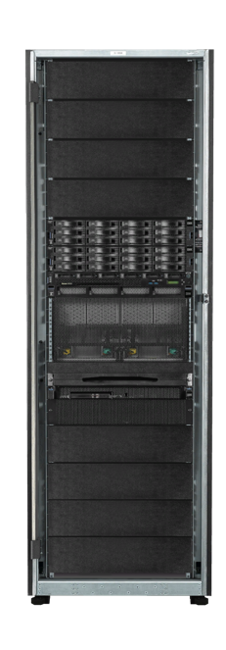
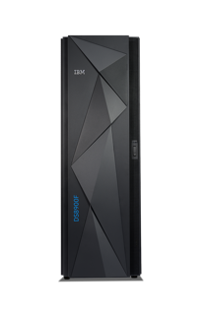
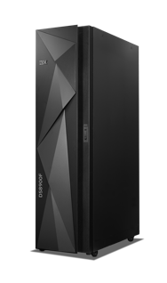

Consolidate your Mainframe storage infrastructure in a single datacenter tile
TO
19’ Customer rack
42U
SAN64-6/7
FICON SWITCHES 2U
10 GBS ETHERNET SWITCHES 2U
FROM
IBM Z
IBM DS8000
IBM TS7700
TS7770
Flash cache 16U /
HDD cache 18U
Ethernet
FICON
Ethernet
FICON
The co-location of IBM DS8910F and TS7770 in just one rack help address today’s business challenges, while keeping costs down with:
Less floorspace requirements.
Less IT and management complexity.
Cost reduction with shared infrastructure.
DS8910F
16U
Notes:
To improve storage flexibility and data economics, IBM is announcing an end-to-end solution, result of the integration of IBM DS8910F and TS7770 in a single 19-inch industry-standard rack, delivering the following benefits to customers:
Floorspace reduction which is especially important for smaller customers in colocation datacenters as they explicitly pay for each tile of floorspace that they are using.
Lower cost through sharing of infrastructure components.
Use of TS7770 as a virtual tape library directly connected to IBM Z through FICON, or as an Object Store to transparently move data from the IBM DS8910F for data protection and disaster recovery.
By integrating the IBM DS8910F and TS7770 in a single frame, small and medium size organizations now can get enterprise storage capabilities, while reducing complexity and costs.

Slide 20
IBM TS7700

Slide 21

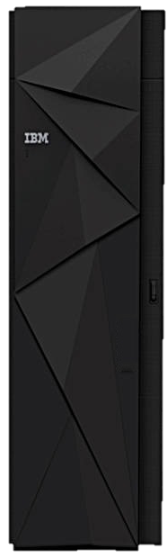

TS7770 – Super Computer Based Control
Built on the Power9 platform (TS7770 VED)
  Two 10 core, 3.8GHz processors
  64GB DDR4 Memory
  16Gb FICON (up to 4 adapters, 2 ports per adapter, 512 paths per port)
  1Gb Copper and 10Gb LW Grid Network (up to 4 ports total)
  SSD or HDD (SAS) for pSeries storage
  Common DS8000 pSeries hardware, I/O bays and adapters
  Single phase power (30AMP), Three Phase 400V support via iRPQ
  Primary ethernet and FC adapters integrated into pSeries slots
  Single Frame: 787 TB’s; 2 Frames: 2362 TB’s, 3 Frames: 3937 TB’s
    Capacities are before Compression – TS7770 utilized New Compression Algorithm
TS7770
Notes:
Two 10 Core CPU Boards
64GB total memory, 2x increase over default TS7760
FICON attachment equivalent to TS7760
1Gb Copper and 10Gb LW network adapters (up to 4 total ports). 1Gb SW optics discontinued.
16Gb FC attachments to disk and tape, Number of FC connections to disk doubled (ports per adapter doubled) for increased throughput.
SSD drives now an option for the pSeries server providing improved code load times, response times and DB maintenance times.
Continue synergy with DS8K by using common hardware.
Default configuration requires 30amp single phase power. Optional three phase PDU available by iRPQ.
To improve resiliency and narrow down failure boundaries, the grid Ethernet and first set of FC adapters are moved into the pSeries I/O Slots. This improves the EEH failure domain given all adapters in an i/o bay fall under one failure boundary while each pSeries slot is on its own.

Slide 22
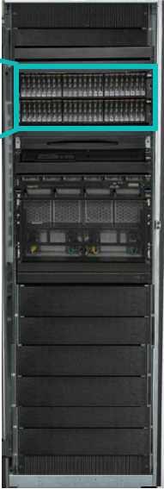
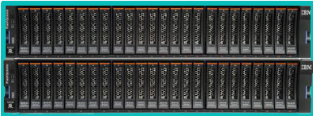
TS7770 All Flash
Grow Performance while Shrinking Footprint
5x faster data transfer
2 SSD drawers deliver better to similar performance to 10 SAS HDDs drawers
Start your all flash infrastructure with as little as 20TB flash usable capacity and expand to 120 TB with Capacity on Demand
Full compatibility with TS7770 Grid
Notes:
Two 10 Core CPU Boards
64GB total memory, 2x increase over default TS7760
FICON attachment equivalent to TS7760
1Gb Copper and 10Gb LW network adapters (up to 4 total ports). 1Gb SW optics discontinued.
16Gb FC attachments to disk and tape, Number of FC connections to disk doubled (ports per adapter doubled) for increased throughput.
SSD drives now an option for the pSeries server providing improved code load times, response times and DB maintenance times.
Continue synergy with DS8K by using common hardware.
Default configuration requires 30amp single phase power. Optional three phase PDU available by iRPQ.
To improve resiliency and narrow down failure boundaries, the grid Ethernet and first set of FC adapters are moved into the pSeries I/O Slots. This improves the EEH failure domain given all adapters in an i/o bay fall under one failure boundary while each pSeries slot is on its own.

Slide 23
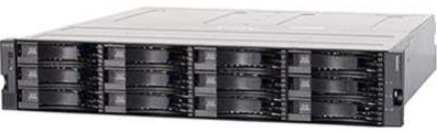
TS7770 – Encryption at Rest - Details
Full AES256 Local or External Encryption Still Supported
  Unlike the TS7760, the TS7770 disk cache must be purchased with encryption enabled.
  Retroactive enablement is no longer supported
  Encryption occurs via the Storwize software/hardware. It no longer occurs within the DDMs themselves. Regular DDMs are used versus FED self encrypting drives.
Local Key Management
  Default encryption option. If encryption is requested, all TS7770s ship from manufacturing with local key management enabled.
  Lock keys are stored on USB sticks plugged into disk cache controllers. Four ship with each CSB string. Locked DK is stored across all disks making data accessibility only possible with a full string of DDMs and the USB sticks.
  USB sticks can be removed if the hardware is at risk (emergency evacuation etc).
External Key Management
  External key management can be concurrently enabled once the TS7770 is installed in customer site. Immediately or months later.
  Only distributed versions of ISKLM are supported (not z/OS). KMIP is used for the protocol. Connection is TLS 1.2 protected.
IBM Synergy: Leveraging V5030E

Slide 24
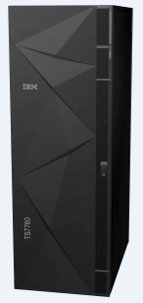
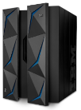
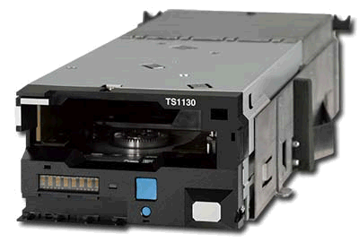
R5.0 Secure Data Transfer
Secure Data Transfer Between Clusters in a Grid
  All logical volume access including copies and remote reads and writes are encrypted in flight
  FC based function can be enabled concurrently at each location on TS7760 or TS7770
  Any two locations with enablement will begin communicating using encryption
  Clusters without enablement or down level can co-exist (non encrypted)
TLS 1.2 Support
  TLS 1.2 used to create a secure connection per logical volume
  Default or customer provided certificate supported
  AES128 or AES256 is utilized once the connection is created
  High Performance
  Exploits the Power9 and Power8 encryption instruction set
  Minimal performance and CPU overhead when enabled
A) TS7700 Cluster
SDT Enabled
C) TS7700 Cluster
SDT Enabled
LAN/WAN
IBM Z
IBM Z
D) TS7700 Cluster
SDT Not Enabled
B) TS7700 Cluster
SDT Enabled
Notes:
24
Secure Data Transfer is the continued support of pervasive encryption behind IBM Z.
Secure Data Transfer is a purchasable feature per TS7700 cluster.
Dedicated devices that provide encryption are no longer needed between sites.
Secure Data Transfer is a Purchasable based feature.
Performance impact is minimal in real world testing with AES256 enabled on a VEC (Power8). Extreme throughput testing shows performance impact up to 5% with CPU utilization up 10%.
If one cluster is AES128 enabled and another is AES256, they will communicate using AES128.
A customer provided certificate is supported.

Slide 25



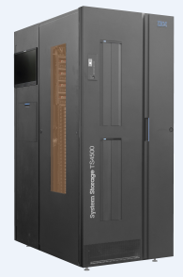
TS7700 Transparent Cloud Tier
Leverage TCT for off load to public or private cloud
Physical tape and cloud tier are both policy managed options
Once one cluster puts a copy in the cloud, all replicated peer clusters have access to the object store instance
Support for IBM COS and AWS S3
  IBM COS On Prem
  AWS S3 Public
Local and cross regional AWS S3 support
TLS 1.2 HTTPS utilized for cloud object store connectivity with optional customer provided certificates
  Encryption on the wire
Cloud
Tier
TS7700
or
IP
Tape Tier
Migration
Private
or
Public Cloud
FC
TS4500
25

Slide 26
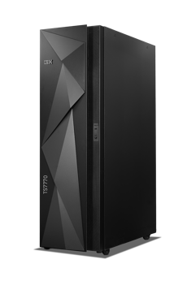

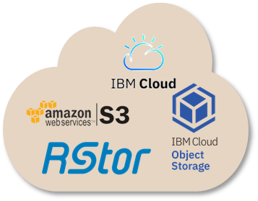
Cloud-Based Disaster Recovery for Tape
Ensure your critical data is available where and when it is needed, while building up your grid
Tape IP addressable in case of a disaster:
Use the saved copies of your data in the cloud to restore outside the grid
Add a layer of security, ensuring critical data is always available
Copy point-in-time backups from TS7770 Cloud Connect¹ to the cloud
Manage cloud pools with DFSMS
Control copies with cloud pool copy versioning
Restore to any empty TS7700 Cloud Connect¹ outside the grid
Supports IBM Cloud, AWS S3, IBM Cloud Object Storage and RStor
Small Grid
Empty TS7770 Cloud Connect
For DR
¹ TS7770 and TS7760 require R5.1 code or later applied
This educational document is intended for IBM and IBM Business Partner staff only.
Not intended for distribution to clients or other third parties until announced.
Notes:
With IBM DS7770, data sets can now be restored to any empty TS7770 system outside TS7700 grids using Cloud Connect technology. As volumes are created in a grid, TS7700 Cloud Connect copies them to the assigned cloud pools, where they can be managed by the Data Facility Storage Management Subsystem (DFSMS). Version retention is enabled within each cloud pool, allowing previous versions to be retained long enough to meet any requirement. These new capabilities are supported in IBM Cloud, AWS S3, IBM Cloud Object Storage on-prem, and RStor.
DFSMS Policy Management used to direct workloads to a particular pool
As volumes are created in a grid, TS7700 Cloud Connect cluster copy them to the assigned cloud pools
Version retention is enabled within each cloud pool needing to be exported which allows previous versions to be retained long enough for any required restores (days, weeks, etc.)

Slide 27

Thank you!
John Wolfgang
jwolfgang@vicominfinity.com
Mark Tansey
mtansey@vicominfinity.com

