Slide 1
consolez
consolez is a tool for Linux on the mainframe to
View z/VM consoles from a browser
Run certain z/VM commands
Part 1: Charts
Part 2: Command line interface
Part 3: Web user interface

Slide 2
The business problem
Our team needs to
Question: How to keep a common CONFIG file and many for each LPAR?
Answer: Centralize all common and individual CONFIG files
Key point: Seek lightweight context switches
Prototype is called opsmgr

Slide 3


TCa
TCa
z/VM LPAR ZS01
z/VM LPAR ZS02
ENGZS012
ssh
ENGZS022
spoolcons
spoolcons
httpd
scp
temp
vmcp
vmur
vmcp
vmur
CP
Reader
CP
Reader
LDAP
TCPIP
TCPIP
FTPSERVE
network
admins
can see
FTPSERVE
CP FOR & SPOOL
SSL00001
SSL00001
MMACISA
MMACISA
MAINT
MAINT
…
…

Slide 4
CLI scripts
spoolcons – spool a console
catcons – print a console (symlink)
rmcons – remove console for 1 VM (symlink)
lscons – list save console files (symlink)
cpcommand – run one CP command
consfuncs – common functions

Slide 5
CGI scripts
consolez – Main page showing all data
onecons – Web page showing one console
onelpar – Page showing one z/VM LPAR
cpcmds – Page to run some/all CP commands
consuifuncs – Common functions
consolez.css – Cascading style sheets

Slide 6
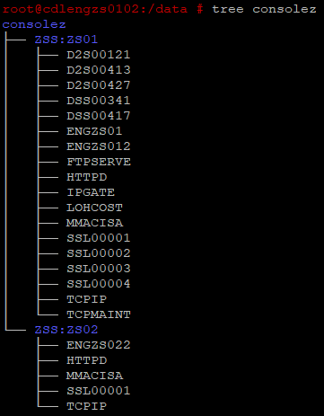
Data structure

Slide 7
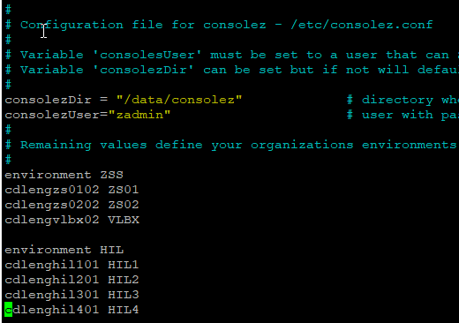
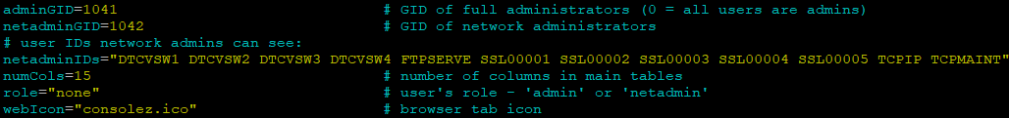
Config files
/etc/consolez.conf:
/srv/www/ldap/consuifuncs:

Slide 8
Future work
Prune – Move data out too old or too long
Search – Grep and Linux files make it easy ☺
Put on github.com
Package into an RPM
Redbook-like document

Slide 9
How to get it
https://sites.google.com/site/mike99mac/home
https://sites.google.com/site/mike99mac/consolez.pptx
https://sites.google.com/site/mike99mac/consolez-0.90.tgz
Also: https://tinyurl.com/y8ceas4c

Slide 10
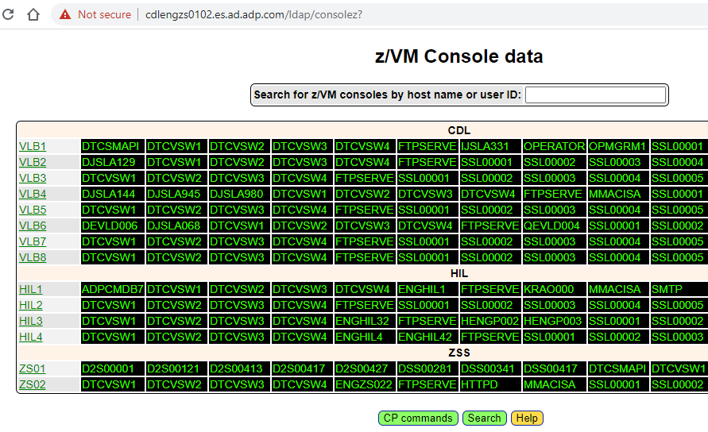
Home page

Slide 11
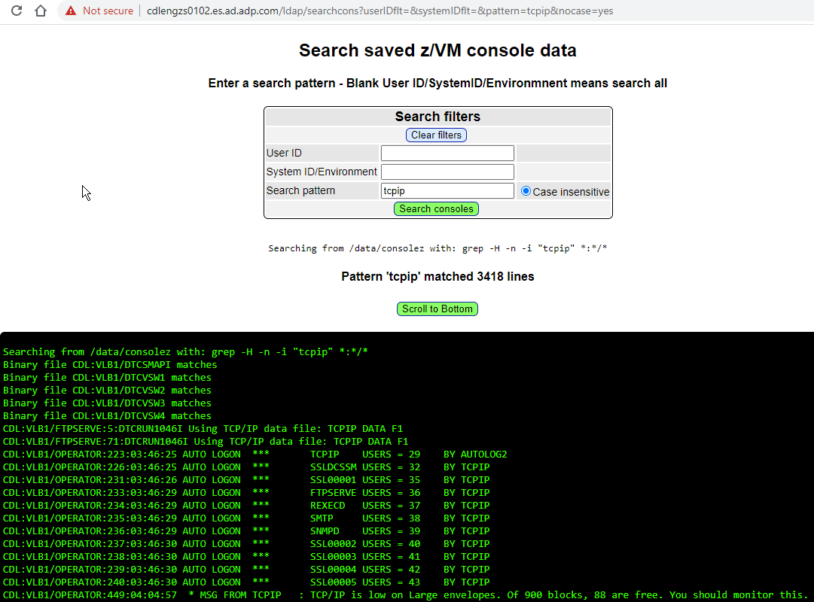
Search page

Slide 12
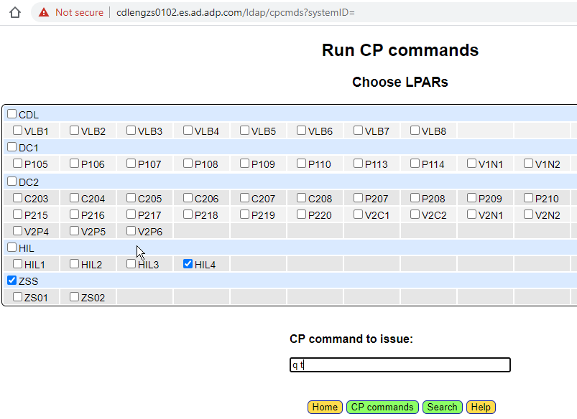
CP Commands

