Slide 1

MVMUA
October 15th, 2013
ITP PANORAMA Demonstration
ALAN Perkins
Chief Solutions Architect
aperkins@metaiq.com
Novel metadata solutions that create value, transform companies and markets, and redefine relationships between citizens and government.

Slide 2
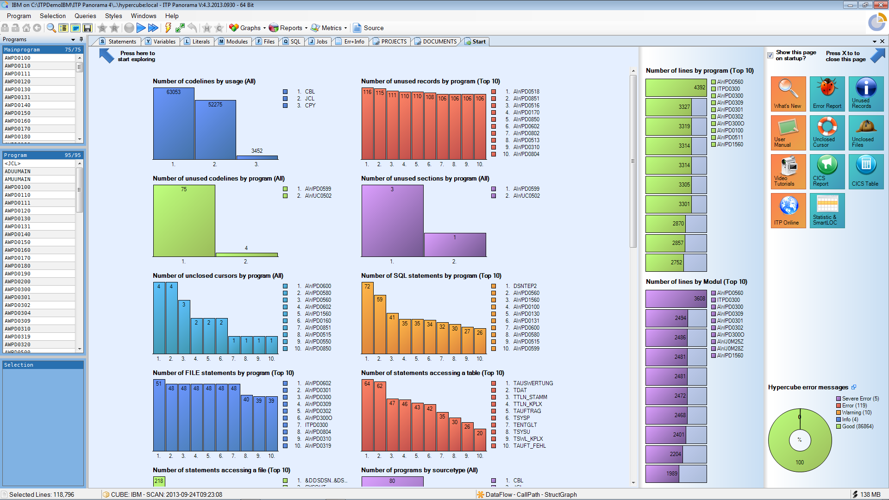

ITP PANORAMA “In Action”
Source
Code
Project Components
Links to Documents

Slide 3
Do you have a “legacy monster”?
Characteristics of OLD (10 years? 20? 30?) software:
Contains lines and lines of dead code
Has lots of sleeping errors
Documentation neither complete nor up to date
Patches, patches, patches
Maintenance cost are way to high
Cost of modernization and migration is daunting
ITP-PANORAMA is proven to help slay the legacy monster!

Slide 4
What Are Your Challenges?
  Do you have a complex, high-volume (millions of lines of code) application portfolio?
  Do you have pressure to reduce cost of software maintenance?
  Do you carry an application back log?
  Is it difficult to deliver all change requests on time and within budget?
  Is the quality of your change process not as high as it needs to be?
  Do you need to become more agile?
  Do you want to leverage your years of investment and migrate to SOA?
  Do you want to retire legacy applications and replace them with newer code or “off the shelf” products?
  Do you really know how your software supports critical business processes?
  Are your developers retiring and/or leaving? Do you have trouble finding experienced developers?
  Are you relying on outsourced developers?

Slide 5
For More Information please contact…
Len Santalucia, CTO & Business Development Manager
Vicom Infinity, Inc.
One Penn Plaza – Suite 2010
New York, NY 10119
212-799-9375 office
917-856-4493 mobile
lsantalucia@vicominfinity.com
About Vicom Infinity
Account Presence Since Late 1990’s
IBM Premier Business Partner
Reseller of IBM Hardware, Software, and Maintenance
Vendor Source for the Last 4 Generations of Mainframes/IBM Storage
Professional and IT Architectural Services
Vicom Family of Companies Also Offer Leasing & Financing, Computer Services, and IT Staffing & IT Project Management

