Slide 1
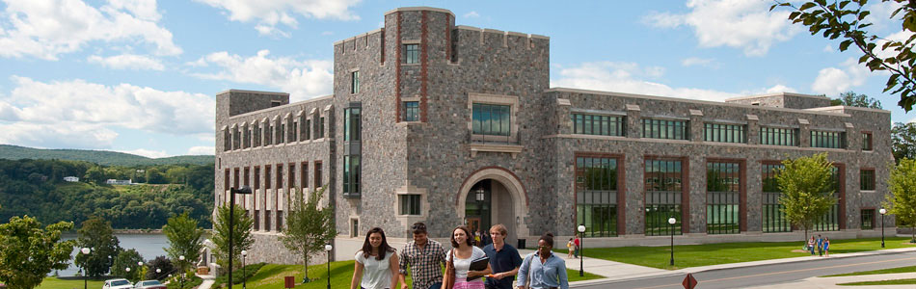
MVMUA Marist Meeting
Marist/IBM Joint Study Update
July 16, 2013

Slide 2

Marist Profile
MISSION: “Marist is dedicated to helping students develop the intellect and character required for enlightened, ethical and productive lives in the global community of the 21st century” (Marist Strategic Plan )
Official State Charter Granted In 1946
Liberal Arts College Emphasizing Teaching & Learning
180 Acres of Riverfront Campus
60 Acre Leadership Institute
4,200 Full-time Undergraduate Students
1,000 Full-time and Part-time Graduate Students
1,000 Adult Continuing Education Students
43 Bachelor Degree Programs
12 Graduate Degree Programs
Fully Online MBA, MPA , MS/IS, & MA in Communication

Slide 3


Marist Profile
A Nationally Recognized College
Princeton Review - Best 371 Colleges
U.S. News & World Report - Ranked Marist 9 out of 178 colleges and universities in the Northern United States
“Highly Selective” - Time/The Princeton Review
Acceptance Rate in Most Selective 4% of US Colleges and Universities
Barron’s Best Buys In College Education
Most Connected Campuses - The Princeton Review/Forbes
Over 11,000 Freshman Applications for the 950 Seats Available Fall 2012
Winner of NACUBO 2010 Innovation Award - Applied Research
Banner on the z

Slide 4
Strategic Objectives of Program
  Collaborate with Marist, IBM experts, and industry partners on projects that support top technology trends (PoC and First-of-a-Kind projects) that are beneficial to all parties
  Support the IBM sales team through customer briefings and reference implementation of IBM technology
  Provide a pipeline of top students to IBM and IBM customers via internships.
  Provide Leadership, Guidance, and Support to the IBM Academic Initiative – course development, faculty training, faculty research, student/faculty access to IBM hardware and software worldwide, and community development.
  Stakeholders
  Dennis Murray - President, Marist College
  Ross Mauri - IBM VP Enterprise Process Transformation, Vice-Chairman of the Board, Marist College
  Howard Baker - IBM/Marist Joint Studies Program Manager
  Susan Cohen - IBM VP, Design and Engineering, Marist College Board Member
  Dean Marsh - IBM VP Sales, Recently appointed Marist PEP Executive
  Steve Frodey - IBM S&D Client Executive, Education & Public Sector
  Casimer DeCusatis – IBM, DE/CTO, IBM Systems Networking Strategic Alliances
  Bill Thirsk - Marist CIO and VP, Information Technology
  Roger Norton - Marist, Dean, School of Computer Science
  Mary Ann Hoffmann - Marist, Asst Dean, School of Computer Science
  Angelo Corridori - Director, Enterprise Computing, Marist College
  Harry Williams - Marist CTO
  Josh Baron – Marist Senior Academic Technology Officer, Chairman, Sakai Foundation Board
  Martha McConaghy – System Architect, Marist
4

Slide 5
A win-win alliance between Marist College, IBM, and Industry and/or Government Partners
Research
Key Focus Areas
Education for a Smarter Planet/Smarter Classrooms
  Open source systems (Sakai enabled on IBM HW/SW, Integration w/existing ERP systems)
  Cloud Computing PoC (K-12 SaaS hosting, Virtualization, Project Greystone)
  Soial Media, OAE, MOOCs
  Analytic Tools (Cognos, SPSS)
  Virtual Worlds (OpenSim)
Smarter/Dynamic Infrastructure
  Technology infrastructure (e.g. systems/data centers, OpenFlow, SOA)
  Virtualization (e.g. hybrid multi-core systems, cloud computing, server provisioning)
Course Development (23 total courses)
  z/OS, AIX/Power
  Converged Networking
  Dynamic Infrastructure
  Business Intelligence/Analytics
Sales
Collaborative Research Projects –OpenFlow
Cutting edge technologies – Cloud Computing
Areas of mutual interest
Direct Sales
Sales Enablement – Briefings/Reference Acct
IP/JDA
Recruitment
Funding
(in-kind/cash)
Product Ecosystem
IBM
Gets
Identify Intellectual Property(IP) and/or Joint Development Agreement(JDA) opportunities
IBM Internships
Full-time hire – Many Marist grads at IBM
Marist
Gets
SUR Grants
Faculty Awards
Collaborative Research Projects
Tools, S/W, Libraries
Access to IBM hardware/software and provides access to many other schools (z and p)
Conference presentations, demos, Workshops, courseware
Recruit top talent
Hardware/Software
Talent Pool
NEC, ADVA, BigSwitch, ONF, NYSTAR, Brocade, NSF, Ellucian, Sakai Community, Juniper
5
Notes:
5

Slide 6
NSF CPATH Grant: 2013 Conference
Grant Activities
$400,000 grant over 2 years (Sept. ’08 – August ’10) with one year extension
Overall Goal: Build an industry and academic community to incorporate large system computing principles into the undergrad CS and ITS curriculum.
Membership: 1000+ Members, 150 Companies, 50 Universities
Hosted 5th Annual ECC Conference, June 9 – 11:
June 9th – Reception at Marist College Historic Boat House
Themes were:
  The New York State Cloud Computing and Analytics Center
  IBM's PureSystems
  Open education: The Academic Computing Community and Massively Open Online Education
Keynotes:
  Mark VanderWiele, Distinguished Engineer, IBM
  Manny Perez, Principal at Interactive Analytics Associates
  Charles Severence, Clinical Associate Professor University of Michigan and Sakai Chief Strategist
Presence on Facebook www.facebook.com/enterprisecomputing

Slide 7
NSF ARI Grant
Marist received a $690K NSF award in 2010 to:
Replace the CS and IT/IS lab in Lowell Thomas building with an expanded CS, ITS, and Mathematics Research and Research Training laboratory in the Hancock Center
Grant covers the cost of fixed assets
Increases the floor space in the new lab
Improves access to the new lab for all students and for handicapped students
Improves power and air conditioning
Improves UPS capability
Reserved floor space for expansion in future

Slide 8
NSF MRI Grant
Marist received an NSF Grant in 2011 or a $680K MRI (major research equipment) to:
Add an enterprise computing system to the new research lab
  z/Enterprise processor and zBX
  Storage devices
  Network equipment
To be used for research, applied research, and research training for
  Marist Faculty
  Faculty from other universities
  Undergraduate and Graduate students
  Applied research projects with industry partners

Slide 9

About the IDCP
The Marist College Institute for Data Center Professionals (IDCP) was founded in 2004 with support and funding from the National Science Foundation. In partnership with professional, industry and governmental organizations, the IDCP has been providing individuals and corporate teams with skills- based, fully online education and credentialing supporting the data center and enterprise computing environments of the future.
Professionals working in the data center and enterprise computing realm are critical resources for the nation’s economic stability and national security, yet there is a significant skills shortage as experienced professionals are retiring from the workforce and traditional educational programs are not yet addressing this challenge.
The IDCP offers a variety of online certificate programs for the working professional. All courses utilize the Marist College Premier iLearn course management system delivering multimedia content. In addition, the Knowledge Center at Marist College provides students from across the globe with a hands-on virtual laboratory environment.

Slide 10
Systems Programming Track
Associate Certificate
Professional Certificate
Expert Certificate
z/OS Intro
z/OS Networking
z/OS Security
z/OS Advanced Topics
z/OS RAS & Prob. Determ
z/OS Emerg. Technologies
Performance
Fundamentals
z/OS Install
DB2 Fund.
Spring / Fall
Fall Only
Fall Only
Application Programming Tracks
COBOL Certificate
z/OS Intro
z/OS COBOL
Adv. COBOL
Fall Only
Assembler Certificate
z/OS Intro
z/OS Assem.
Adv. Assem.
Spring Only
  7 Certificates
  16 Unique Courses
IMS Certificate
z/OS Intro
Intro. IMS
IMS Appl. Prog
Fall Only
DB2 Certificate
z/OS Intro
DB2 Fund.
DB2 Appl. Prog
Spring Only
See www.idcp.org/learnzos for details

Slide 11
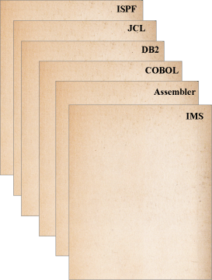
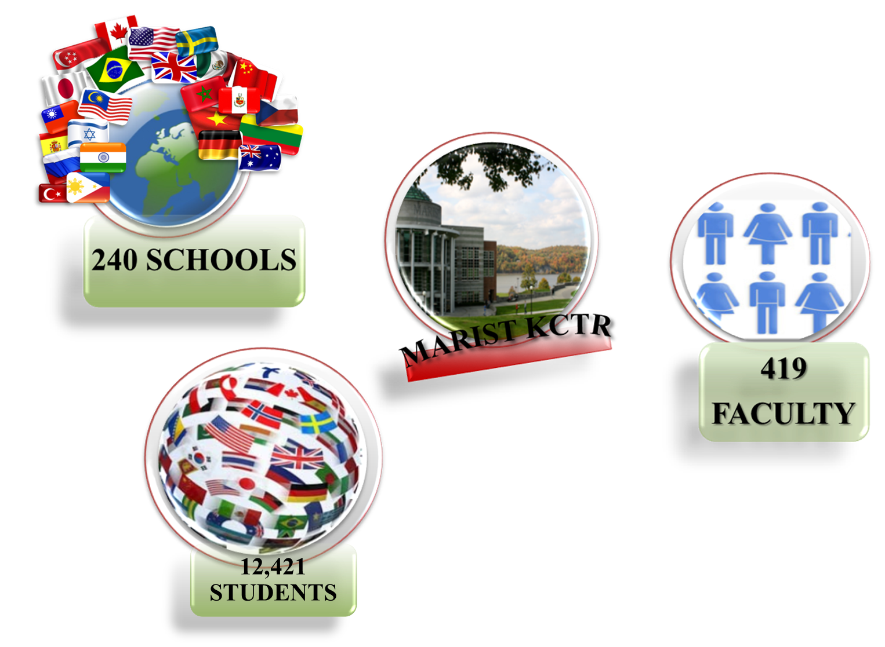
Success on System z z/OS Knowledge Center on System z
553
Courses

Slide 12
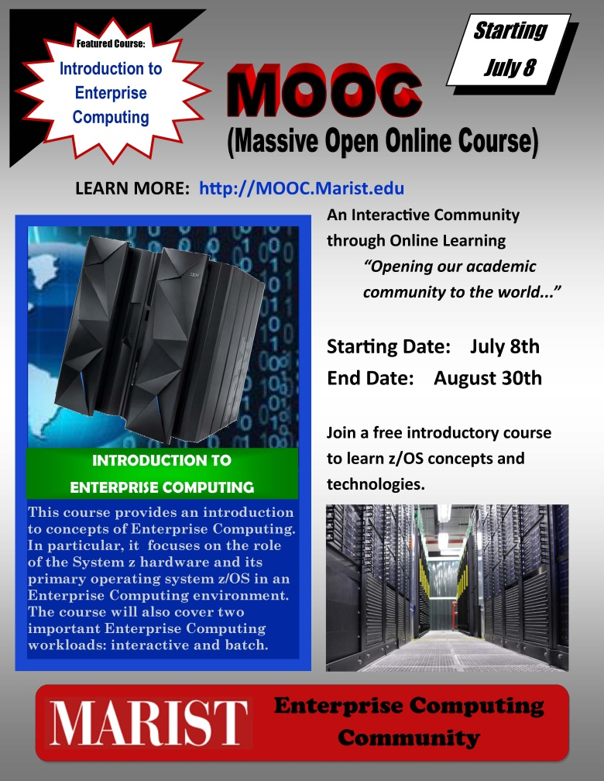
Marist Massive Open Online Course
Introduction to Enterprise Computing
Week # | Topic(s) | Activities
1 | Topic 1 Course Welcome
1 | Topic 2 Introduction to Enterprise Computing
2 | Topic 3 Introduction to Enterprise Servers | Quiz
3 | Topic 4 Introduction to z/OS | Quiz
4 | Topic 5 Introduction to Data Sets and Related Concepts | Quiz
5 | Topic 6 Introduction to TSO, ISPF, and USS | Quiz
6 | Topic 7 Introduction to Batch
7 | Topic 8 Introduction to JCL | Quiz
8 | Topic 9 Introduction to the Job Entry Subsystem | Quiz
8 | Topic 10 Course Closing
12

Slide 13


Data Center Technologies
Systems and Software- 9 credits
Info Tech & Systems Concepts
Introduction to Programming
Arch. Of Hardware & Software
Advanced Facilities Management
12 weeks/non-credit
Facilities Management- 6 credits
Info Tech & Systems Concepts
Introduction to Facilities
The Greening of the Data Center
10 weeks/non-credit
Networking-9 credits
Info Tech & Systems Concepts
Data Communication
Internetworking
Operations & Process Management-12 credits
Info Tech & Systems Concepts
Managing IT Organizations
System Design & Analysis
Project Management
Security-9 credits
Info Tech & Systems Concepts
System Administration & Management
Internet Security
Product Development & Financial Planning-9 credits
Info Tech & Systems Concepts
Accounting for the Data Center
Project Management
Successful Completion of all six certificates leads to 7th Certificate as a Certified Data Center Professional

Slide 14
Enterprise UNIX Systems Education
AIX on Power Certificate
Introduction to AIX on Power
Fundamentals of AIX Administration
Emerging Technologies
High Availability Storage Networking
Dynamic Infrastructure
HAS Networking I
HAS Networking II
Dynamic Infrastructure- in theory and practice
Virtualization
Graduate Certificate in Business Analytics
Introduction to Data Analysis and Computational Statistics
Data Management
Decision Support Systems
Data Mining and Predictive Analytics
Notes:
14

Slide 15
Advanced Certificate in Business Analytics
Started with Decision Support Systems and Database Management
Over the last 10 years we added
  Business Intelligence (DW, OLAP, BPM, intro to Data Mining)
  Data & Information Quality
  Data Mining and Predictive Analytics
  Computational Statistics
  (all MSIS electives)
Recently launched an Advanced Certificate in Business Analytics
  Started with funding from IBM
  Intensive use of technology, hands-on approach
  Close Collaboration with IBM, but very balanced (commercial software, open source)
  Virtual Computing Lab
15

Slide 16
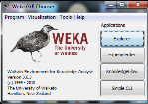


Virtual Computing LAB @ Marist
16

Slide 17
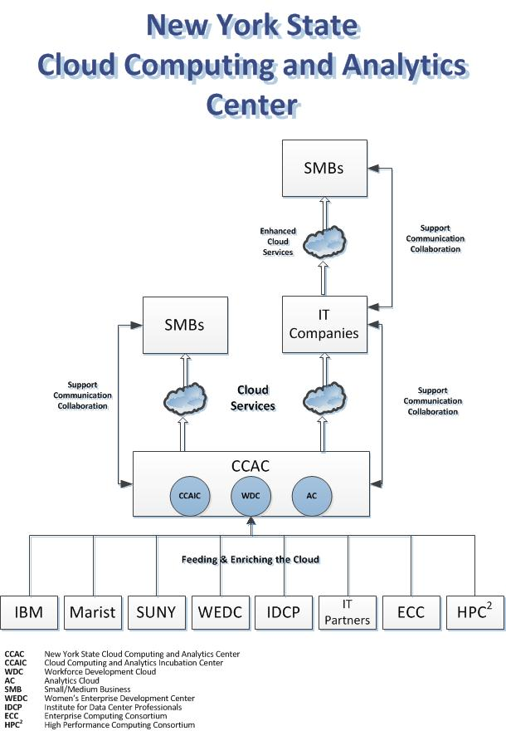
NY State Center of Excellence for Cloud Computing and Analytics
$3M grant
Awarded Dec. 2012
Cloud Computing
Analytics
Incubation Center
Workforce Development Center

Slide 18
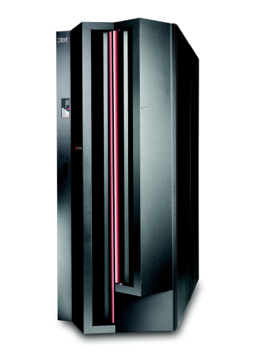
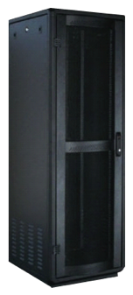

Physical View of Marist CCAC
Dev/Test Cloud – Hancock (ECRL)
Production Cloud - Donnelly
zM114 3 IFL’s
Supporting Applications
Advanced Analytics (SPSS)
ETL (Datastage/QualityStage)
Cognos BI
zM114 8 IFL’s
Supporting Applications
Advanced Analytics (SPSS)
ETL (Datastage/QualityStage)
Cognos BI
Analytics PaaS
Analytics PaaS
Shared security, identity,
and access management
PureData
for Analytics
PureData
for Analytics
Cloud
SaaS
Cloud
SaaS
Applications
CAD
ERP
Sakai
MySQL
LifeRay
LAMP (Linux, Apache, MySQL, PHP)
Etc
.
Applications
CAD
ERP
Sakai
MySQL
LifeRay
LAMP (Linux, Apache, MySQL, PHP)
Etc
.
¼ Rack
Netezza
1/2 Rack
Netezza
PureFlex – IaaS
Power/Intel Nodes
Disk storage
PureFlex - IaaS
-Power/Intel Nodes
Disk Storage

Slide 19
Marist/IBM Joint Study Update
Agenda
Intro/Joint Study Overview - Howard Baker, IBM
Marist ECRL Projects Overview - Junaid Kapadia, IT Major
Defect Analytics Projects Update - Andrew Evans, CS Major
Digital Archives Project – Rebecca Murphy, CS Major
SDN Overview – Kevin Pietrow, CS Major
ADVAlanche Project - Zack Meath, Mary Miller, CS Majors
AVIOR 2.0 Project – Devin Young, Kevin Pietrow, CS Majors

Slide 20
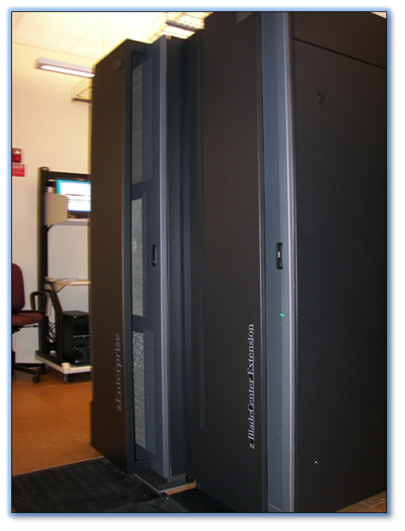

MARIST ECRL zEnterprise
By Junaid Kapadia

Slide 21
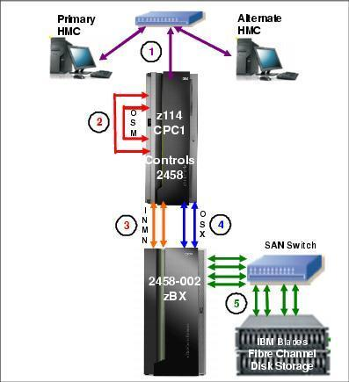
zEnsemble Layout
Management network
Intranode management network
Intranode management network - extension
Intraensemble data network
FC-attached disk storage

Slide 22
zBX Specifications
2 PS701 Power blades
64 GB of memory each
Eight 3.0 GHz processors; 64 "virtual processors" each blade
300GB Internal HDD
2 HX5 X blades
Eight 8GB memory kits (total 64GB memory) each
Two 2.13GHZ Processors with eight cores; total 16 cores (virtual processors) each
100GB SSD internal disk

Slide 23
System z Breakdown
SUSE Linux Cognos Server
SUSE Linux Cognos database
Extra Redhat Server
Extra SUSE Server
IBMCOP SUSE Server
SUSE Linux on z Ron Coleman
Linux Router
DB2
z/VM
z/OS
z/VM
LP1
LP2
LP3
z114

Slide 24
zBX Breakdown
z/os IEDN OSA server
z/os IEDN OSA server
P.Blade 1.1
z/os IEDN OSA server
P.Blade 1.1
z/os IEDN OSA server
NIM
NIM
Power VM Hypervisor
Power VM Hypervisor
R. Coleman P blade Scaly
R. Coleman P blade Scaly
P.blade 1.2
Matt Johnson AIX
P.blade 1.2
Matt Johnson AIX
John’s Hopkins Research
John’s Hopkins Research
Windows Deployment Server
Windows Deployment Server
Cognos Framework Manager
zBX
Cognos Framework Manager
zBX
X.blade 1.04
Eiel Lauria - OAAI
X.blade 1.04
Eiel Lauria - OAAI
Tivoli Monitoring
Tivoli Monitoring
zSentinel
zSentinel
Ron Coleman - Scaly
Ron Coleman - Scaly
X Hypervisor
X Hypervisor
Scott Frank – Underwater Acoustics
Scott Frank – Underwater Acoustics
Cognos Express Server
Cognos Express Server
X.blade 1.05
zBX OpenFlow Controller
zBX OpenFlow Controller
VCL Management Node
X.blade 1.05
VCL Management Node
SuSE PXE
SuSE PXE
Network File System
Network File System
DayTrader
DayTrader

Slide 25
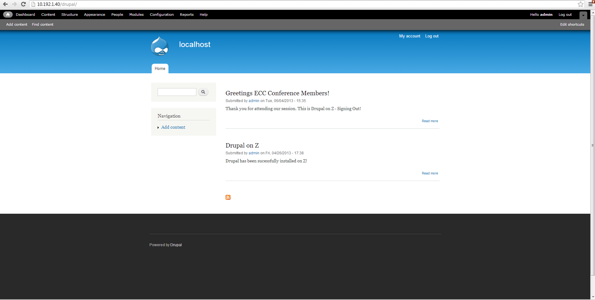
Drupal on z114 – First Time Ever!

Slide 26

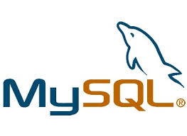




Sakai on z114 – Mid-East Universities

Slide 27
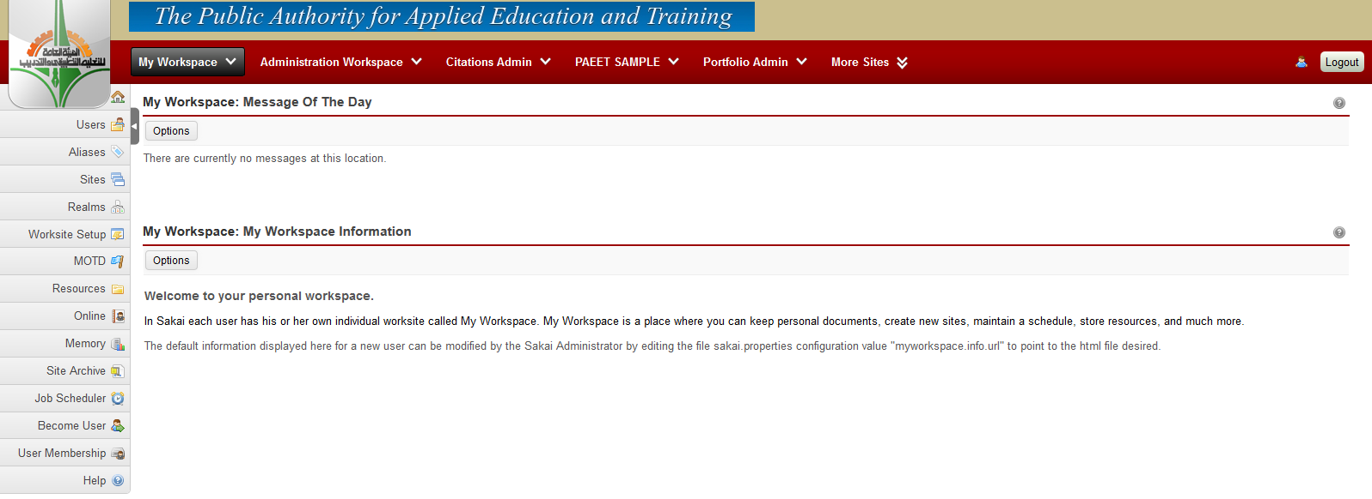
Sakai on z114 – Up & Running

Slide 28



University of Baghdad E-Health System
-Collaborating with the University of Baghdad in developing a national E-Health System on System Z.
-Potential to be used on a larger scale nationally through Iraq.

Slide 29
Open Academic Analytics Initiative
Multi-Year Grant Program
Aimed at increasing college readiness
Deployment of open-source learning analytics
Early detection and intervention of academic risk students
Recipient of Campus Technology Innovators Award

Slide 30
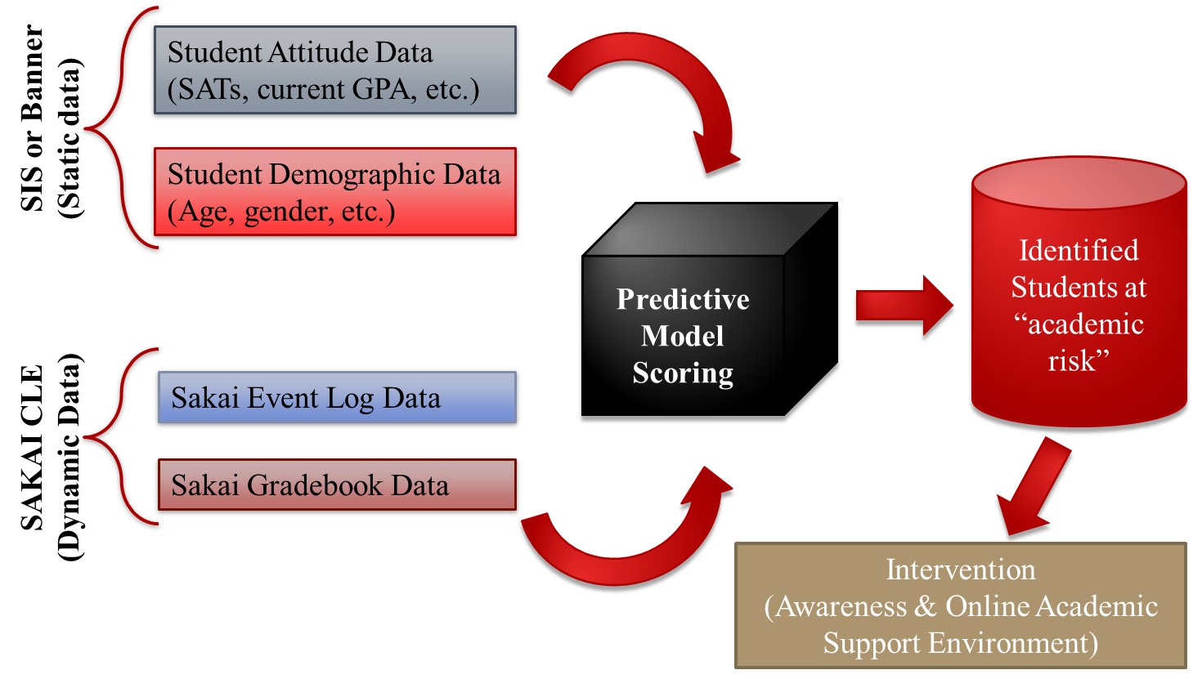
OAAI Early Alert System Overview
30

Slide 31
Results
On Marist data, encouraging results
  Detected more than 80% of at risk students
  Still, rather high false positive rate (12%)
On Pilots, encouraging (and rather surprising) results
    Detected average 72 % of at risk students
    Higher false alarm rates (around 28%)
Why do Academic Alerts Help?
  Early feedback is important
  Despite poor grade students may not believe they are at risk
  In large classes students don’t receive the attention they do in smaller classes
Bragging section (☺)
In March 2013, the OAAI was recognized by Computerworld as a 2013 Honors Laureate and Finalist in the Emerging Technology category
In June 2013, Campus Technology Magazine recognized the OAAI as one of only 9 recipients for the Campus Technology Innovator Award (over 230 applied)
31
Notes:
Campus Technology Innovators Award 2013 (8 awards among 230 something nominations)
31

Slide 32
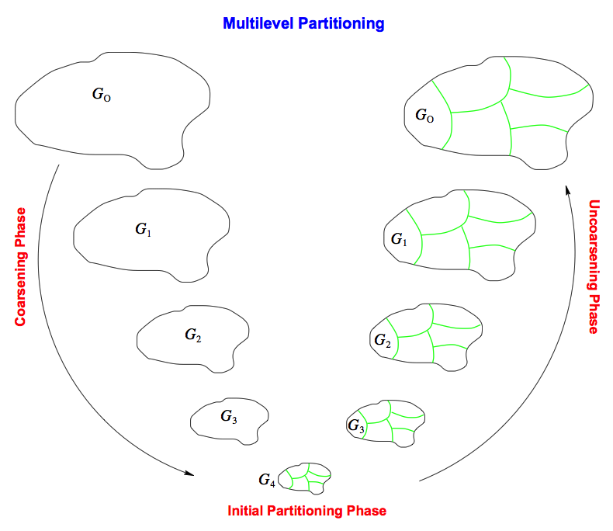
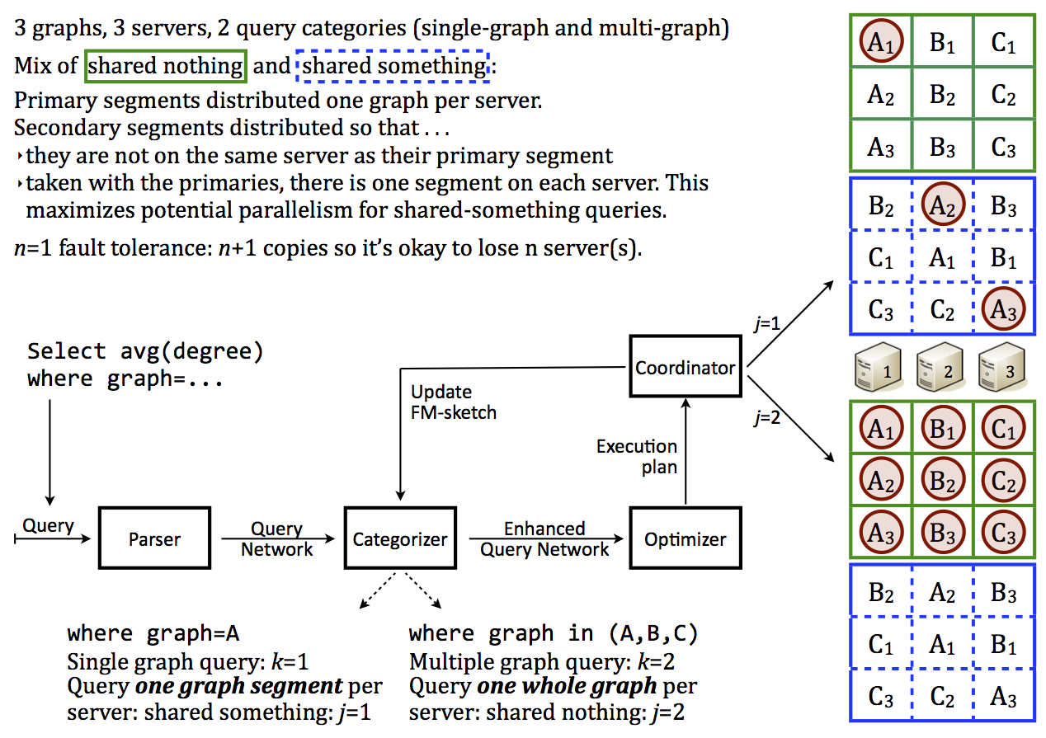
Graph Replication And Smart Partitioning
Very Large Graphs:
Sensor Data
Social Networks
Financial Transactions
Web Communications
Cyber Security Data

Slide 33
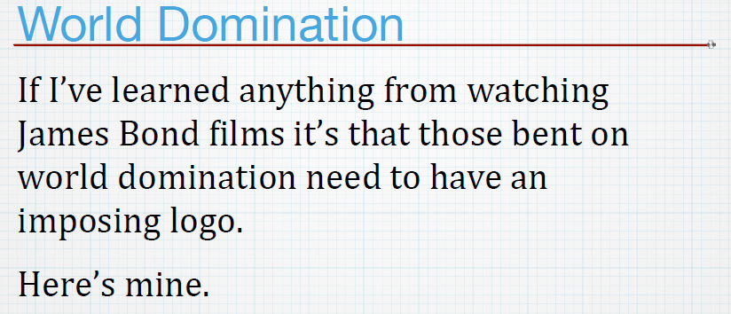
Graph Replication & Smart Partitioning
-Alan L.

Slide 34

Graph Replication & Smart Partitioning

Slide 35



zSentinel
By Christopher Cordisco

Slide 36
Overview
The zEnterprise is a powerful system capable of running many applications concurrently.
zSentinel is a non-interactive web application which gives a simplified layout of real-time resource utilization of the zEnterprise on a single webpage.
It uses REST requests to gather data from the system, and uses a Python web server to send the data to a browser.
The browser displays the data using a combination of traditional web elements and Google Charts.
zSentinel provides a visual layout of the servers running on each host of the system as well as a tabular layout which gives details on each server. It also provides an overview of processor utilization of the mainframe itself. zSentinel is not interactive but designed to run on an external monitor to give an overview of the system at a single glance.

Slide 37
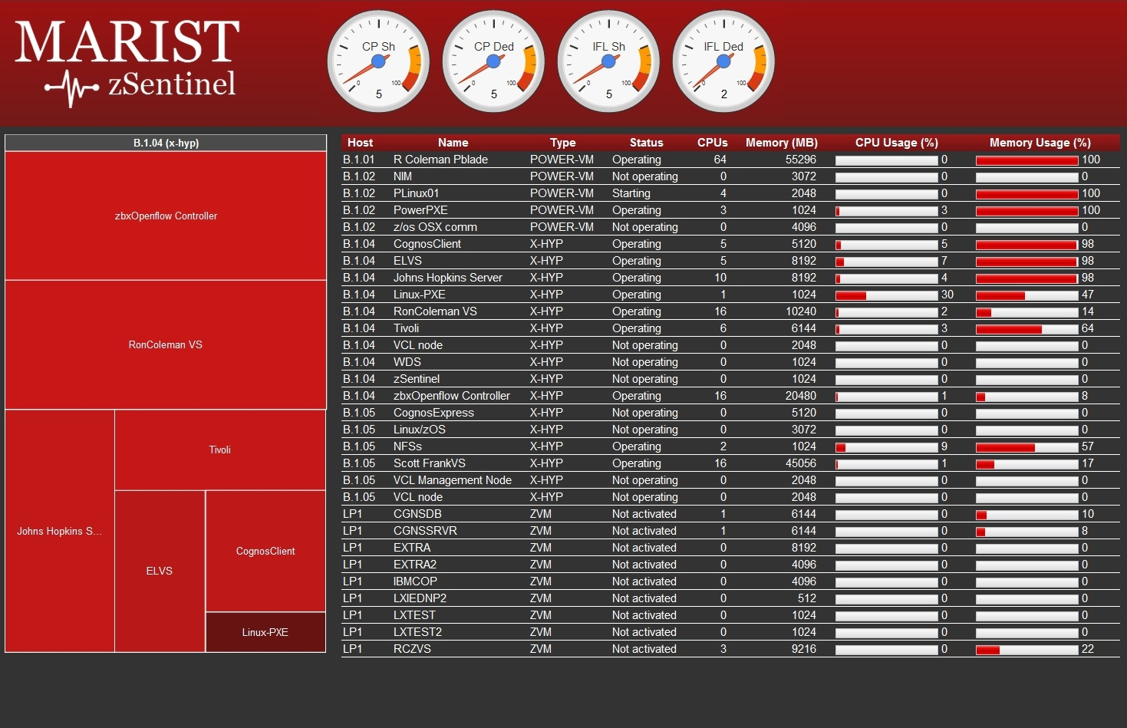

Slide 38
Predictive Defect Analytics
Marist/IBM Joint Studies

Slide 39
Background
IBM z/OS operating system
  Mature software product
Every potential defect recorded
  Defect record management system
Multiple cycles of extensive testing
  System Test
Valid Defect Distribution
Data Partitioning:
  Training – 65%
  Test – 20%
  Validate – 15%
  Same target distribution as original data

Slide 40


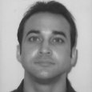

Overview
Mission:
Automatically predict defect validity upon record creation and send notifications of that outcome in real time to leverage historic empirical test data to drive a smarter test process
Team:
Michael Gildein
James Gilchrist
Chris Robbins
Andrew Evans
Marist Joint Studies

Slide 41
Benefits
Increased test efficiency by reducing invalid and duplicate defects
Creation of base infrastructure and process for future analytics work
Visualization reporting to determine future test focus areas
Automate basic defect analysis reporting including release quality tracking

Slide 42
Implementation
IBM Cognos:
  Report and analyze data and results
IBM SPSS Modeler:
  Predictive analysis to determine potential validity
Prediction Accuracies:
  > 100 different algorithm variations executed
  ~70% overall accuracy on average
  ~90% confidence on average for true positive
  Academic field research averages ~70% accuracy in defect predictions
Increasing Accuracy:
  With more training data
  With more data points
  With voting scheme combining multiple algorithms

Slide 43
Data Prep Flow
Merge pulled data
Remove non related defect records
Remove obviously erroneous records
Derived Target – Valid flag
Removed Fields:
  Dates
  Elapsed times
  Manual text fields
  Mostly blank
  No unique values
  > 90% 1 categorical value (+~5% Accuracy Correct)
  Fields not applicable
Reclassified remaining fields properly through binning:
  Blanks & white space
  Manually entered categories
  Defaults
  User error

Slide 44
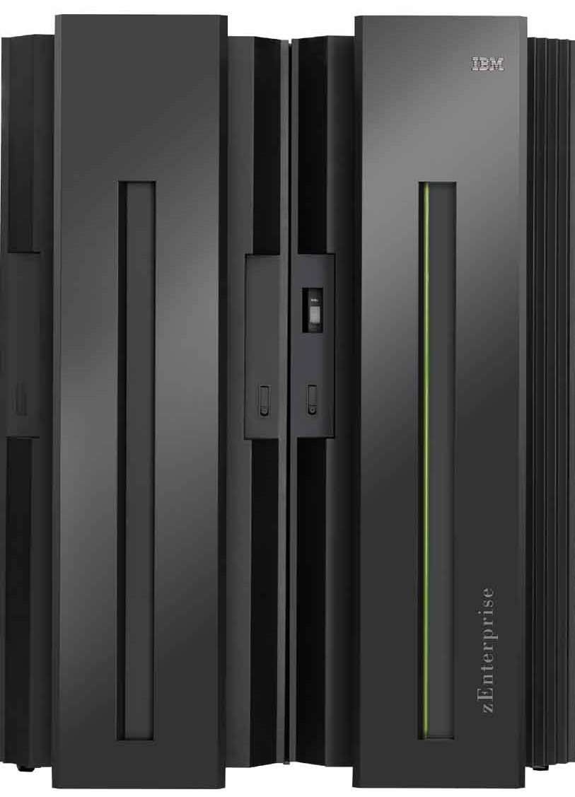
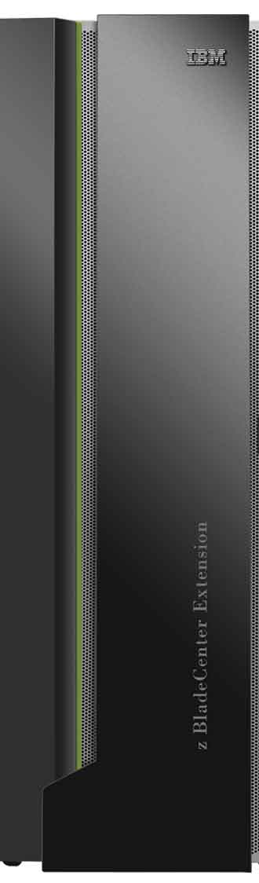


Physical Infrastructure
System z Host
Clients
IBM
SPSS
Modeler
Server
IBM
Cognos
Server
IBM
DB2
IBM Data Studio
IBM SPSS Modeler Client
IBM Cognos Metric Designer
IBM Cognos Framework Manager
Scripts & Data Crawlers
zLinux
Windows Server
zVM
Defect Record Management Servers
Additional Input Data Servers

Slide 45
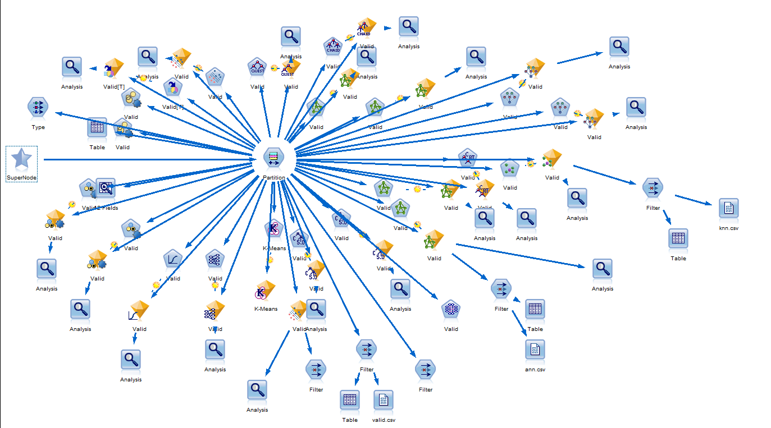
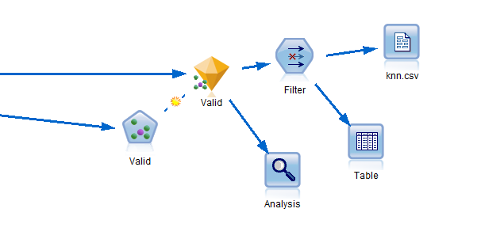
SPSS Models

Slide 46
Cognos Reports
Automated, scheduled, and on demand real time reporting
Analysis:
  Algorithm Accuracies (release/product)
  Confusion Matrices (release/product)
  Defect Prediction Densities (release/product)
Management:
  Non closed defect tables (release/product/team)
  Current defect state graphs (release/product/team)
Project Managers:
  Open vs. closed defects over time (release/product/team)
  Test end criteria report
  Defect rate over time of release (release/product)
Testers:
  Hardware trigger vs. root cause (release/product)
  Test area vs. root cause (release/product)
  Lines of code changed (release/product)
  Hardware trigger vs. component (release/product)

Slide 47
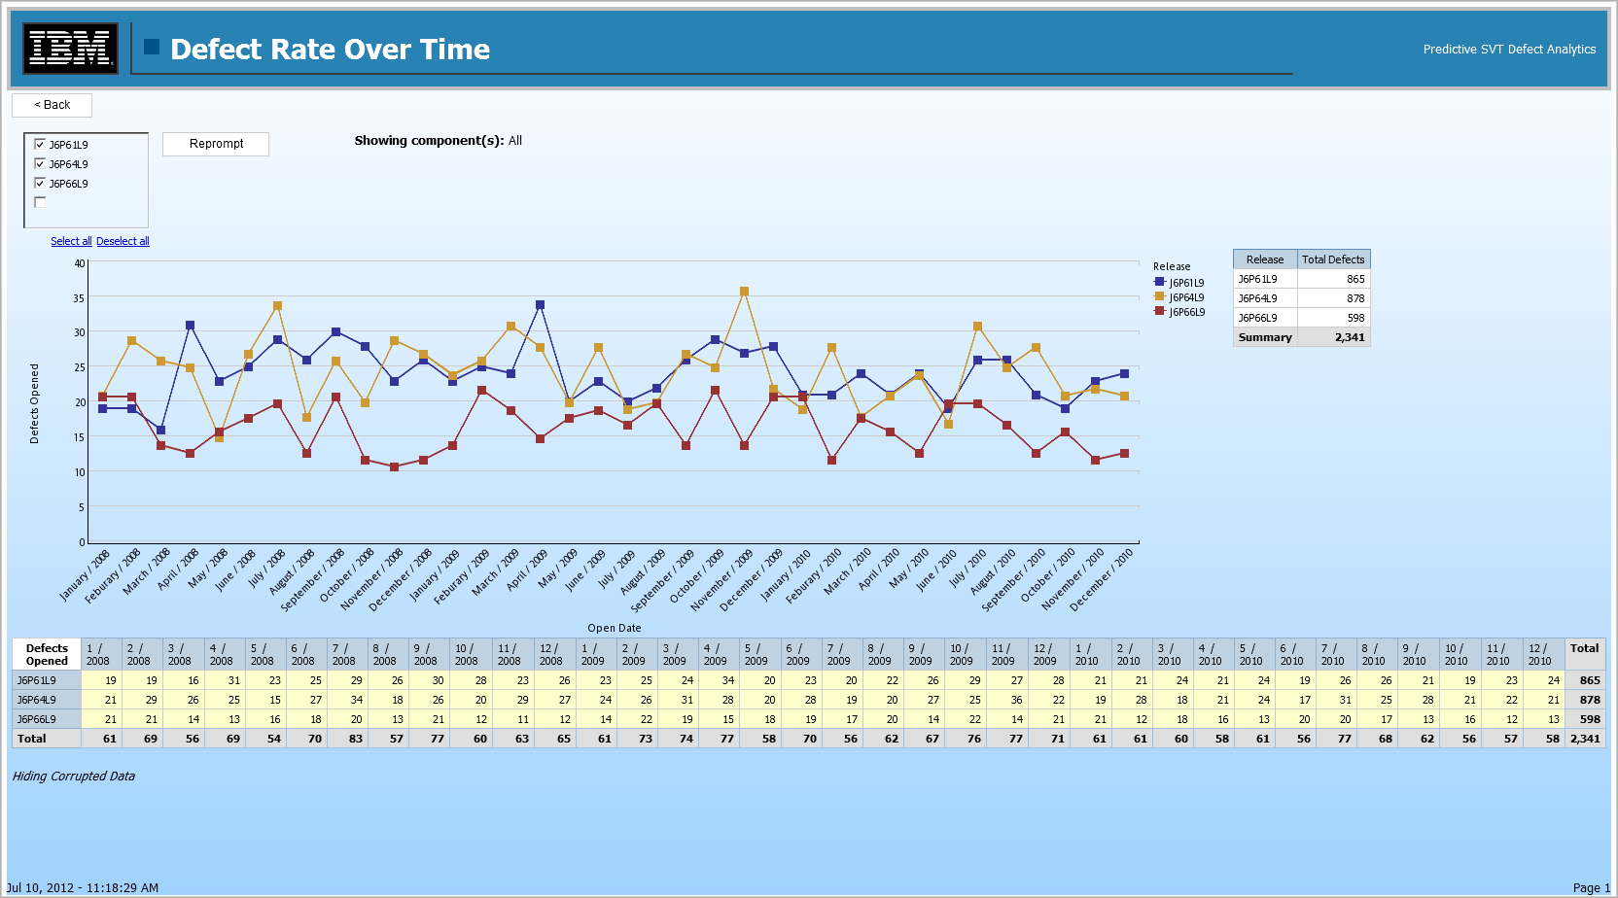
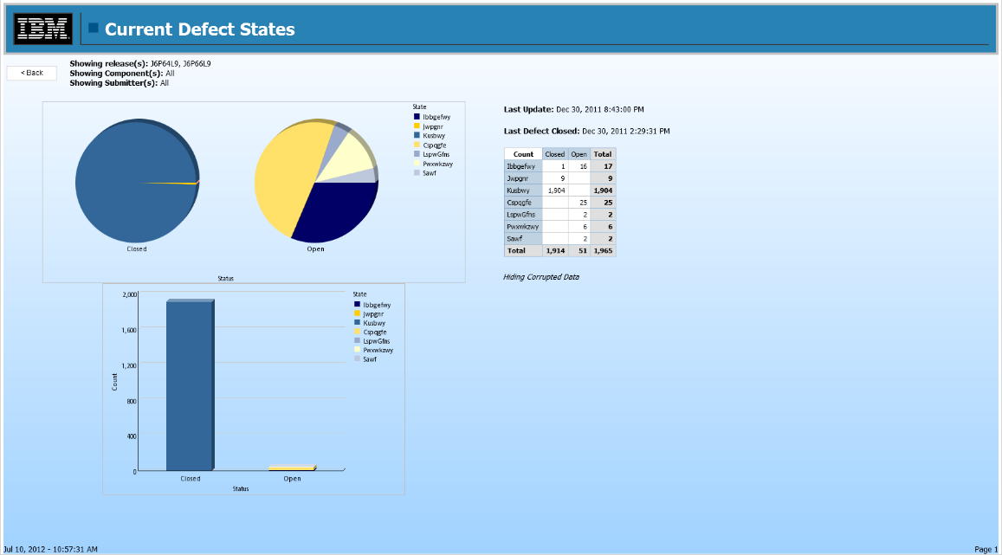
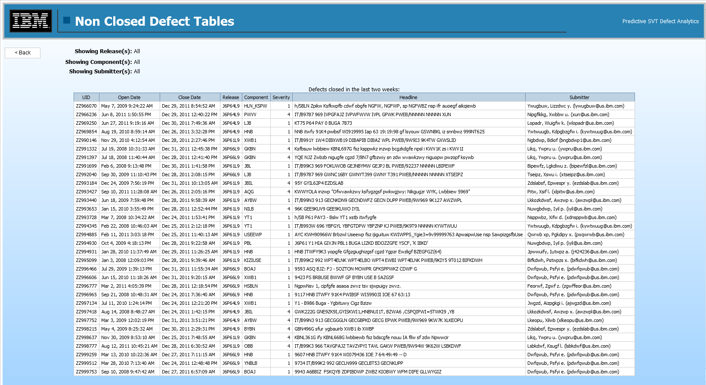
Cognos Report Examples

Slide 48
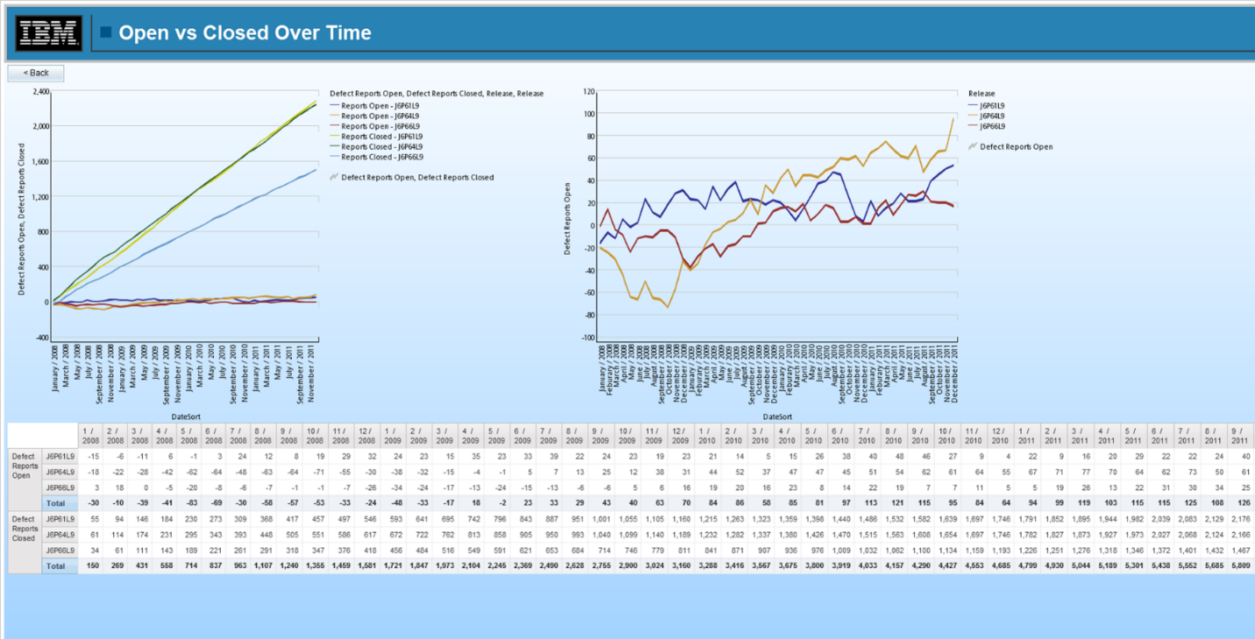
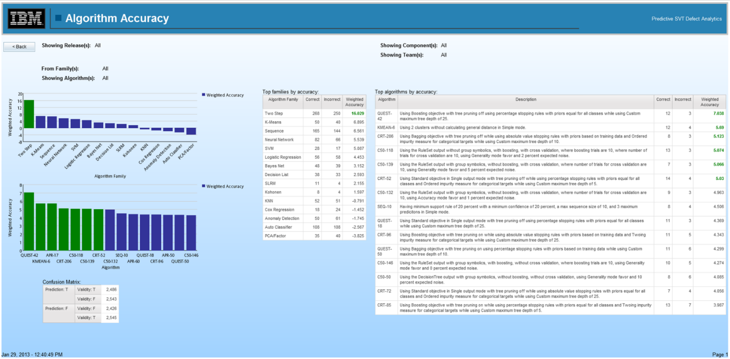
Cognos Report Examples

Slide 49
Current Objectives
Continue leveraging new defect report data to increase the accuracy of our predictions
Improve system based on user feedback
Research and implement new tools and features to expand the scope of our analytic environment
  Text analytics
  Collaboration and Deployment Services
  Additional Cognos Reports

Slide 50
Digital Archives Project
By Rebecca Murphy

Slide 51
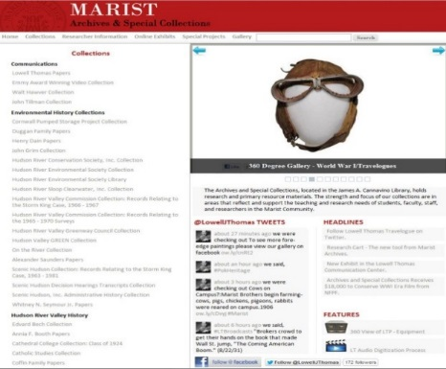
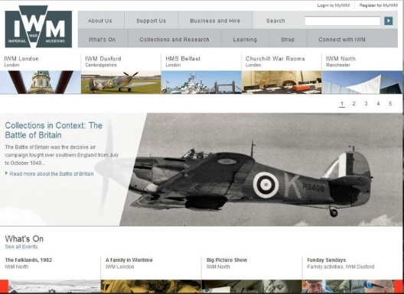
Problems faced by Researchers Today
Fig. Marist Archives
Fig. FDR Library
Fig. Imperial War Museum
To research a topic like “World War I” a user would have to make use of multiple interfaces, which is difficult to organize and inefficient.
Though there are many digital archive's with numerous historical items, there is not a way to search all of them at the same time.
Chances are the researcher would miss vital research materials and that they wouldn’t have an efficient way to save their digital research for future use.

Slide 52



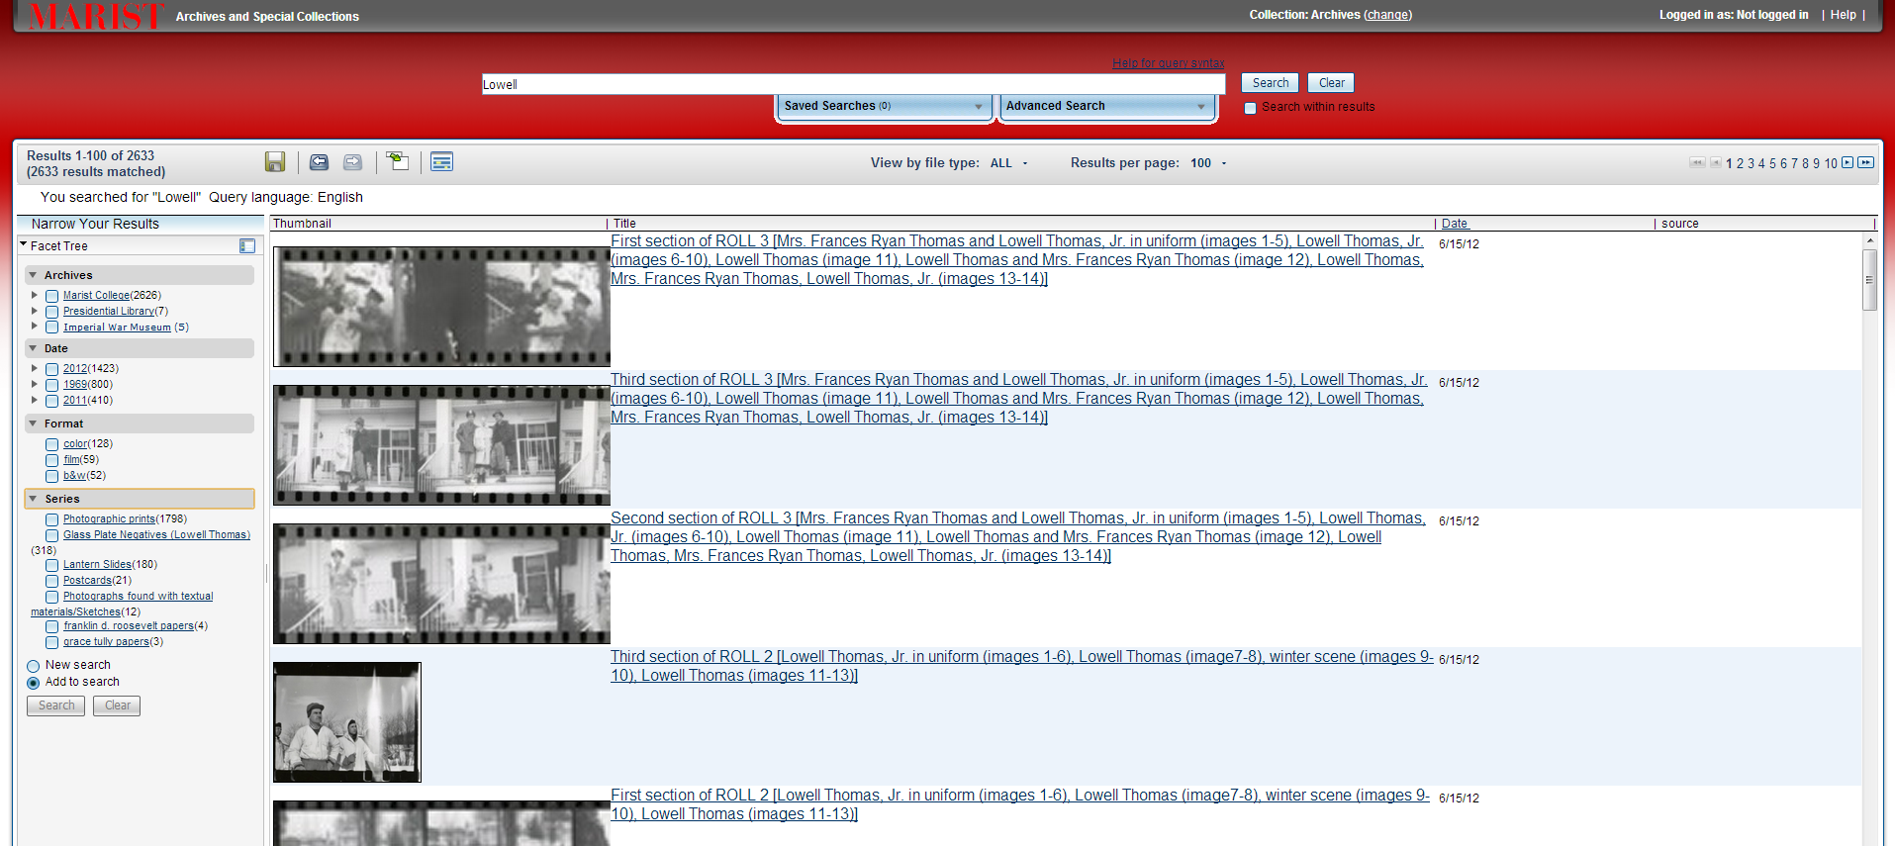
Proposed Solution

Slide 53
Advantages of this System
Research Tool that can search across multiple archives and libraries.
Deep integration and fluidity between finding aids and search engine.
Single, uniform, and consistent user experience.
Efficient research and discovery for researchers.

Slide 54
How it works: An OmniFind Enterprise Edition for IBM DB2 Content Manager
Overview

Slide 55
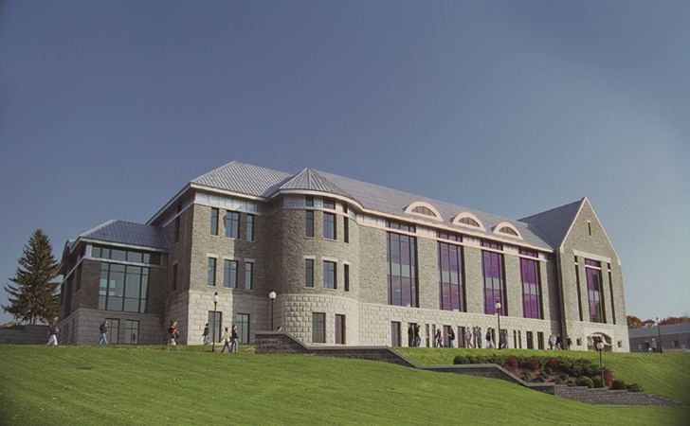
Content Manager and the Library
Project Started June 2009
The Lowell Thomas Papers were donated to Marist College by the Thomas family in 2006
Background:
  The papers of Lowell Thomas document the professional and personal life of Lowell Thomas (1892-1981), who was perhaps most notably an American radio news broadcaster from 1930 to 1976, first on the NBC and then the CBS radio network. He was also an author of more than 50 books and countless newspaper and magazine articles, a noted speaker who for much of his life traveled widely on the national lecture circuit, a world traveler, filmmaker, entrepreneur and friend and associate of many of the most influential people of the 20th century. Included in the papers are approximately 36,000 photographs, hundreds of hours of audio, thousands of feet of motion picture film, numerous artifacts and over one million pages of manuscript materials. Materials in the papers range from 1789 to 1984, with the bulk of material ranging from 1900 to 1981.
Solution:
  Library Archivists scanning into digitized format
  Technical Systems Services storing digital images in Content Manager
  Technical Systems Services “Web Publishes” digital images from Content Manager
Current Status:
  ~37,000 Documents/Images in Content Manager

Slide 56
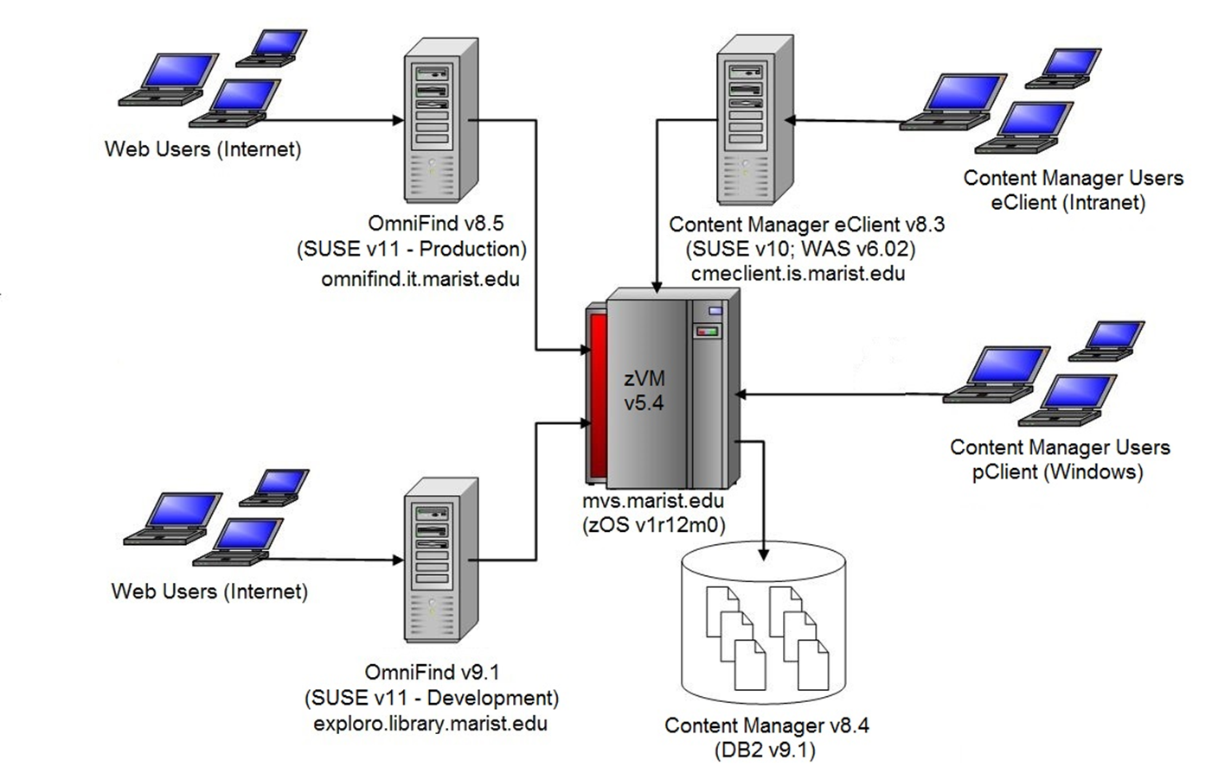
Marist Hardware/Software Configuration

Slide 57
IBM DB2 Content Manager
Content Manager manages all types of digitized content across multiple platforms, databases and applications. It provides a content platform for imaging, digital asset management, Web content management and content integration. Built on a multi-tier distributed architecture, it provides the scalability to grow from a single department to a geographically dispersed enterprise.

Slide 58
What is enterprise search?
The enterprise search system is the search engine implemented by OmniFind.
It provides:
  Fast query response times
  A consolidated, ranked result set that is based on extensive text analysis enable you to not just locate documents of interest, but extract meaning from document content
  The ability to search local and remote databases, collaboration systems, content management systems, file systems, and internal and external Web sites at the same time

Slide 59
What is a Crawler?
Enterprise search crawlers collect documents from data sources so that the documents can be analyzed, indexed, and searched.
A crawler basically goes through the documents in a collection, creating metadata about each document. The metadata is then used by OmniFind to search through the documents and display accurate results.
  A web crawler looks through a collection of HTML/XML pages, using organizational tags to create metadata about each page.

Slide 60
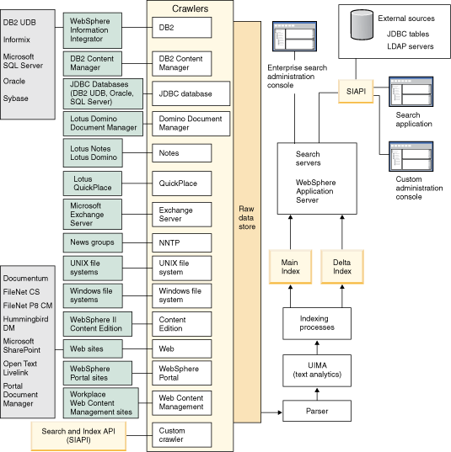
How Data Flows through the Omnifind System

Slide 61
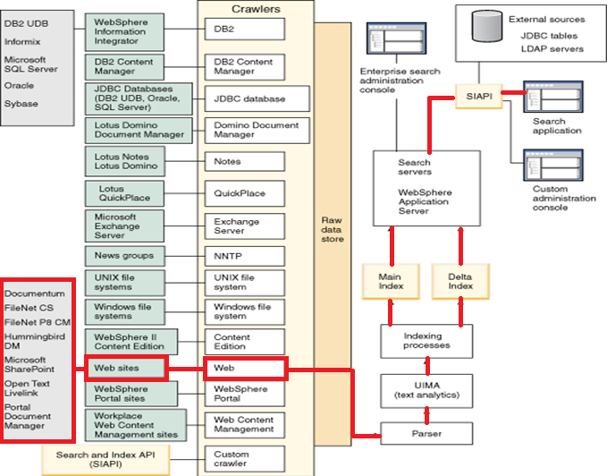

Slide 62
Websites

Slide 63
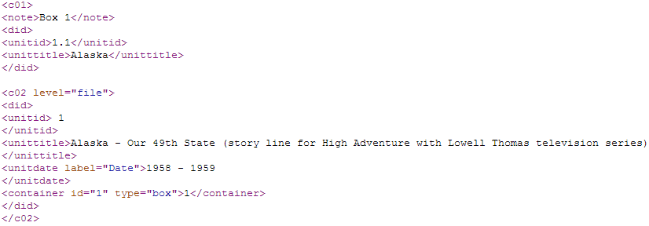
Specifics on the Crawler
The Crawler would go through the html/xml create metadata on the individual items.
unittitle = contentStr.substring(contentStr.indexOf("<unittitle>", index) + "<unittitle>".length(), contentStr.indexOf("</unittitle>", index));
FieldMetadata itemtitle = new FieldMetadata("Item Title", unittitle);
arg.addMetadataField(itemtitle);
date = contentStr.substring(contentStr.indexOf("<unitdate label=\"Date\">", index) + "<unitdate label=\"Date\">".length(), contentStr.indexOf("</unitdate>", index));
FieldMetadata itemdate = new FieldMetadata("Item Date", date);
arg.addMetadataField(itemdates);

Slide 64
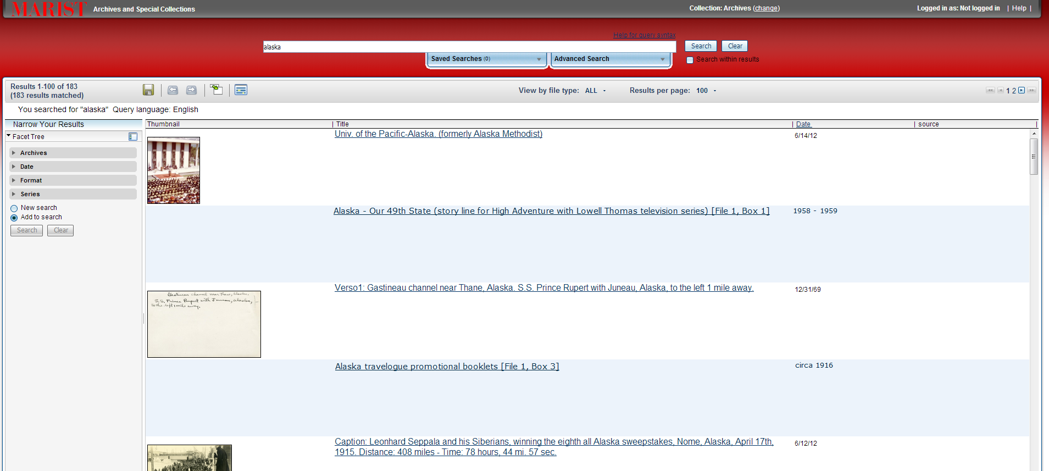
What a User Would See:

Slide 65
Immediate Goals
Given this, unless all the html/xml pages were organized the same way, it would not be possible to create one method for the crawler to use.
Thus, my method is to cover the originally intended archives and in cases of future expansion, have a template for code in comments that someone could easily add the specific tags of the new archive, then the crawler would be able to crawl the new archive accurately.

Slide 66
Possible Problems
The Crawler System is designed that a result is an individual HTML/XML page.
The items we want to be in the results, will not have individual HTML/XML pages.
This may cause problems with the search results, or require additional configuration.
Questions?

Slide 67
SDN Overview
By Kevin Pietrow

Slide 68
Networks are outdated
Need specialists to configure switches
Network reconfigurations can easily take days or weeks
Both data centers and servers have outstripped them through use of VMs

Slide 69
What is Software Defined Networking?
"a form of network virtualization in which the control plane is separated from the data plane and implemented in a software application" - Wikipedia
Traditional Network
App
…
App
…
OS
OS
Physical Data Plane
Physical Data Plane
App
…
App
…
OS
OS
Physical Data Plane
Physical Data Plane
http://openflow.marist.edu
Notes:
Ryan Flaherty

Slide 70
The Software Defined Network
. . .
Applications
Well Defined API
Network Operating System
OpenFlow
Simple Forwarding
Simple Forwarding
. . . . . . .
. . . . . . .
Physical Data Plane
Physical Data Plane
Simple Forwarding
Simple Forwarding
. . . . . . .
. . . . . . .
Physical Data Plane
Physical Data Plane
http://openflow.marist.edu
Notes:
Ryan Flaherty

Slide 71

OpenFlow
An open, developing industry-wide option for SDN
Multiple opensource controllers, such as Floodlight, the upcoming OpenDaylight, Beacon, Maestro, etc.
Vendor agnostic

Slide 72
OF Controller
Packet A Info
Switch #1
Switch #3
New Flow
Switch #2
Packet A
Packet A
Notes:
Behold how great it is

Slide 73
Port Down Reconciliation
Can handle link failure between switches automatically
The controller handles entire process
Occurs within seconds, with minimal packet loss

Slide 74
Normal Functioning Network
http://openflow.marist.edu
Notes:
Ryan F.

Slide 75
Network with a bad link
http://openflow.marist.edu
Notes:
Ryan F.

Slide 76
After Port Down Reconciliation
http://openflow.marist.edu
Notes:
Ryan F.

Slide 77
What are the advantages?
Development at software speeds
Multi vendor interoperability
Centralized and customized network control
Efficiency and speed

Slide 78
Optical Networking
The next frontier
OpenFlow not quite optimized for working with optical yet
We are currently working with ADVA Optical Networking to rectify this

Slide 79
ADVAlanche
By Mary Miller & Zack Meath

Slide 80
Optical Networking
In a combination network, the traditional network is not fully aware of the optical network

Slide 81
Marist ADVA - FSP3000 Setup
Three nodes A,B,C each representing three different data center sites.
Two 50km connections and a 20km connection between the different data centers.
Using a floodlight controller

Slide 82
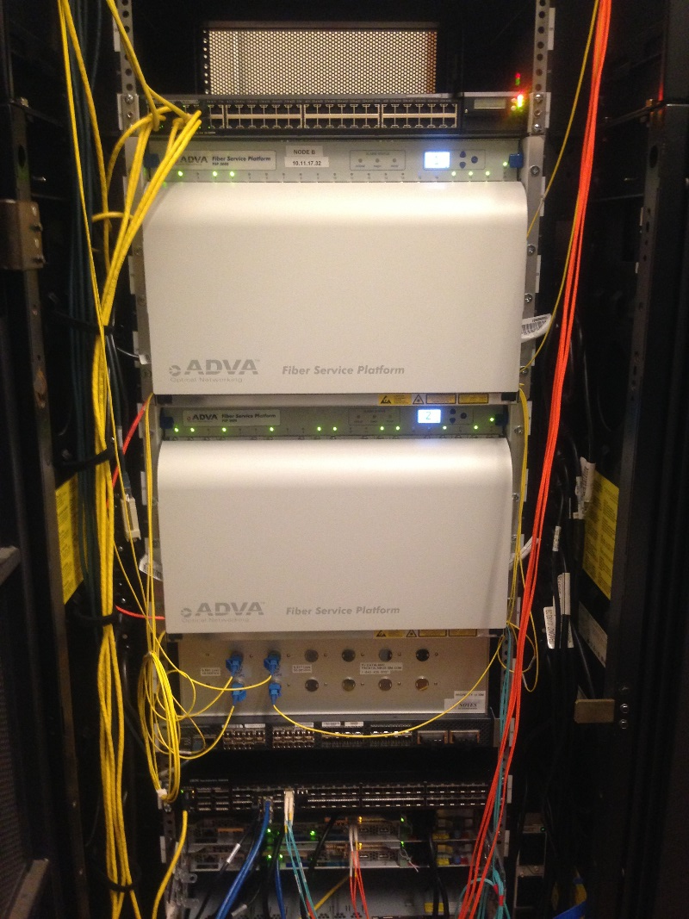
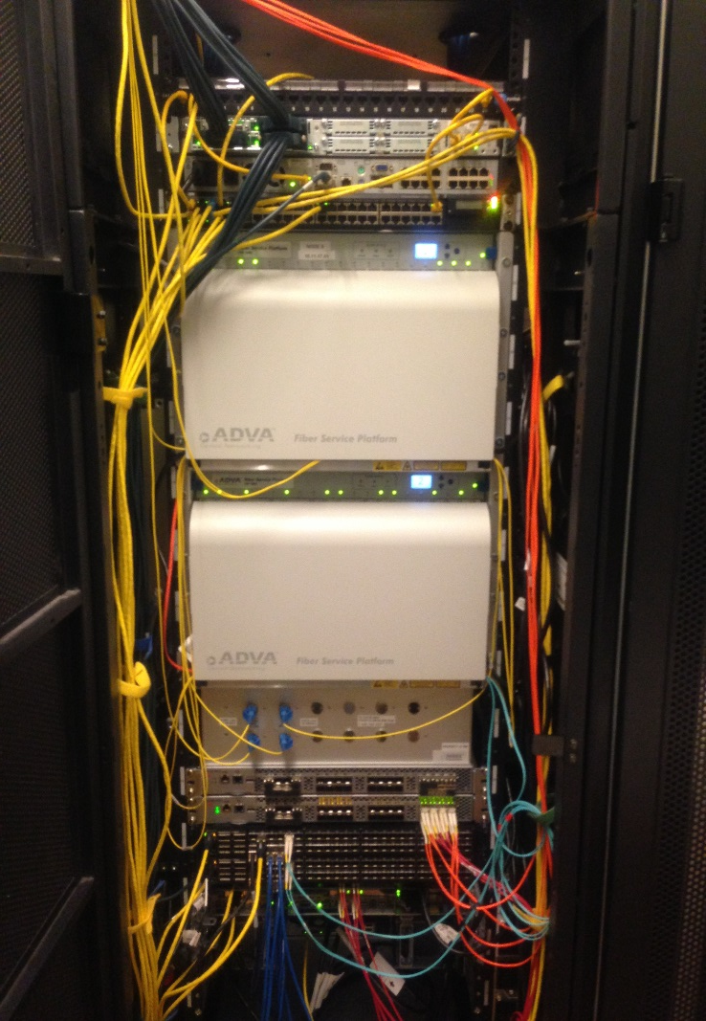
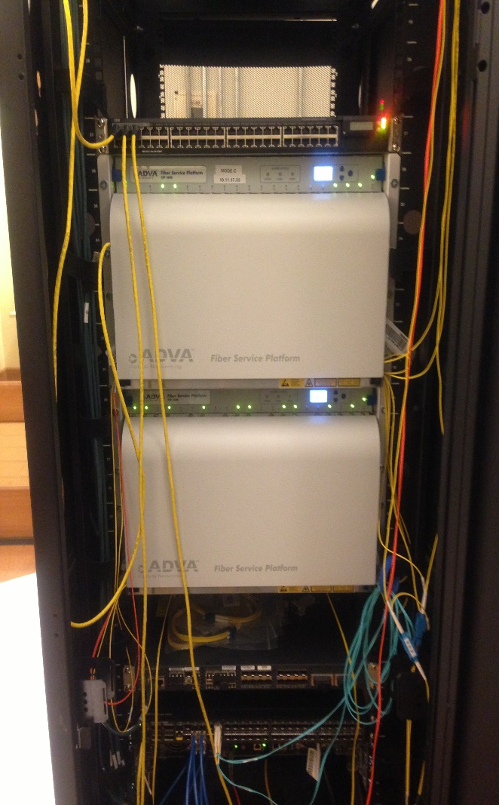
ADVA FSP 3000

Slide 83

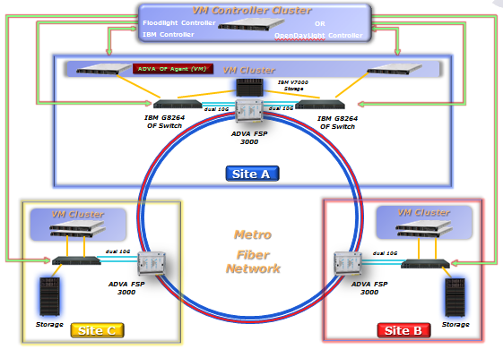
Marist Testbed
http://openflow.marist.edu
Notes:
Ryan

Slide 84
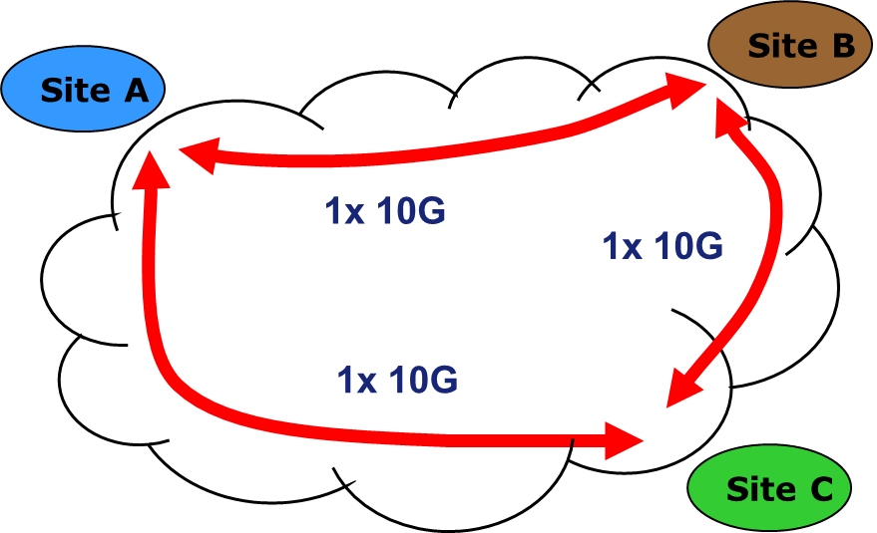
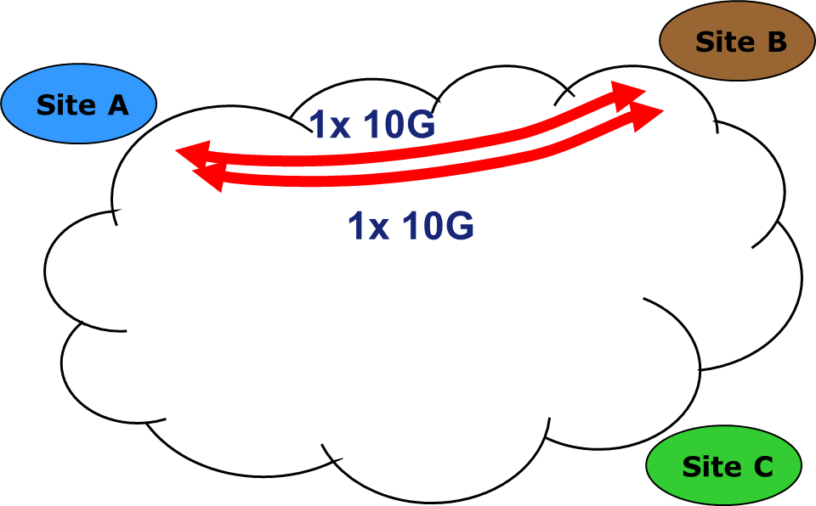
Use Cases

Slide 85
ADVAlanche
Automatically allows for implementation of preprogramed profiles.
Creation of custom profiles
Graphical Representation of current profile and selected profile

Slide 86
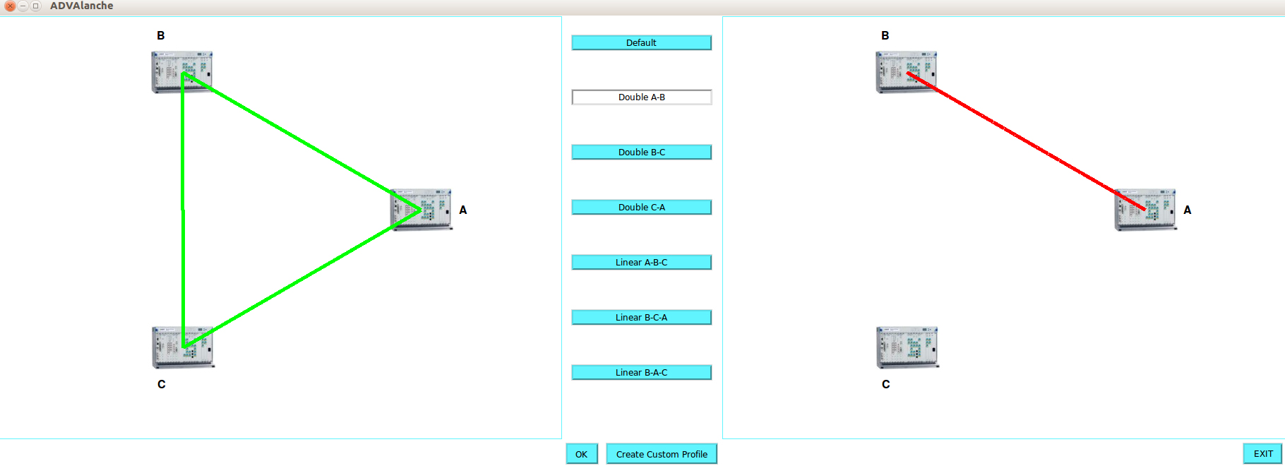

Slide 87
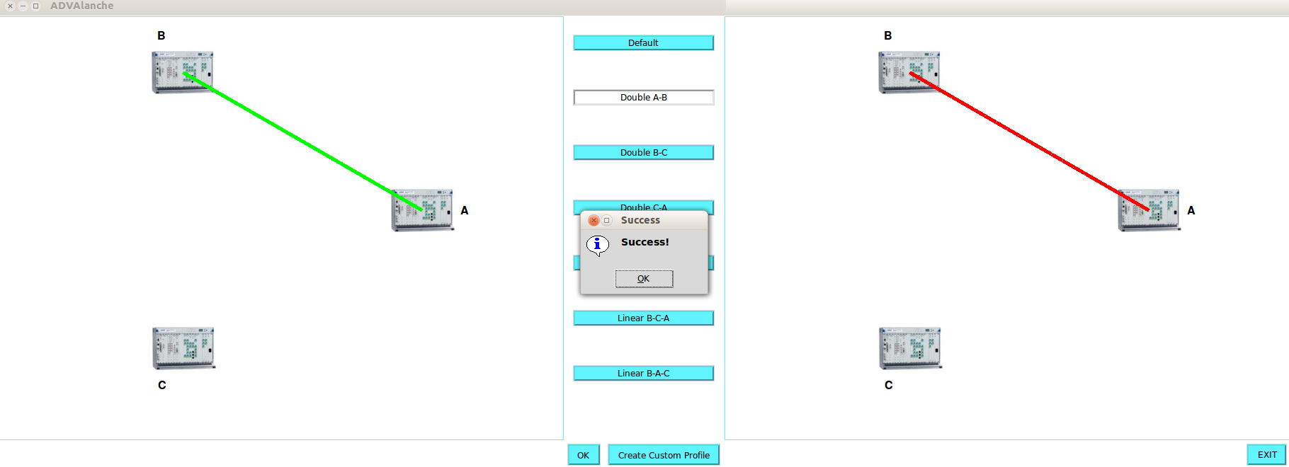

Slide 88
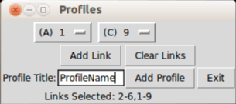

Slide 89
Next Steps
Create scheduled profile changes for automated backup etc.
Connecting ADVAlanche and Vcenter to allow for more automation
  Based on input from Vcenter, ADVAlanche will change profiles based on current needs.

Slide 90
Avior 2.0
By Kevin Pietrow, Devin Young

Slide 91
Avior
Avior is a GUI for Floodlight that eliminates the dependency on using python scripts or viewing the restAPI in order to monitor or manipulate the network.
Avior supports the following features:
  Static flow entry pusher interface. Add, modify, and delete flows easily
  Useful error checking and flow verification
  Detailed controller, switch, device, port, and flow statistics that update in real time
  Easy to use Logical patch panel
http://openflow.marist.edu
Notes:
Kevin
An open source OpenFlow controller.
Allows for static or dynamic handling of packets within the network.
Modular and easily extended.

Slide 92
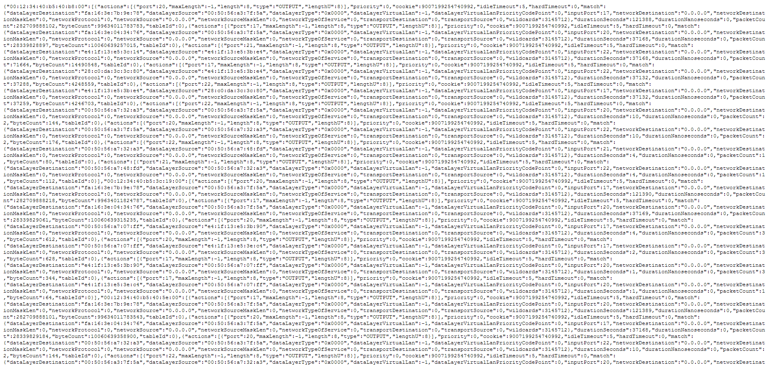
What Problem Does Avior Address?
http://openflow.marist.edu
Notes:
Kevin
JSON queries

Slide 93
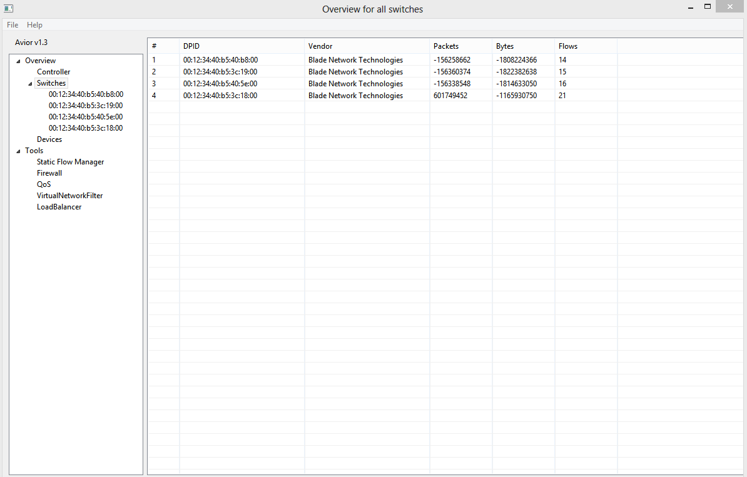
Avior – Overview for all Switches
http://openflow.marist.edu
Notes:
Kevin

Slide 94
Avior 2.0
Avior is currently being developed into a web application. Some of the goals include:
  Ease of access from mobile devices
  Controller agnosticism
  Enhanced features
  Sleeker design
Notes:
Devin

Slide 95
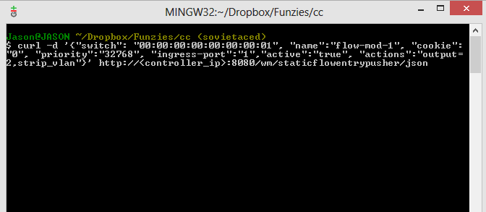
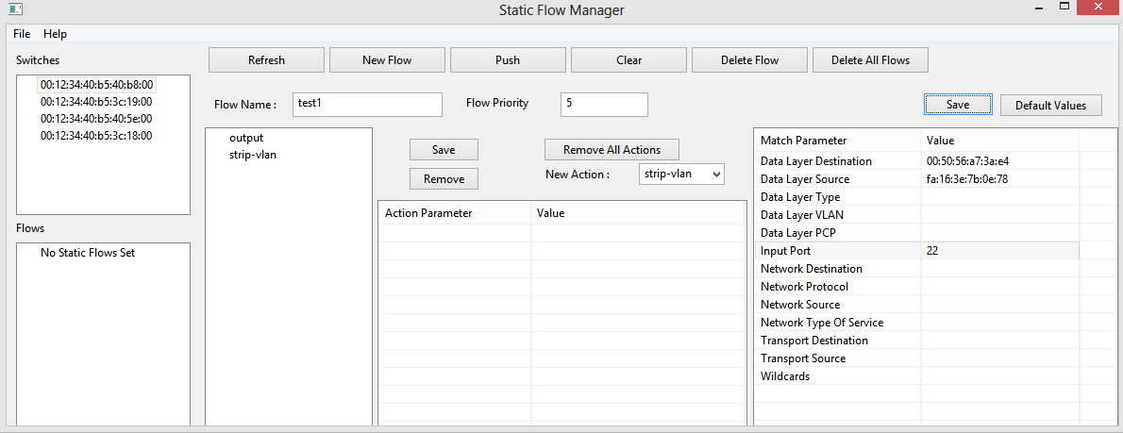
Static Flows
Avior:
Static Flow Manager
http://openflow.marist.edu
Notes:
Devin
Static flows using curl commands
Static Flow Manager – adds a Graphical interface without issuing curl commands and achieves the same outcome

Slide 96
Current Development
Core Functionality (July)
  Switch module
  Controller module
  Flow sub-module
Static Flow Entry Pusher Module (July)
  Static flow entry pusher module
Notes:
Devin

Slide 97
Current Development Details
Core Functionality Sub-Modules
  A sub-module for switches connected to a controller, which will contain information about each switches port data, flow data, and id number
Static Flow Entry Pusher Module
  Developing basic and advanced UI to manipulate static flows for individual switches
Notes:
Devin

Slide 98
Current Development (cont.)
Controller sub-module
  A sub-module which will display updated information on the current state of the controller (Available memory, loaded modules, etc.)
Flow sub-module
  Will contain detailed information on each flow on the network
  Will eventually allow for dynamic flow creation and deletion
Notes:
Kevin

Slide 99
Future Development
Future developmental considerations (TBD):
  Security module
  QoS module
  Firewall module
  Enhancements to Flow module
Notes:
Devin/Kevin
Security: user validation
QoS:
Firewall:
Enhancements to Flow Module:

Slide 100


